Slide 1

The Uncertainty Principle
of Quantum Processes
(arXiv:2004.05315)
Pre-Processing
Post-Processing
Yunlong Xiao

Slide 2
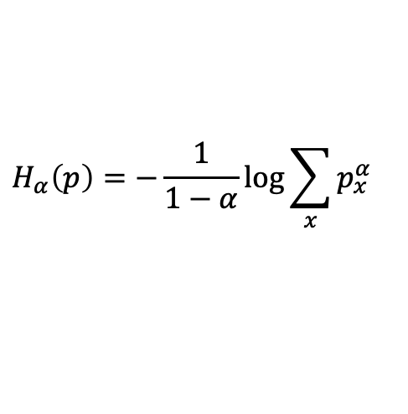
Preliminary Review on Quantum States
Physical scenario of measurement
Information gain from M
p
Uncertainty associated with M
How to quantify the uncertainty associated with P?
Renyi Entropy
$$H_{α}\left(p\right)=−\frac{1}{1−α}\log{\sum_{x}{p_{x}^{α}}}$$

Slide 3
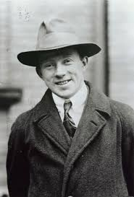
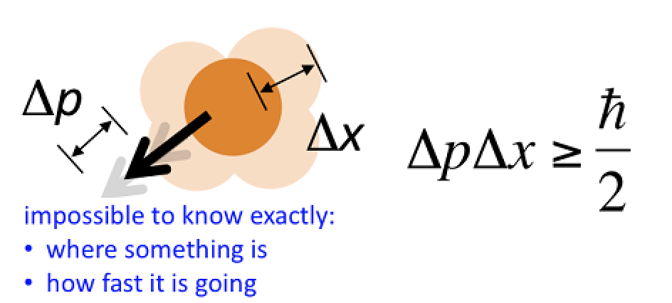
Preliminary Review on Quantum States
Physical scenario of preparational UR
A short history [see e.g. Coles-Berta-Tomamichel-Wehner’17, RMP]
1927, Heisenberg: (heuristic idea) impossible to prepare a state such that its outcome probability distributions from the position and moment observables are both sharp.
1927, Kennard/ 1928, Weyl

Slide 4
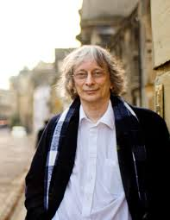

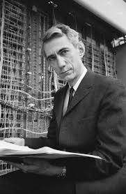
A Bit of History
Physical scenario of preparational UR
A short history [see e.g. Coles-Berta-Tomamichel-Wehner’17, RMP]
1983, Deutsch:
1988, Maassen-Uffink:

Slide 5

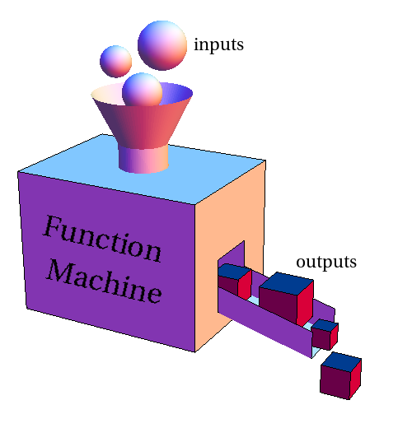
A Bit of History
Physical scenario of preparational UR
Recent advances
2010, Berta-﻿Christandl-﻿Colbeck-﻿Renes-﻿Renner:
2011, ﻿Partovi/ 2013, ﻿Friedland-﻿Gheorghiu-Gour:

Slide 6
A Plethora of Applications
Uncertainty Relation
Determine
Nonlocality
e.g. Oppenheim, J. and Wehner, S., 2010. The uncertainty principle determines the nonlocality of quantum mechanics. Science, 330(6007), pp.1072-1074.
Witness
Entanglement
e.g. Hofmann, H.F. and Takeuchi, S., 2003. Violation of local uncertainty relations as a signature of entanglement. Physical Review A, 68(3), p.032103.
Detect
Non-Markovianity
e.g. Maity, A.G., Bhattacharya, S. and Maujmdar, A.S., 2019. Detecting non-Markovianity via uncertainty relations. arXiv preprint arXiv:1901.02372.
Secure
Quantum Cryptography/QKD
e.g. Ng, N.H.Y., Berta, M. and Wehner, S., 2012. Min-entropy uncertainty relation for finite-size cryptography. Physical Review A, 86(4), p.042315.
Certify
Quantum Randomness
e.g. Miller, C.A. and Shi, Y., 2016. Robust protocols for securely expanding randomness and distributing keys using untrusted quantum devices. Journal of the ACM (JACM), 63(4), p.33.
Notes:
During the long-time study, plenty of applications have emerged. From determining the nonlocality, witnessing quantum entanglement to quantum cryptography and certifying quantum randomness.
These applications, on the other hand, provide us motivations to keep working on this topic.

Slide 7
Preliminary Review on Quantum Channels
qu. Quantum Subchannel
Quantum
Effect
Quantum Channel
State Preparation
Measurement
Implementation

Slide 8
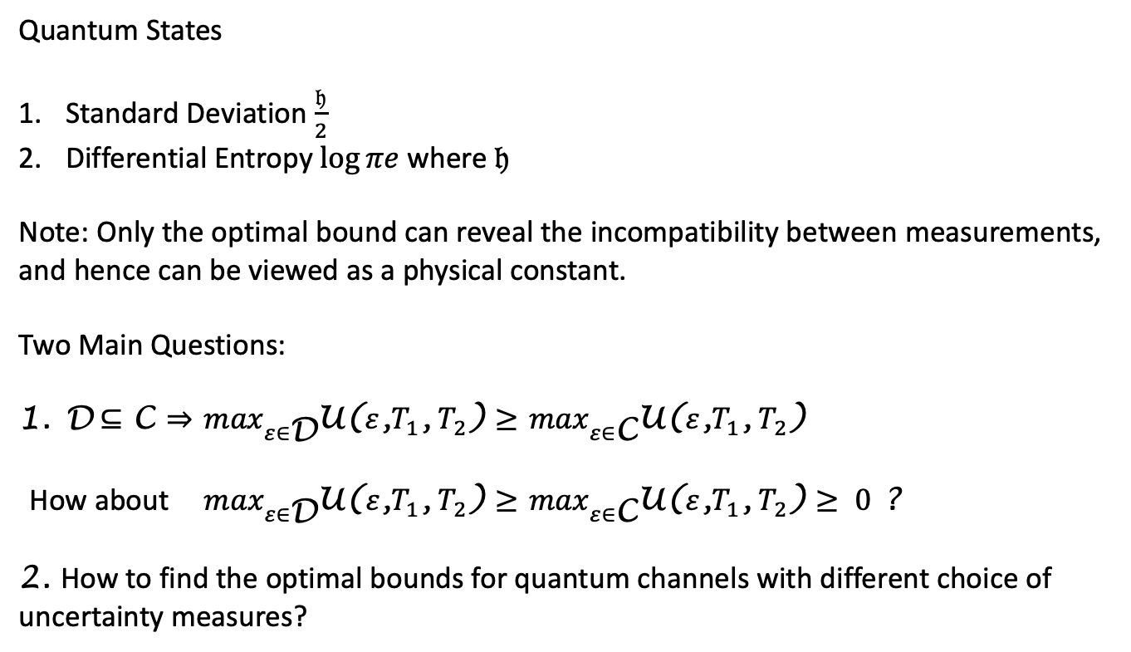
Preliminary Review on Quantum Channels
Quantum States
Standard Deviation $\frac{𝔥}{2}$
Differential Entropy $\log{πe}$ where $𝔥$
Note: Only the optimal bound can reveal the incompatibility between measurements,
and hence can be viewed as a physical constant.
Two Main Questions:
D$⊆$ C $⇒$ $\max_{ε∈\text{D}}$U($ε$,$T_{1}$, $T_{2}$) $≥$ $\max_{ε∈\text{C}}$U($ε$,$T_{1}$, $T_{2}$)
How about$\max_{ε∈\text{D}}$U($ε$,$T_{1}$, $T_{2}$) $≥$ $\max_{ε∈\text{C}}$U($ε$,$T_{1}$, $T_{2}$) $≥ 0$ ?
2. How to find the optimal bounds for quantum channels with different choice of
uncertainty measures?

Slide 9

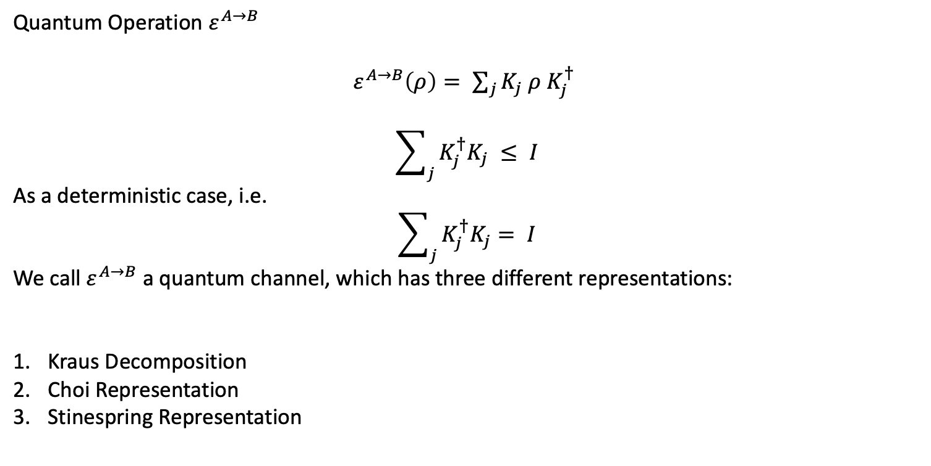
Preliminary Review on Quantum Channels
Quantum Operation $ε^{A→B}$
${ ε}^{A→B}\left(ρ\right)= \sum_{j}{K_{j} ρ K_{j}^{†}}$
$$\sum_{j}{K_{j}^{†}K_{j} ≤ I}$$
As a deterministic case, i.e.
$$\sum_{j}{K_{j}^{†}K_{j}= I}$$
We call${ ε}^{A→B}$ a quantum channel, which has three different representations:
Kraus Decomposition
Choi Representation
Stinespring Representation

Slide 10

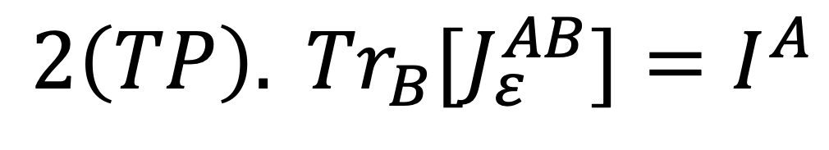
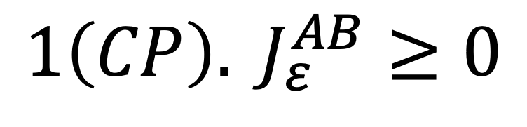
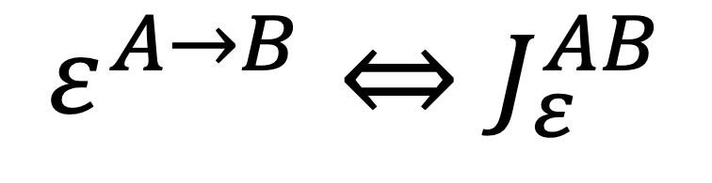
Preliminary Review on Quantum Channels
Quantum States
$$ε^{A→B}$$
A
B
POVMs
Quantum Channel (QChannel):
Completely Positive (CP) and Trace Preserving (TP)
$$ε^{A→B}⇔J_{ε}^{AB}$$
$${1\left(CP\right). J}_{ε}^{AB}≥0$$
$${2\left(TP\right). {Tr}_{B}[J}_{ε}^{AB}]=I^{A}$$

Slide 11


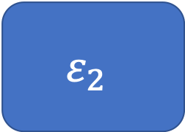
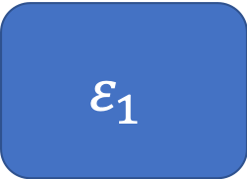

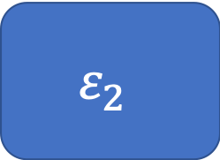



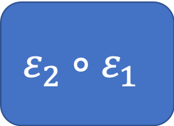
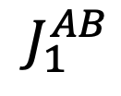
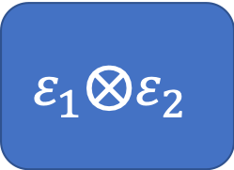


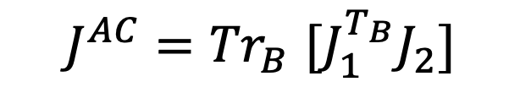
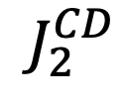



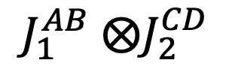

Quantum Circuit Architecture
Parallel Connection
Series Connection
$$ε_{1}$$
$$ε_{1}$$
$$ε_{2}$$
$$A$$
$$B$$
$$J_{1}^{AB}$$
$$A$$
$$B$$
$$C$$
$$ε_{2}$$
$$C$$
$$D$$
$$J_{2}^{CD}$$
$$ε_{2}∘ε_{1}$$
$$A$$
$$C$$
$$ε_{1}⨂ε_{2}$$
$$AC$$
$$BD$$
$J_{1}^{AB}$ $⨂J_{2}^{CD}$
$$J^{AC}{=Tr}_{B}[J_{1}^{T_{B}}J_{2}]$$

Slide 12



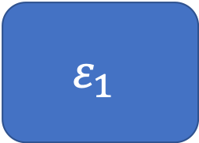





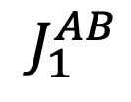


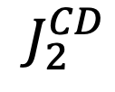



Quantum Circuit Architecture
$$ε_{1}$$
$$θ$$
$$ε_{2}$$
$$A$$
$$B$$
$$J_{1}^{AB}$$
$$C$$
$$D$$
$$J_{2}^{CD}$$
1. $θ$ is a superchannel, i.e. CCPP + TPP
2. $θ$ has the following realization
Pre-
$$ε_{1}$$
Post-
$$A$$
$$B$$
$$C$$
$$D$$
$$R$$
3. The Choi matrix of $θ$, i.e. $J_{θ}^{ABCD}={Tr}_{R}[J_{Pre}^{T_{R}}J_{Post}]$ satisfies
$$J_{θ}≥0, { Tr}_{AD}\left[J_{θ}\right]=I_{BC}, {Tr}_{D}\left[J_{θ}\right]={J_{θ}^{AC}⨂I}_{B}$$

Slide 13



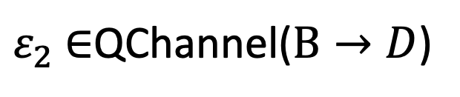

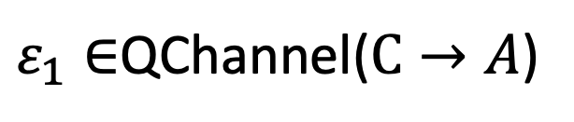


Quantum Circuit Architecture
No-Signaling
$$ε$$
$ε_{1}∈$QChannel($C→A$)
Pre-
$$C$$
$$A$$
$$θ$$
Post-
Alice
$$R$$
Bob
$$B$$
$$D$$
$ε_{2}$ $∈$QChannel($B→D$)
No-Signaling from Alice to Bob: ${Tr}_{A}\left[ε\left(ρ^{BC}\right)\right]={ε_{2}(Tr}_{C}[ρ^{BC}])$ for $∀ρ^{BC}$
No-Signaling from Bob to Alice: ${Tr}_{D}\left[ε\left(ρ^{BC}\right)\right]={ε_{1}(Tr}_{B}[ρ^{BC}])$ for $∀ρ^{BC}$

Slide 14





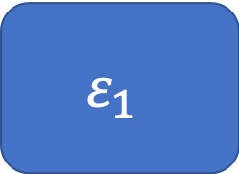



Quantum Circuit Architecture
Pre-
$$A$$
$$C$$
$$θ$$
Post-
Alice
$$R$$
Bob
$$D$$
$$B$$
4. $θ∈$Qchannel(BC$→$AD) and no-signaling from Bob to Alice
Pre-
Post-
$$ε_{1}$$
$$A$$
$$B$$
$$A$$
$$B$$
$$C$$
$$D$$
$$R$$
1-comb
2-comb

Slide 15


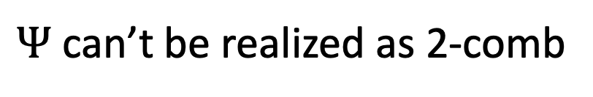
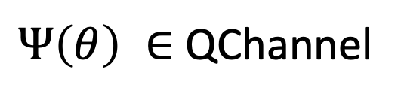
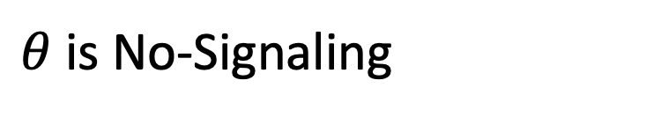
Quantum Circuit Architecture
Pre-
$$A$$
$$C$$
$$θ$$
Post-
Alice
$$R$$
Bob
$$D$$
$$B$$
$θ$ is No-Signaling
$Ψ$ can’t be realized as 2-comb
$Ψ\left(θ\right) ∈$ QChannel
For example, $Ψ$ can be the quantum switch

Slide 16





















Quantum Circuit Architecture
$$C_{0}$$
$$1$$
$$0$$
$$A_{1}$$
$$C_{1}$$
$$R_{1}$$
$$3$$
$$A_{2}$$
$$2$$
$$C_{2}$$
$$R_{2}$$
$$5$$
$$4$$
$$A_{3}$$
$$R_{3}$$
$$⋯$$
$$C_{n−1}$$
$$R_{n−1}$$
$$2n−2$$
$$2n−1$$
$$A_{n}$$
n-comb

Slide 17

























Quantum Circuit Architecture
$$C_{0}$$
$$C_{1}$$
$$C_{n−1}$$
$$1$$
$$2$$
$$3$$
$$⋯$$
$2$(n-1)
$$0$$
$$2n−1$$
n-comb
$$⋯$$
$$⋯$$
$$ρ$$
$$C_{0}$$
$$C_{1}$$
$$C_{n−1}$$
$$1$$
$$2$$
$$3$$
$$⋯$$
$$0$$
$2$(n-1)
$$⋯$$
$$2n−1$$
n-tester, i.e. a special (n+1)-comb

Slide 18
















Uncertainty Principle of Quantum Processes
$$R$$
$$p_{x} =Tr[M_{x} I⊗ ε(ρ)]$$
$$ρ$$
$$ε^{A→B}$$
$$p_{x}$$
$$T_{1}$$
$$A$$
$$B$$
$$M_{x}$$
Tradeoff?
$$R$$
$$T_{2}$$
$$σ$$
$$ε^{A→B}$$
$$q_{y}$$
$$A$$
$$B$$
$$N_{y}$$

Slide 19







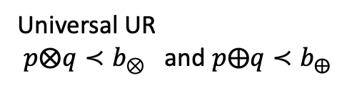





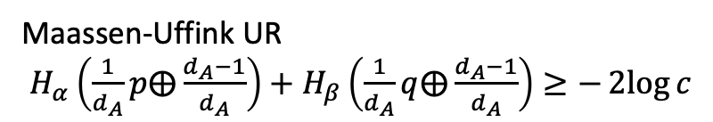


Uncertainty Principle of Quantum Processes
Maassen-Uffink UR
$H_{α}\left(\frac{1}{d_{A}}p⨁\frac{d_{A}−1}{d_{A}}\right)+H_{β}\left(\frac{1}{d_{A}}q⨁\frac{d_{A}−1}{d_{A}}\right)≥−2log{c}$
$$R$$
$$ρ$$
$$Ψ$$
$$p_{x}$$
Universal UR
$p⨂q≺b_{⊗}$ and $p⨁q≺b_{⨁}$
$$A$$
$$B$$
$$M_{x}$$
The optimal bounds are formulated by min-entropy
$$R$$
$$H_{1,min}≔H_{min}$$
$$σ$$
$$q_{y}$$
$$⇓$$
$$Ψ$$
$$H_{n,min}$$
$$A$$
$$B$$
$$N_{y}$$

Slide 20
Summary & Discussions
Notes:
Now, I will give a brief summary of this talk.

Slide 21
Summary
Uncertainty Principle of Quantum Network: given the ports of a quantum causal network, we can fully characterize the uncertainty of the causal network.
  Majorization bounds are SDP computable;
  Unique and tight in majorization.
  works for POVMs and even multiple n-testers.
Applications
  Generalization of min-entropy
  Fine-Grained UR of Causal Networks
  Determine QRT of Causal Networks
Open problems and future directions:
1. Is it possible to compute the bounds of resource speed limit for causal networks?
2. Is there any more concrete applications of our general framework?
E.g. in complete resource theory of incompatible n-testers….

Slide 22
Thanks for your attention!
arXiv:2004.05315

