Slide 1



Efficient photon loading on a single superconducting artificial atom
Kuan-Ting Lin, Io-Chun Hoi , Guin-Dar Lin*
National Tsing Hua University, Hsinchu, Taiwan
*National Taiwan University, Taipei, Taiwan
2020 Young Researchers Forum on Quantum Information Science, NTHU, Hsinchu, 8/28/2020

Slide 2
Outline
Introduction
  Quantum network
  Motivation
Model
  Transmon as a qubit
Results
  Analytical analysis
  The effect of band width
  The effect of pure dephasing process
  Comparison to single-photon Fock state
Conclusion

Slide 3
Outline
Introduction
  Quantum network
  Motivation
Model
  Transmon as a qubit
Results
  Analytical analysis
  The effect of band width
  The effect of pure dephasing process
  Comparison to single-photon Fock state
Conclusion

Slide 4
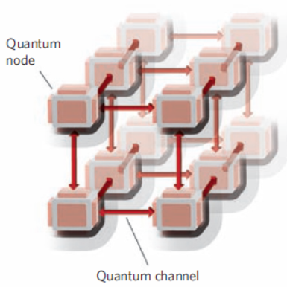
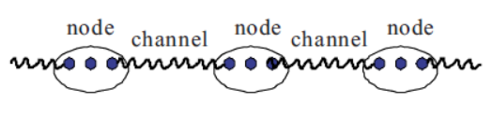
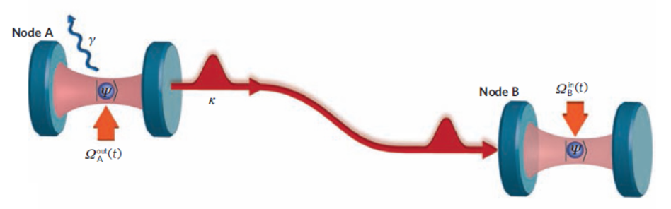
Quantum network : introduction
Kimble, Nature 453 1023(2008).
Duan, Rev. Mod. Phys. 82 1209(2010).
Cirac, PRL. 78 3221(1997).
Quantum node : a group of qubits/single qubit
How to efficiently load photons from node
to node through quantum channel?
Quantum channel : optical fiber, waveguide,…
1

Slide 5
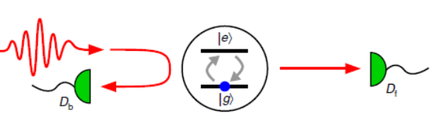
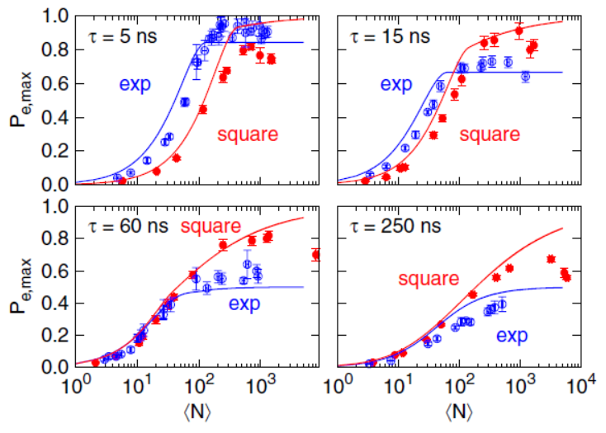
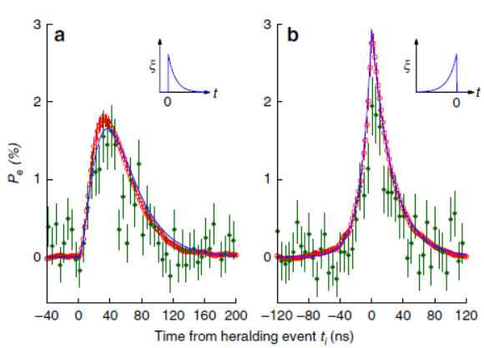
Quantum network : time reversal symmetry
single photon
multiple photons
Abdullah, PRL 111, 263601(2013).
Leong, Nature Commun. 7, 13716(2016).
2

Slide 6
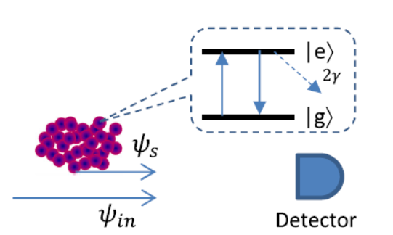
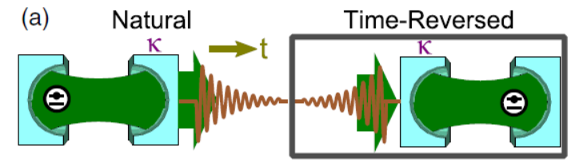
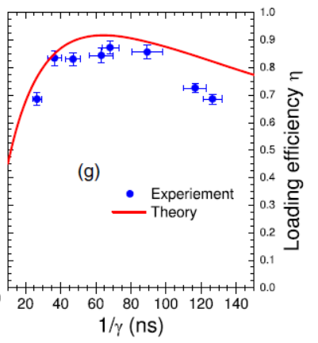
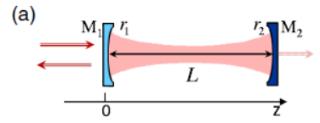



Quantum network : destructive interference
Shanchao Zhang, PRL 109, 263601(2012).
Wenner, PRL 112, 210501(2012).
efficiency ~ $20\%$
efficiency ~ $99\%$
efficiency ~ $87\%$
Chang Liu, PRL 113, 133601(2014).
3

Slide 7
Quantum network : difficulties
1.The incidence and radiation field usually have different spatial patterns.
reduce 3D geometry to 1D geometry
2.Strong light-atom coupling is hard to be achieved.
artificial atom
1D systems + artificial systems = circuit QED systems
Can we efficiently load photons on such a circuit QED system?
4

Slide 8
Outline
Introduction
  Quantum network
  Motivation
Model
  Transmon as a qubit
Results
  Analytical analysis
  The effect of band width
  The effect of pure dephasing process
  Comparison to single-photon Fock state
Conclusion

Slide 9

Model
exponential rising waveform
Superconducting atom
input pulse
$$V_{out}$$
terminated TX line
capacitor
5

Slide 10
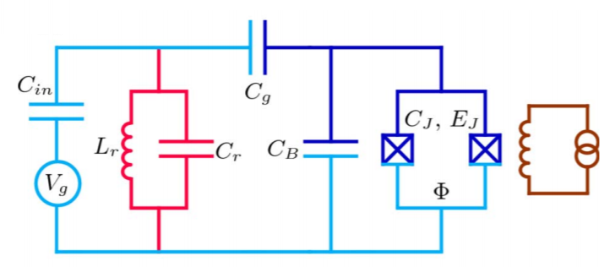
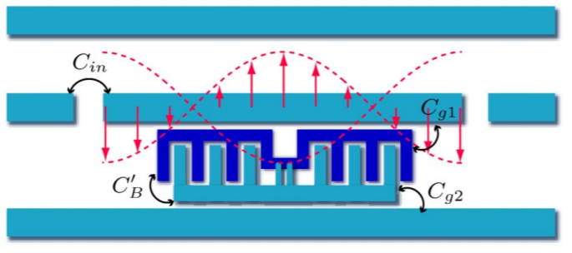
Circuit model
a circuit QED system
circuit model
transmon
transmon
It is modeled as a LC circuit.
Jens Koch, PRA, 76, 042319.(2007)
6

Slide 11
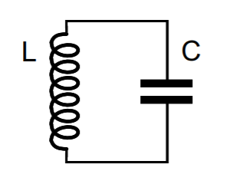





Energy spectrum
Vool, Arxiv:1610.30438.(2016)
L
C
traditional
LC circuit
transmon
$$ħω$$
ħ$ω−α$
$$α≫γ_{0}$$
$$ħω$$
$$ħω$$
equal spacing
not equal spacing
7

Slide 12
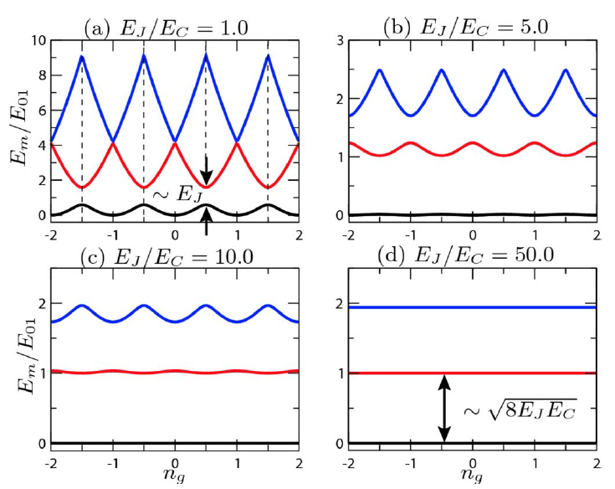

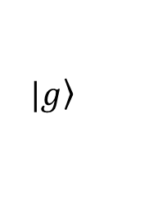
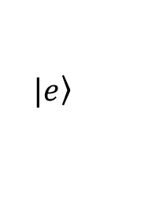
Transmon as a qubit
charging energy
Josephson energy
$$H={4E}_{c}{\left(\hat{n}−n_{g}\right)}^{2}−E_{J}\cos{\hat{∅}}$$
The transmon can be treated
as a two-level
atom approximately.
$$\left.|e\right\rangle$$
$$\left.|g\right\rangle$$
Jens Koch, PRA, 76, 042319.(2007)
8

Slide 13
Outline
Introduction
  Quantum network
  Motivation
Model
  Transmon as a qubit
Results
  Analytical analysis
  The effect of band width
  The effect of pure dephasing process
  Comparison to single-photon Fock state
Conclusion

Slide 14
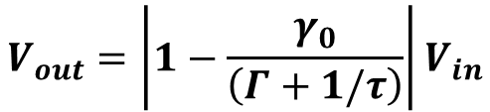

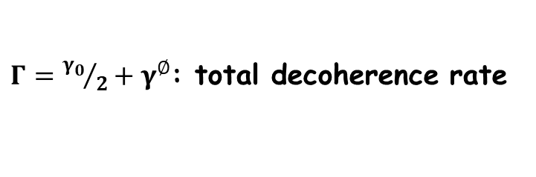




Analytical results : weak field limit
transmon qubit
$${V_{in}=V}_{0}e^{t/τ}$$
$$V_{out}$$
During the pulse
$γ_{0}$: qubit decay rate
input signal
$$V_{out}=\left|1−\frac{γ_{0}}{\left(Γ+1/τ\right)}\right|V_{in}$$
$τ$: time constant
$Γ={γ_{0}}/2+γ^{∅}$: total decoherence rate
After the pulse
qubit response
Our goal
$$V_{out}=\frac{γ_{0}}{\left(Γ+1/τ\right)}e^{−Γt}$$
Perfect destructive interference
9

Slide 15







The effect of the band width
white noise limit : $τ$is small.
exponential
rising
profile
$$\frac{V_{in}}{V_{0}}$$
$$\frac{V_{out}}{V_{0}}$$
$$γ_{0}t$$
optimal case:$τ=2/γ_{0}$
time
Lorentzian
$$2/τ$$
plane wave limit : $τ$is large.
frequency
10

Slide 16





Comparison to experiment
dot : experiments
Solid line : theory
optimal case
antinode
$${V_{in}=V}_{0}e^{t/τ}$$
$$V_{out}$$
$$V_{in}$$
$$V_{out}$$
Our theory agrees with the
experiment very well.
NON-perfect destructive interference
due to finite pure dephasing rate
$$t (μs)$$
11

Slide 17



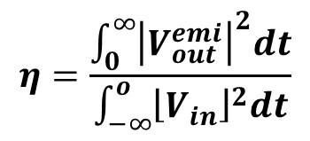
Loading efficiency : definition
Quantitative way
emission energy
$$γ^{∅}=0$$
$$η=\frac{\int_{0}^{∞}{{\left|V_{out}^{emi}\right|}^{2}dt}}{\int_{−∞}^{o}{{\left\lfloor V_{in}\right\rfloor }^{2}dt}}$$
$$η$$
input energy
The loading efficiency is 100%
due to the perfect
quantum destructive interference.
$$γ_{0}τ$$
12

Slide 18






Loading efficiency : effect of $γ^{∅}$
$$γ^{∅}=0$$
$$τ_{opt}$$
line width broadening
$$γ^{∅}=0.1$$
$$η$$
$$γ^{∅}=0.2$$
$$η_{max}$$
NON-perfect
destructive interference
$$γ^{∅}=0.4$$
$$γ_{0}τ$$
$$γ^{∅}/γ_{0}$$
13

Slide 19
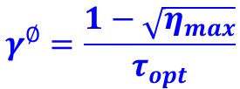
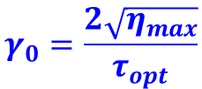
Loading efficiency : measure of decoherence rates
Spontaneous emission rate
$$τ_{opt}$$
line width broadening
$$γ_{0}=\frac{2\sqrt{η_{max}}}{τ_{opt}}$$
$$η_{max}$$
NON-perfect
destructive interference
Pure dephasing rate
$$γ^{∅}=\frac{1−\sqrt{η_{max}}}{τ_{opt}}$$
$$γ^{∅}/γ_{0}$$
14

Slide 20






Comparison to single-photon Fock state
$$γ^{∅}=0.074γ_{0}$$
Fock state : dotted line
coherent state : solid line
Fock state
$$τ_{opt}$$
$$η$$
76%
Coherent state
$$η_{max}$$
$$γ_{0}τ$$
$$γ^{∅}/γ_{0}$$
The Fock state is more robust
against decoherence rates.
15

Slide 21
Conclusion
In a case when pure dephasing process is neglected, our
calculation shows the loading efficiency can reach 100%
due to destructive interference.
We have demonstrated that coherent state photons with an
optimal temporal waveform can be efficiently loaded on a
single superconducting artificial atom.
The loading efficiency for single-photon Fock state is more
robust against the pure dephasing process.
In a case when pure dephasing process is neglected, our
calculation shows the loading efficiency can reach 100%
due to destructive interference.
We have demonstrated that coherent state photons with an
optimal temporal waveform can be efficiently loaded on a
single superconducting artificial atom.
The loading efficiency for single-photon Fock state is more
robust against the pure dephasing process.
16

Slide 22
Thank you very much!

Slide 23
Appendix

Slide 24



Semi-infinite long 1D transmission line
Why the semi-infinite long 1D TX line?
open TX line
$$f\left(x,t\right)\sim \cos{(kx−ωt)}$$
terminated TX line
$$\cos{(kx−ωt)}$$
$$\cos{(kx+ωt)}$$
tunable qubit-photon coupling
or natural linewidth
Position

Slide 25
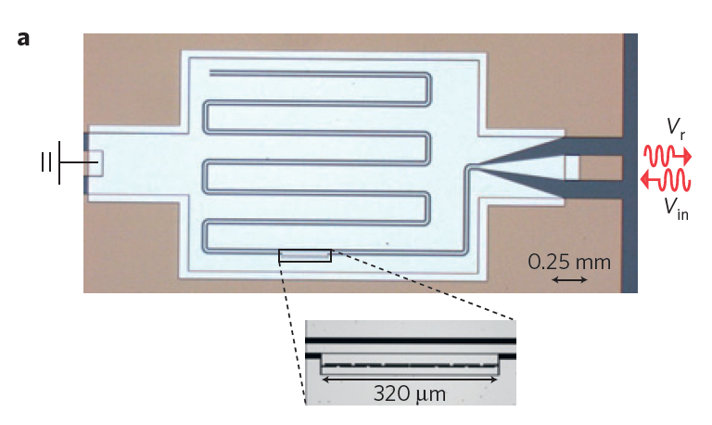
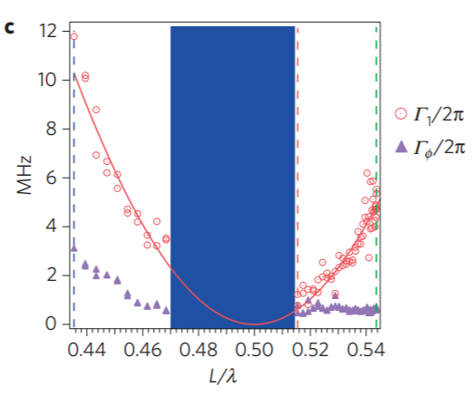
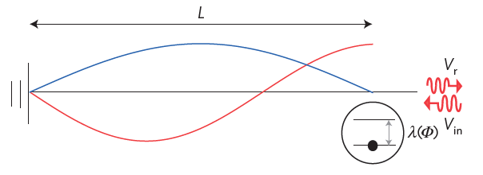

Experimental realization : single qubit
$$γ_{0}=2πg^{2}(x)\sim \sin^{2}(x)$$
probing the vacuum by adjusting the
effective position of the qubit
I.C. Hoi, Nature Physics 11, 1045(2015)

Slide 26
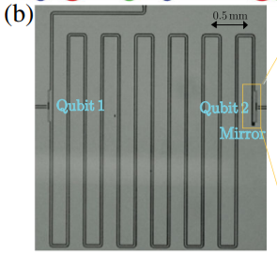
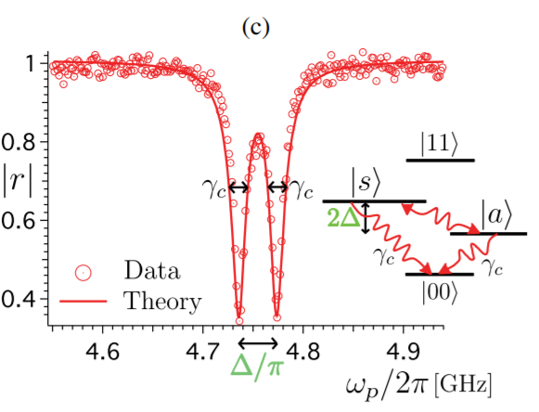
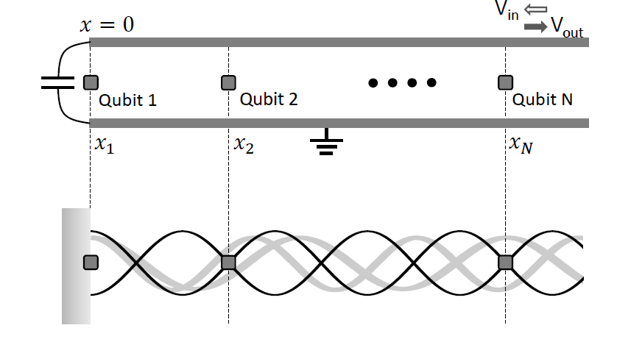
Experimental realization : two qubits
KT Lin, PRL 123, 633602(2019)
observation of the large collective Lamb
in a waveguide system
KT Lin, Scientific Report 9, 19175(2019)

