Slide 1
Secure Quantum Multi-party Computation
Bar Alon¹, Hao Chung², Kai-Min Chung², Mi-Ying Huang², Yi-Lee², Yu-Ching Shen²
¹ Department of Computer Science, Ariel University, Israel
² Institute of Information Science, Academia Sinica, Taiwan
Aug. 27, 2020

Slide 2
Players jointly compute a function $f(x_{1},x_{2},…,x_{k})$.
Player $i$ has input $x_{i}$.
After computation, Player $i$ gets his outputs $y_{i}$ .
E.g. who is the richest guy? $f\left(x_{1},x_{2},…,x_{k}\right)=argmax(x_{1},x_{2},…,x_{k})$.
👿 can deviate from the protocol and collude with each other.
Privacy : The only information that players can learn is whatever they can infer from their outputs.
Correctness: At the end of the protocol, the honest players will get the correct output, or they abort by detecting errors.
$$x_{1}=$$
$$1337$$
$$x_{2}=$$
$$2.718$$
$$x_{4}= \\ 9487$$
$$x_{3}= \\ 1/137$$

Slide 3
Players jointly execute a quantum circuit.
Inputs: Player $i$ has a q-state $\left|ψ_{i}\right\rangle$.
After executing the protocol, Player $i$ gets his outputs $|φ_{i}⟩$ .
👿 can deviate from the protocol and collude with each other.
Privacy : The only information that players can learn is whatever they can inferred from their outputs.
Correctness: At the end of the protocol, the honest players will get the correct output, or they abort by detecting errors.
$$|ψ_{1}⟩$$
$$|ψ_{2}⟩$$
$$|φ_{1}⟩$$
$$|φ_{2}⟩$$
$$|φ_{4}⟩$$
$$|φ_{3}⟩$$
$$|ψ_{4}⟩$$
$$|ψ_{3}⟩$$

Slide 4
Adversary model
Adversary’s behavior
Honest but curious (passive, semi-honest):
She follows the protocol but tries to learn more than allowed.
Malicious (active):
She can deviate from the protocol.
Adversary’s power
Computational unbounded
Computational bounded
Polynomial time
Quantum polynomial-time (QPT)
Notes:
IT secure. Computational secure. Relay on the hardness of mathematical problem. We consider malicious, and QPT adversary.

Slide 5
$$|φ_{1}⟩$$
$$|φ_{2}⟩$$
Ideal functionality of QMPC (secure w/ abort)
Every players send his input to 📦.
📦 executes the q-circuit.
📦 returns👿’s output.
👿 chooses to continue or abort.
If continue,📦 returns honest players’ output.
$$⊥$$
$$⊥$$
$$|φ_{4}⟩$$
$$|φ_{3}⟩$$
$$|ψ_{1}⟩$$
$$|ψ_{2}⟩$$
If abort, returns abort.
conti
conti
abort
$$|ψ_{4}⟩$$
$$|ψ_{3}⟩$$
Notes:
Why it is ideal?

Slide 6
$Π$ is $ε$-secure if $∀$ QPT Adversary $A$ and q-circuit $C$, $∃$ a QPT simulator $S$ s.t. $∀$ distinguidher $𝒟$,
What does it mean that a protocol is secure?
Simulation paradigm
$\left|\operatorname{Pr}\left[𝒟\left(Π_{C,A}\right)=1\right]−\operatorname{Pr}\left[𝒟\left(ℑ_{C,S}\right)=1\right]\right|<ε$.
$$≈$$
S
$$x_{i}$$
$$x_{i}$$
$$y_{i}$$
$$y_{i}$$
Distinguisher

Slide 7
Historical review
Using secret sharing
Up to $k/6$ 👿 [CGS02]
$\#$ of 👿 $<k/2$ is optimal [BOCG+06]
Introducing authentication & classical MPC
Two-party protocol [DNS12]
Extended to $k$-party, against up to $k−1$👿 [DGJ+20]
The above two protocol are computational secure against QPT adversary.
Crépeau, Gottesman, and Smith. STOC, 2002.
Ben-Or, Crépeau, Gottesman, Hassidim, and Smith. FOCS, 2006.
Dupuis, Nielsen, and Salvail. CRYPTO 2012.
Dulek, Grilo, Jeffery, Majenz, and Schaffner. EUROCRYPT, 2020.

Slide 8
Subroutine: Classical MPC
Has internal memory
Against up to $k−1$ QPT 👿
Secure with abort
cMPC is modeled as a classical trusted party😇.

Slide 9
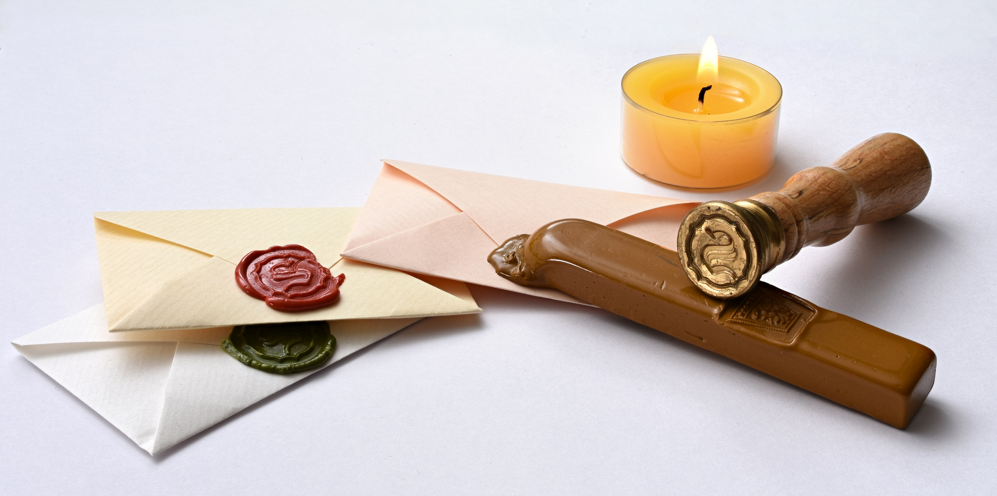
Authentication code

Slide 10
Clifford code[ABOE10]
$$|φ⟩$$
$$\left|ψ\right\rangle ⊗|0^{n}⟩$$
$$|ψ⟩$$
$$⊗|0^{n}⟩$$
$$E($$
$$)$$
$$E^{†}$$
Encoding: $\left|ψ\right\rangle ↦\left|φ\right\rangle =E\left(\left|ψ\right\rangle ⨂\left|0^{n}\right\rangle \right)$, where $E∈_{R}𝒞_{n+1}$.
Decoding: Apply $E^{†}$on $|φ⟩$, then measure the last $n$ qubits.
Accept, if the outcome is $0^{n}$.
Reject, otherwise.
For 👿, $|φ⟩$ looks uniformly random without the information of $E$.
The probability that 👿 changes the message but is not caught is negligible $(2^{−n})$.
Clifford gate $E$:
If $G$ is a Pauli gate, then $EGE^{†}$is also a Pauli gate.
Single-qubit Clifford: $X$, $Y$, $Z$, $H$, $P$, $I$
Two-qubit Clifford: CNOT
Aharonov, Ben-Or, and Eban. ICS 2010.

Slide 11
Clifford code supports Homomorphic encryption for Clifford gates!
$$E$$
$$E^{′}=E(G^{†}⊗I)$$
$$\left|φ\right\rangle =E\left(\left|ψ\right\rangle ⊗|0^{n}⟩\right)$$
$$E^{′†}\left|φ\right\rangle =GE^{†}E\left(\left|ψ\right\rangle ⊗|0^{n}⟩\right)$$
$$=G\left|ψ\right\rangle ⊗|0^{n}⟩$$
Homomorphic encryption
$$x$$
$$y=Enc(x)$$
$$x^{′}=Dec\left(y\right)=f(x)$$
$$y′=\tilde{f}(Enc\left(x\right))$$

Slide 12
[DGJ+20]’s protocol
QMPC
Input encoding
Computation
Decoding
Clifford gate
T gate

Slide 13
Input encoding
Goal:
Honest parties’ inputs are protected.
Malicious parities cannot temper with their inputs.
$P_{1}$ encode his input in Clifford Code. $|ψ⟩↦E(|ψ⟩|0^{n}⟩)$
😇stores Clifford key $E$ in his internal register.
If 👿 attacks, 😇 replaces $E$ by $⊥$.
$$|ψ⟩$$
0
0
$$F_{1}$$
$$E/⊥$$
$$F_{2}$$
$$V$$
$$r′$$
$$F_{4}$$
$$F_{3}$$
Security: based on Clifford code

Slide 14
(Classical control) single-qubit Clifford $G^{(m)}$
protocol:
😇 (reads $m,$) updates Clifford key $E↦E(G^{(m)†}⊗I)$
❶
❷
$$E_{1}$$
$$E_{2}$$
$$E_{3}$$
$$E_{4}$$
$$m$$
$$↦E_{1}G^{†}$$
❹
❸

Slide 15
How about CNOT?
Updating key by $E_{1}⊗E_{2}↦(E_{1}⊗E_{2})CNOT$?
Decrypt $E_{1}$and $E_{2},$ then apply $CNOT$. Finally encrypt them again. How to do it?
Passing the q-register through every player!
❶
⓪
⓪
❷
$$E_{1}$$
$$E_{2}$$
$${↦E′}_{1}/⊥$$
$$↦{E′}_{2}/⊥$$
Notes:
CNOT over player 1 and player 2

Slide 16
Decoding
😇 sends $E$ to $P_{1}$, and removes it from his internal register.
$P_{1}$ applies $E^{†}$.
$P_{1}$ measures the trap, if he doesn’t get $0^{n}$, returns abort.
❶
$$E$$

Slide 17
Using Clifford circuit to compute $T$ gate
Resource: $T$ magic state $\left|T\right\rangle ≔T|+⟩$
T is special

Slide 18
Magic state preparation
$P_{1}$ creates $(t+k)n$ copies of $|T⟩$, and encodes them separately by input encoding.
😇 picks disjoint sets $S_{i}$.
$P_{i}$ decodes magic state indicated by $S_{i}$, and checks if the message is $|T⟩$.
Players run magic distillation circuit.
T
T
conti/
abort
T
T
T
$$S_{2}$$
Close enough magic state
Very good magic state
$O(\log{n})$CNOT
$poly(n)$ c-ctrl Clifford and measurement
conti/
abort
conti/
abort
$$S_{4}$$
$$S_{3}$$
$$⋮$$
$$⋮$$
Bravyi and Kitaev, Physical Review A, (022316), 2005.

Slide 19
Summary
A QMPC protocol can be realized by Clifford authentication code & cMPC.
Against up to $k−1$ QPT malicious parties
To Be Continued

Slide 20
Ongoing work
QMPC with identifiable abort
If the protocol is aborted, every honest party will agree on the same malicious one.
The honest parties can kick away the identified one and then execute a new protocol.
$$⊥$$
$$⊥$$
abort
$$⊥$$

Slide 21
Thank You

