Slide 1

Preservation of Non-Classical Property in Quantum Memories
Yan-Cheng Wei*, Yu-Zhi Tseng, and Ying-Cheng Chen
Institute of Atomic and Molecular Sciences, Academia Sinica
Dept. of Physics, National Taiwan University

Slide 2
Repeater
Sender
Receiver
Sender
Receiver

Slide 3
Quantum Repeater
Swapping
BSM
S
S
Phys. Rev. Lett. 67, 661(1991)

Slide 4
Quantum Repeater
BSM
BSM
BSM
S
S
S
S

Slide 5
Quantum Repeater
Sender
BSM
BSM
Receiver
BSM
BSM
S
S
S
S
S
S
S
Quantum Repeater

Slide 6
Quantum Repeater
Sender
BSM
BSM
Receiver
BSM
BSM
S
S
S
S
S
S
S
Quantum Repeater

Slide 7
Quantum Repeater
BSM
BSM
Sender
QM
QM
Receiver
QM
QM
BSM
BSM
S
S
S
S
S
S
S
Quantum Repeater

Slide 8
Quantum Repeater
BSM
BSM
Sender
QM
QM
Receiver
QM
QM
BSM
BSM
S
S
S
S
S
S
S
Quantum Repeater
Quantum memories: devices that can store
and retrieve photonic quantum states on demand

Slide 9

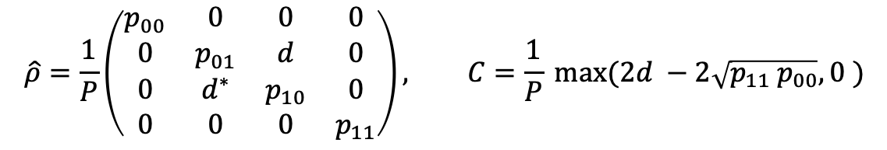



Non Classical Property of single photons
1. Bell Measurement
BSM
$$B_{ab}\left|1_{a}, 1_{b}\right\rangle =\frac{i}{2}\left({| 2}_{a}\right\rangle −{|2}_{b}⟩ )$$
Single photon
$$\left|1_{a}\right\rangle ⊗ |1_{b}⟩$$
2. Maximizing entanglement
$$a$$
$$\hat{ρ}=\frac{1}{P}\left(\begin{matrix}p_{00} & 0 & 0 & 0 \\ 0 & p_{01} & d & 0 \\ 0 & d^{∗} & p_{10} & 0 \\ 0 & 0 & 0 & p_{11}\end{matrix}\right), C=\frac{1}{P} max(2d −2\sqrt{{p_{11} p}_{00}}, 0 )$$
$$b$$
1. C. Simon, H. de Riedmatten, M. Afzelius, N. Sangouard,H. Zbinden, and N. Gisin, Phys. Rev. Lett. 98, 190503 (2007).
2. Lvovsky, A., Sanders, B. & Tittel, W. Optical quantum memory. Nature Photon 3, 706–714 (2009).
3. Cao, M., Felix Hoffet, Siye Qiu, Alexandra S Sheremet and Julien Laurat. “Efficient reversible entanglement transfer between light and quantum memories.” arXiv:2007.00022 (2020).

Slide 10
Quantum Memory
Preserve non-classical property
Storage efficiency
Delay Bandwidth Product
Fidelity
Multimode Capacity
Lvovsky, A., Sanders, B. & Tittel, W. Optical quantum memory. Nature Photon 3, 706–714 (2009). https://doi.org/10.1038/nphoton.2009.231

Slide 11
Quantum Memory
Preserve non-classical property
Storage efficiency
Delay Bandwidth Product
Fidelity
Multimode Capacity
This Work
Future work
Lvovsky, A., Sanders, B. & Tittel, W. Optical quantum memory. Nature Photon 3, 706–714 (2009). https://doi.org/10.1038/nphoton.2009.231

Slide 12
Outline
Experimental Scheme
Experimental Design
Shaping technique
Results
Future plan

Slide 13
Single Photon Source
Quantum Memory
Four - Wave Mixing Process
Raman transitions
Single atoms in the cavity
SPDC Process (THz)
  Cavity-enhanced (MHz)
Free space atomic ensemble
Warm atomic vapor
Rare-earth-doped crystals
Single-atom quantum memory
1. S. Du, P. Kolchin, C. Belthangady, G. Y. Yin, and S. E. Harris, Phys. Rev. Lett. 100, 183603 (2008).
2. J. McKeever, A. Boca, A. D. Boozer, R. Miller, J. R. Buck, A. Kuzmich, and H. J. Kimble, Science 303, 1992 (2004).
3. C. W. Chou, S. V. Polyakov, A. Kuzmich, and H. J.Kimble, Phys. Rev. Lett. 92, 213601 (2004).
4. X.-H. Bao, Y. Qian, J. Yang, H. Zhang, Z.-B. Chen,T. Yang, and J.-W. Pan, Phys. Rev. Lett. 101, 190501 (2008).
5. C. Clausen, I. Usmani, F. Bussires, N. Sangouard, M. Afzlius, and H. de Riedmatten, Nature 469, 508 (2011).
6. H. Zhang, X.-M. Jin, J. Yang, H.-N. Dai, S.-J. Yang, T.- M. Zhao, J. Rui, Y. He, X. Jiang, F. Yang, G.-S. Pan, Z.-S. Yuan, Y. Deng, Z.-B. Chen, X.-H. Bao, S. Chen, B. Zhao, and J.-W. Pan, Nature Photonics 5, 628 (2011).
7. Specht, H., Nölleke, C., Reiserer, A. et al. A single-atom quantum memory. Nature 473, 190–193 (2011)
8. P S Michelberger et al 2015 New J. Phys. 17 043006

Slide 14
Single Photon Source
Quantum Memory
Four - Wave Mixing Process
Raman transitions
Single atoms in the cavity
SPDC Process (THz)
  Cavity-enhanced (MHz)
Free space atomic ensemble
Warm atomic vapor
Rare-earth-doped crystals
Single-atom quantum memory
Compact, Scalable
1. S. Du, P. Kolchin, C. Belthangady, G. Y. Yin, and S. E. Harris, Phys. Rev. Lett. 100, 183603 (2008).
2. J. McKeever, A. Boca, A. D. Boozer, R. Miller, J. R. Buck, A. Kuzmich, and H. J. Kimble, Science 303, 1992 (2004).
3. C. W. Chou, S. V. Polyakov, A. Kuzmich, and H. J.Kimble, Phys. Rev. Lett. 92, 213601 (2004).
4. X.-H. Bao, Y. Qian, J. Yang, H. Zhang, Z.-B. Chen,T. Yang, and J.-W. Pan, Phys. Rev. Lett. 101, 190501 (2008).
5. C. Clausen, I. Usmani, F. Bussires, N. Sangouard, M. Afzlius, and H. de Riedmatten, Nature 469, 508 (2011).
6. H. Zhang, X.-M. Jin, J. Yang, H.-N. Dai, S.-J. Yang, T.- M. Zhao, J. Rui, Y. He, X. Jiang, F. Yang, G.-S. Pan, Z.-S. Yuan, Y. Deng, Z.-B. Chen, X.-H. Bao, S. Chen, B. Zhao, and J.-W. Pan, Nature Photonics 5, 628 (2011).
7. Specht, H., Nölleke, C., Reiserer, A. et al. A single-atom quantum memory. Nature 473, 190–193 (2011)
8. P S Michelberger et al 2015 New J. Phys. 17 043006

Slide 15
Single Photon Source
Quantum Memory
Four - Wave Mixing Process
Raman transitions
Single atoms in the cavity
SPDC Process (THz)
  Cavity-enhanced (MHz)
Free space atomic ensemble
Warm atomic vapor
Rare-earth-doped crystals
Single-atom quantum memory
Potentials of High SE and Fidelity, clean platform
Compact, Scalable
1. S. Du, P. Kolchin, C. Belthangady, G. Y. Yin, and S. E. Harris, Phys. Rev. Lett. 100, 183603 (2008).
2. J. McKeever, A. Boca, A. D. Boozer, R. Miller, J. R. Buck, A. Kuzmich, and H. J. Kimble, Science 303, 1992 (2004).
3. C. W. Chou, S. V. Polyakov, A. Kuzmich, and H. J.Kimble, Phys. Rev. Lett. 92, 213601 (2004).
4. X.-H. Bao, Y. Qian, J. Yang, H. Zhang, Z.-B. Chen,T. Yang, and J.-W. Pan, Phys. Rev. Lett. 101, 190501 (2008).
5. C. Clausen, I. Usmani, F. Bussires, N. Sangouard, M. Afzlius, and H. de Riedmatten, Nature 469, 508 (2011).
6. H. Zhang, X.-M. Jin, J. Yang, H.-N. Dai, S.-J. Yang, T.- M. Zhao, J. Rui, Y. He, X. Jiang, F. Yang, G.-S. Pan, Z.-S. Yuan, Y. Deng, Z.-B. Chen, X.-H. Bao, S. Chen, B. Zhao, and J.-W. Pan, Nature Photonics 5, 628 (2011).
7. Specht, H., Nölleke, C., Reiserer, A. et al. A single-atom quantum memory. Nature 473, 190–193 (2011)
8. P S Michelberger et al 2015 New J. Phys. 17 043006

Slide 16
Quantum Storage Protocol
Electromagnetically induced transparency (EIT)
Raman Process
Atomic Frequency Comb (AFC)
Gradient Echo Memory (GEM)
Autler-Townes splitting (ATS)
1. PRL 110, 133604 (2013)
2. Optica 3, 100-107 (2016)
3. PRL 120, 183602(2018)
4. PRL. 110, 083601(2013)
5. Nat. Photo. 12, 774–782
6. Nat. Commun. 10, 148 (2019)

Slide 17
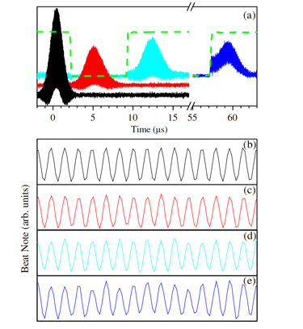
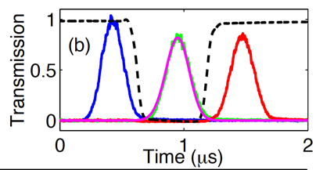
Quantum Storage Protocol
High Waveform Likeness (classical fidelity)
High SE (reach 92 % for attenuated classical field)
-------------------------------------------------------------------
Narrow Bandwidth
Electromagnetically induced transparency (EIT)
Raman Process
Atomic Frequency Comb (AFC)
Gradient Echo Memory (GEM)
Autler-Townes splitting (ATS)
Ref. [1]
Ref. [2]
1. Yi-Hsin Chen, Meng-Jung Lee, I-Chung Wang, Shengwang Du, Yong-Fan Chen, Ying-Cheng Chen, and Ite A. Yu, Phys. Rev. Lett. 110, 083601 (2013)
2. Ya-Fen Hsiao, Pin-Ju Tsai, Hung-Shiue Chen, Sheng-Xiang Lin, Chih-Chiao Hung, Chih-Hsi Lee, Yi-Hsin Chen, Yong-Fan Chen, Ite A. Yu, and Ying-Cheng Chen, Phys. Rev. Lett. 120, 183602 (2018)

Slide 18



Two-Level Absorption
$$|e⟩$$
$${\hat{a}}_{p}$$
$$|g⟩$$

Slide 19
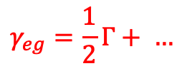
Two-Level Absorption
$$|e⟩$$
$$γ_{eg}=\frac{1}{2}Γ+ …$$
$${\hat{a}}_{p}$$
$$|g⟩$$

Slide 20
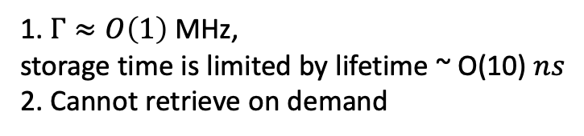
Two-Level Absorption
$$|e⟩$$
$$γ_{eg}=\frac{1}{2}Γ+ …$$
$${\hat{a}}_{p}$$
$$|g⟩$$
1. $Γ≈O\left(1\right)$ MHz,
storage time is limited by lifetime ~ O(10) $ns$
2. Cannot retrieve on demand

Slide 21




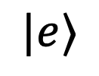

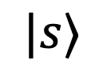
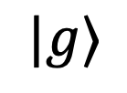
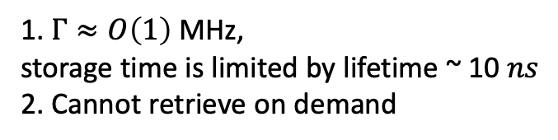
Two-Level Absorption
$$|e⟩$$
$$γ_{eg}=\frac{1}{2}Γ+ …$$
$${\hat{a}}_{p}$$
$$|g⟩$$
1. $Γ≈O\left(1\right)$ MHz,
storage time is limited by lifetime ~ 10 $ns$
2. Cannot retrieve on demand
Electromagnetically induced transparency protocol
$${\hat{a}}_{p}$$
$$δ_{p}$$
$$δ_{c}$$
$$|e⟩$$
$$Ω_{C}$$
$${\hat{a}}_{p}$$
$$|s⟩$$
$$|g⟩$$

Slide 22



Two-Level Absorption
$$|e⟩$$
$$γ_{eg}=\frac{1}{2}Γ+ …$$
$${\hat{a}}_{p}$$
$$|g⟩$$
1. $Γ≈O\left(1\right)$ MHz,
storage time is limited by lifetime ~ 10 $ns$
2. Cannot retrieve on demand
Electromagnetically induced transparency protocol
$\hat{Ψ}=\cos{θ \hat{E}\left(z,t\right)−\sin{θ}\sqrt{N}} σ_{sg}$_{[1]}
$${\hat{Ψ}}_{}$$
$${\hat{a}}_{p}$$
$$δ_{p}$$
$$δ_{c}$$
Writing Process
$$|e⟩$$
$$Ω_{C}$$
$${\hat{a}}_{p}$$
$$|s⟩$$
$$σ_{sg}$$
$$|g⟩$$
1. M. Fleischhauer and M. D. LukinPhys. Rev. Lett. 84, 5094 (2000)

Slide 23


Two-Level Absorption
$$|e⟩$$
$$γ_{eg}=\frac{1}{2}Γ+ …$$
$${\hat{a}}_{p}$$
$$|g⟩$$
1. $Γ≈O\left(1\right)$ MHz,
storage time is limited by lifetime ~ 10 $ns$
2. Cannot retrieve on demand
Electromagnetically induced transparency protocol
$\hat{Ψ}=\cos{θ \hat{E}\left(z,t\right)−\sin{θ}\sqrt{N}} σ_{sg}$_{[1]}
$${\hat{Ψ}}_{}$$
$${\hat{a}}_{p}$$
$$δ_{p}$$
$$δ_{c}$$
Writing Process
$$|e⟩$$
Storage
$$Ω_{C}$$
$${\hat{a}}_{p}$$
$$|s⟩$$
$$σ_{sg}$$
$$γ_{sg}≈0$$
$$|g⟩$$
1. M. Fleischhauer and M. D. LukinPhys. Rev. Lett. 84, 5094 (2000)

Slide 24








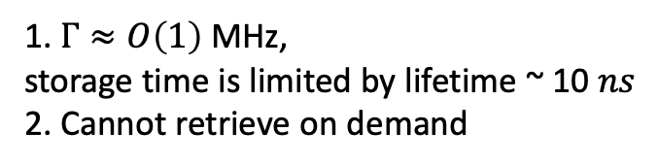

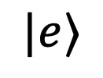



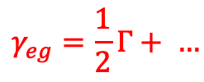
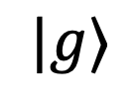

Two-Level Absorption
$$|e⟩$$
$$γ_{eg}=\frac{1}{2}Γ+ …$$
$${\hat{a}}_{p}$$
$$|g⟩$$
1. $Γ≈O\left(1\right)$ MHz,
storage time is limited by lifetime ~ 10 $ns$
2. Cannot retrieve on demand
Electromagnetically induced transparency protocol
$\hat{Ψ}=\cos{θ \hat{E}\left(z,t\right)−\sin{θ}\sqrt{N}} σ_{sg}$_{[1]}
$${\hat{Ψ}}_{}$$
$${\hat{a}}_{p}$$
$$δ_{p}$$
$$δ_{c}$$
Writing Process
$$|e⟩$$
Storage
$$Ω_{C}$$
$${\hat{a}}_{p}$$
$$|s⟩$$
$${\hat{Ψ}}_{}$$
$$σ_{sg}$$
$$γ_{eg}≈0$$
$$|g⟩$$
Reading Process
1. M. Fleischhauer and M. D. LukinPhys. Rev. Lett. 84, 5094 (2000)

Slide 25

Two-Level Absorption
$$|e⟩$$
$$γ_{eg}=\frac{1}{2}Γ+ …$$
$${\hat{a}}_{p}$$
$$|g⟩$$
1. $Γ≈O\left(1\right)$ MHz,
storage time is limited by lifetime ~ 10 $ns$
2. Cannot retrieve on demand
Electromagnetically induced transparency protocol
$\hat{Ψ}=\cos{θ \hat{E}\left(z,t\right)−\sin{θ}\sqrt{N}} σ_{sg}$_{[1]}
$${\hat{Ψ}}_{}$$
$${\hat{a}}_{p}$$
$$δ_{p}$$
$$δ_{c}$$
Writing Process
$$|e⟩$$
Storage
$$Ω_{C}$$
$${\hat{a}}_{p}$$
$$|s⟩$$
$${\hat{Ψ}}_{}$$
$$σ_{sg}$$
$${\hat{a}}_{p}$$
$$γ_{eg}≈0$$
$$|g⟩$$
Reading Process
1. M. Fleischhauer and M. D. LukinPhys. Rev. Lett. 84, 5094 (2000)

Slide 26
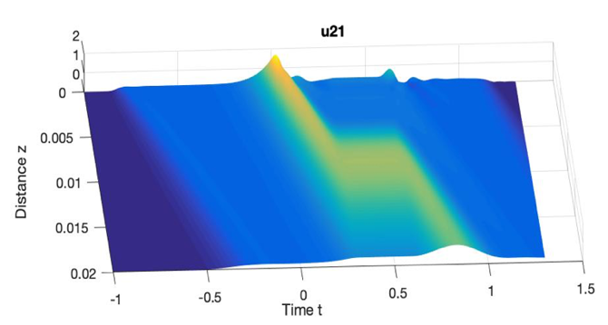
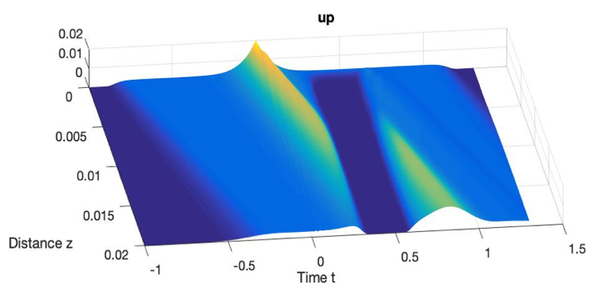


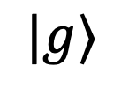









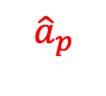
Electromagnetically induced transparency (EIT)-based quantum memory
$${\hat{a}}_{p}$$
z
$$σ_{sg}$$
$$δ_{p}$$
$$δ_{c}$$
$$|e⟩$$
Probe Field
$$Ω_{C}$$
$${\hat{a}}_{p}$$
Control Field
Time $(μs)$
$${{\hat{⟨a}}_{p}⟩}_{}$$
$$|s⟩$$
$$γ_{eg}≈0$$
$$σ_{sg}$$
$$|g⟩$$
Spin Wave
Time $(μs)$

Slide 27
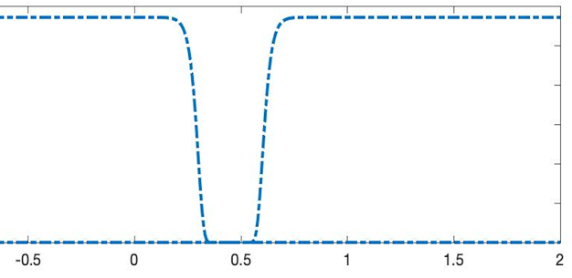
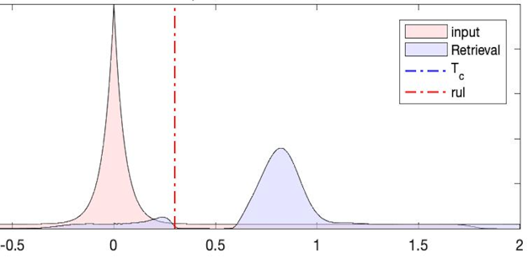



Electromagnetically induced transparency (EIT)-based quantum memory
$$δ_{p}$$
$$δ_{c}$$
$$|e⟩$$
Control Field $(a.u.)$
Probe Field
$$Ω_{C}$$
$${\hat{a}}_{p}$$
Control Field
$$|s⟩$$
$$γ_{eg}≈0$$
$$σ_{sg}$$
$$|g⟩$$
Spin Wave
Rabi Frequency $(a.u.)$
Time$(μs)$

Slide 28
Electromagnetically induced transparency (EIT)-based quantum memory
$$δ_{p}$$
$$δ_{c}$$
$$|e⟩$$
Control Field $(a.u.)$
Probe Field
$$Ω_{C}$$
$${\hat{a}}_{p}$$
Control Field
$$|s⟩$$
$$γ_{eg}≈0$$
$$σ_{sg}$$
$$|g⟩$$
Spin Wave
Rabi Frequency $(a.u.)$
Time$(μs)$

Slide 29
Cavity-enhanced spontaneous parametric down conversion (SPDC)
Linewidth ~ O(1) THz
Single Photon
Pumping
crystals
Single Photon
Single Photon
Single Photon
Chih-Sung Chuu and S. E. Harris, Phys. Rev. A 83, 061803(R) (2011)
Quantum Sci. Technol. 3 (034005)

Slide 30
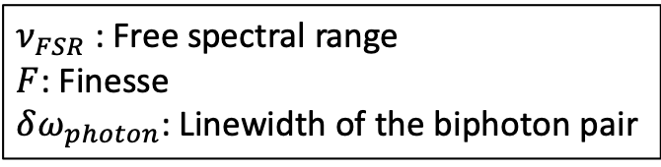
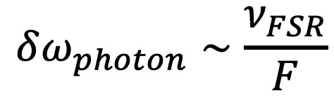
Cavity-enhanced spontaneous parametric down conversion (SPDC)
$ν_{FSR}$: Free spectral range
$F$: Finesse
$δω_{photon}$: Linewidth of the biphoton pair
Linewidth ~ O(1) THz
Single Photon
Pumping
crystals
$$δω_{photon}∼\frac{ν_{FSR}}{F}$$
Single Photon
Single Photon
Pumping
crystals
Single Photon
Linewidth ~ O(1) MHz
Single Photon
Single Photon
Chih-Sung Chuu and S. E. Harris, Phys. Rev. A 83, 061803(R) (2011)
Quantum Sci. Technol. 3 (034005)

Slide 31
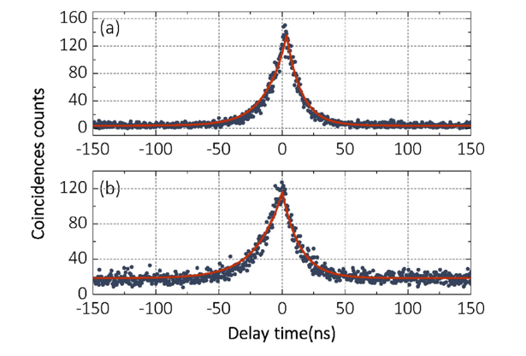


Cavity-enhanced spontaneous parametric down conversion (SPDC)
$ν_{FSR}$: Free spectral range
$F$: Finesse
$δω_{photon}$: Linewidth of the biphoton pair
Linewidth ~ O(1) THz
Single Photon
Pumping
crystals
$$δω_{photon}∼\frac{ν_{FSR}}{F}$$
Single Photon
Single Photon
Pumping
Ref. [2]
crystals
Linewidth = $2π × 7.2$ MHz
Single Photon
Linewidth ~ O(1) MHz
Single Photon
Linewidth = $2π × 6$ MHz
Single Photon
Chih-Sung Chuu and S. E. Harris, Phys. Rev. A 83, 061803(R) (2011)
Quantum Sci. Technol. 3 (034005)

Slide 32
Using Heralded Idler Photon as QM’s control
Single Photon Lab
Optical Switch
Control
PBS
crystals
Probe
oscilloscope
Idler
Detector
Quantum Memory Lab
Function Generator
Detector
Coupling (R)
Coupling (W)
Storage
2 mus
Burst
Signal
Idler
Electronic Signal

Slide 33
Using Heralded Idler Photon as QM’s control
Single Photon Lab
Optical Switch
Control
PBS
crystals
Probe
oscilloscope
Idler
Detector
Quantum Memory Lab
Function Generator
Detector
Coupling (R)
Coupling (W)
Storage
2 mus
Burst
Signal
Idler
Electronic Signal

Slide 34

Single Photon Lab (3.2 kHz)
time
crystals
Lasing
Single
photon
Lasing
Single
photon
Lasing
Single
photon
Lasing
Photon Counting
Prepare Atomic Ensembles
Quantum Storage
Prepare Atomic Ensembles
~ 60 $μs$
Quantum Memory Lab (16 Hz)
Prepare Atomic Ensembles
Prepare Atomic Ensembles
Prepare Atomic Ensembles
Prepare Atomic Ensembles
time

Slide 35
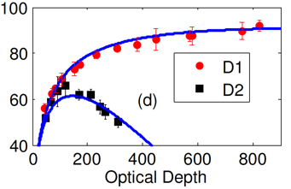
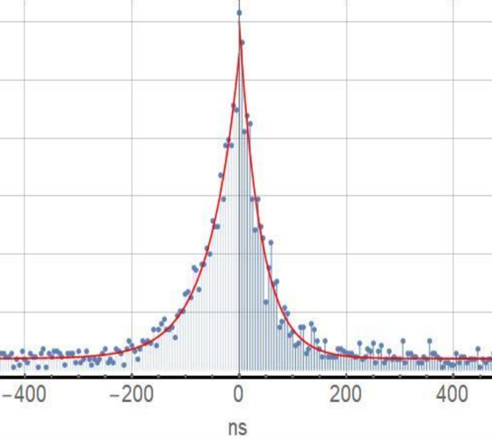
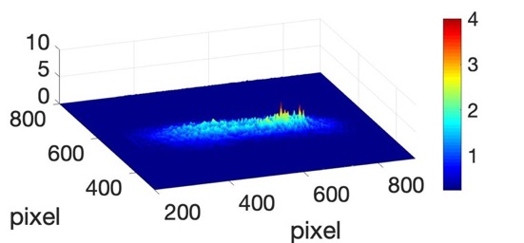
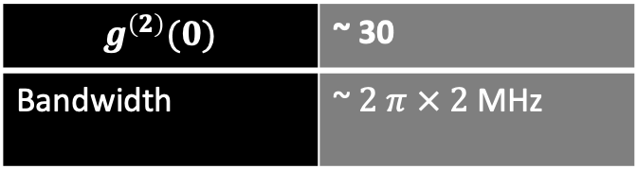
QM Lab
Optical Depth | > 400
Storage Efficiency (Classical) | Reach 92 %
$$g^{\left(2\right)}(0)$$ | ~ 30
Bandwidth | ~ $2 π × 2$MHz
Single Photon Lab
Ref [1]
Transverse Optical depth
~ 1 cm
Y.-F. Hsiao, P.-J. Tsai, H.-S. Chen, S.-X. Lin, C.-C. Hung, C.-H. Lee, Y.-H. Chen, Y.-F. Chen, I. A. Yu, and Y.-C. Chen, Phys. Rev. Lett. 120, 183602 (2018).
Y.-F. Hsiao, H.-S. Chen, P.-J. Tsai, and Y.-C. Chen, Phys. Rev. A 90, 055401 (2014).

Slide 36
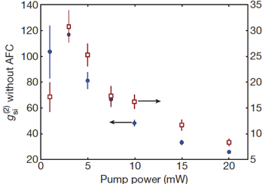
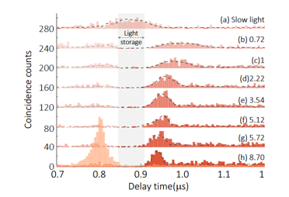


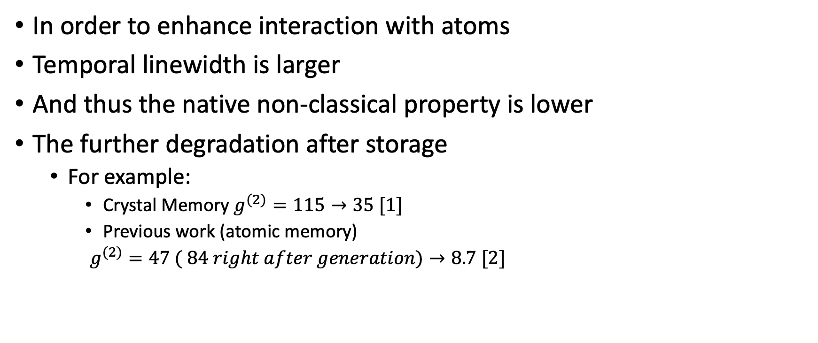


Issue: low non-classical property of
Narrow Bandwidth photon source
Single Photon waveform
$$τ$$
In order to enhance interaction with atoms
Temporal linewidth is larger
And thus the native non-classical property is lower
The further degradation after storage
  For example:
    Crystal Memory $g^{(2)}=115→35 [1]$
    Previous work (atomic memory)
    $g^{(2)}=47 ( 84 right after generation)→8.7 [2]$
$$τ$$
Ref. $[1]$
Ref. $[2]$
Clausen, C., Usmani, I., Bussières, F. et al. Quantum storage of photonic entanglement in a crystal. Nature 469, 508–511 (2011).
Pin-Ju Tsai, Ya-Fen Hsiao, and Ying-Cheng Chen, Phys. Rev. Research 2, 033155

Slide 37
Nonclassical Property and Shaping Technique

Slide 38

Cross correlation Measurement
PBS
crystals
Signal
Idler
s
Detector
Detector
i
&
$$g_{si}\left(τ\right)$$

Slide 39

Cross correlation Measurement
PBS
crystals
Cauchy–Schwarz inequality
Signal
$$g_{si}^{2}\left(δτ\right)≤g_{ss} g_{ii}$$
Idler
s
Detector
Detector
i
&
$$g_{si}\left(τ\right)$$
Kuzmich, A., Bowen, W., Boozer, A. et al. Generation of nonclassical photon pairs for scalable quantum communication with atomic ensembles. Nature 423, 731–734 (2003)
Phys. Rev. A 79, 035801 (2009)
Phys. Rev. A 81, 037801 (2010)

Slide 40

Cross correlation Measurement
PBS
crystals
Cauchy–Schwarz inequality
$g_{si}\left(τ\right)$
$g_{ss}\left(τ\right),g_{ii}\left(τ\right)$:
Thermal State
Signal
$$g_{si}^{2}\left(δτ\right)≤g_{ss} g_{ii}$$
Idler
s
Detector
Detector
i
2
&
$$g_{si}\left(τ\right)$$
Kuzmich, A., Bowen, W., Boozer, A. et al. Generation of nonclassical photon pairs for scalable quantum communication with atomic ensembles. Nature 423, 731–734 (2003)
Phys. Rev. A 79, 035801 (2009)
Phys. Rev. A 81, 037801 (2010)

Slide 41

Cross correlation Measurement
PBS
crystals
Cauchy–Schwarz inequality
$g_{si}\left(τ\right)$
$g_{ss}\left(τ\right),g_{ii}\left(τ\right)$:
Thermal State
Signal
$$g_{si}^{2}\left(δτ\right)≤g_{ss} g_{ii}$$
Idler
s
Detector
Detector
i
2
$g_{si}\left(δτ\right)>2$:
Violation of
Cauchy–Schwarz inequality
&
$$g_{si}\left(τ\right)$$
Kuzmich, A., Bowen, W., Boozer, A. et al. Generation of nonclassical photon pairs for scalable quantum communication with atomic ensembles. Nature 423, 731–734 (2003)
Phys. Rev. A 79, 035801 (2009)
Phys. Rev. A 81, 037801 (2010)

Slide 42

Hanbury Brown and Twiss (HBT) experiment
BS
s1
s2
Count
Detector
Detector
$$δt$$
Nature 178, 1046–1048 (1956). https://doi.org/10.1038/1781046a0
Nature 178, 481–482 (1956). https://doi.org/10.1038/178481a0

Slide 43


Auto correlation Measurement
BS
PBS
crystals
$g_{si}\left(τ\right)$
$g_{ssi}\left(τ\right)$
$g_{ss, heralded}\left(τ\right)=$ $\frac{g_{ssi}\left(τ\right)}{g_{si}\left(τ\right)}$
Signal
Idler
s1
Detector
Detector
i
s2
Detector
&
$$g_{ssi}\left(τ\right)$$
&
$$g_{si}\left(τ\right)$$
Phys. Rev. A 79, 035801 (2009)
Phys. Rev. A 81, 037801 (2010)

Slide 44
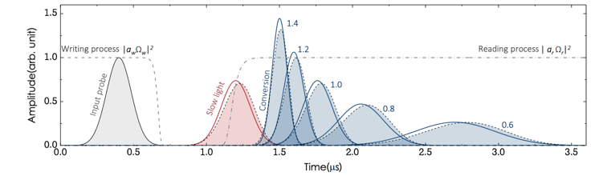
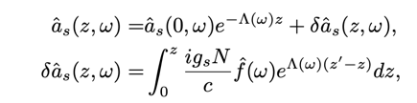


Shaping Technique
Detection Module 1
crystals
Optical Depth = 700
$$Ω_{w}=7 Γ$$
$$Ω_{r}=20 Γ$$
Detection Module 2
Detection Module 3
1. Pin-Ju Tsai, Yan-Cheng Wei, Bo-Han Wu, Sheng-Xiang Lin, and Ying-Cheng Chen
Phys. Rev. A 100, 063843 (2019)
Time ($μs$)

Slide 45
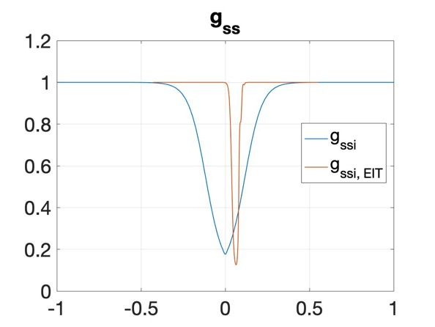

Shaping Technique
Detection Module 1
crystals
Optical Depth = 700
$$Ω_{w}=7 Γ$$
$$Ω_{r}=20 Γ$$
Detection Module 2
Detection Module 3
1. Pin-Ju Tsai, Yan-Cheng Wei, Bo-Han Wu, Sheng-Xiang Lin, and Ying-Cheng Chen
Phys. Rev. A 100, 063843 (2019)
Time ($μs$)

Slide 46

Shaping Technique
Detection Module 1
crystals
Optical Depth = 700
$$Ω_{w}=7 Γ$$
$$Ω_{r}=20 Γ$$
Detection Module 2
Detection Module 3
1. Pin-Ju Tsai, Yan-Cheng Wei, Bo-Han Wu, Sheng-Xiang Lin, and Ying-Cheng Chen
Phys. Rev. A 100, 063843 (2019)
Time ($μs$)

Slide 47
Results – Single photon generation, detection

Slide 48
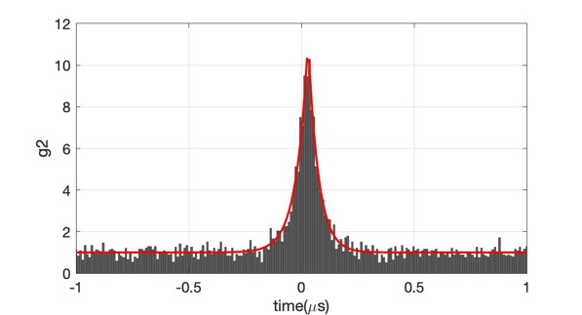
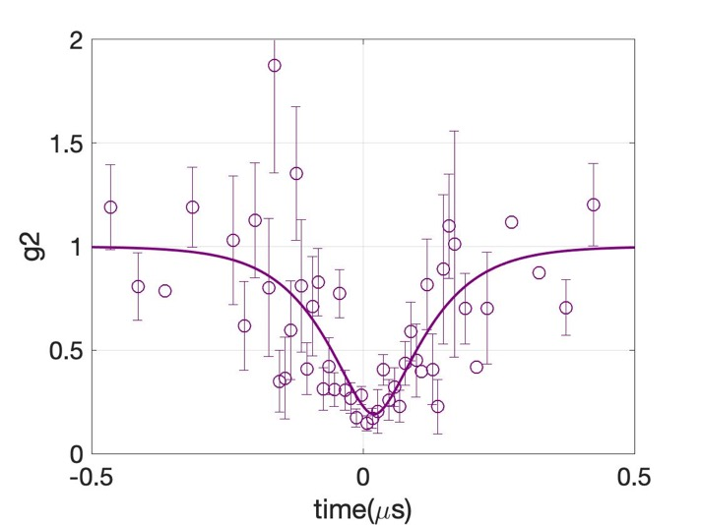
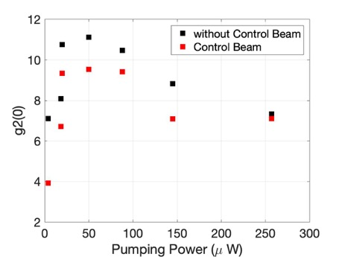
Measured in QM lab
Measured Right After SPDC cavity

Slide 49
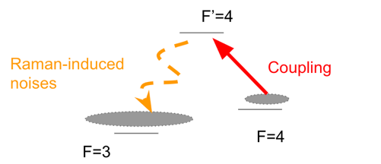
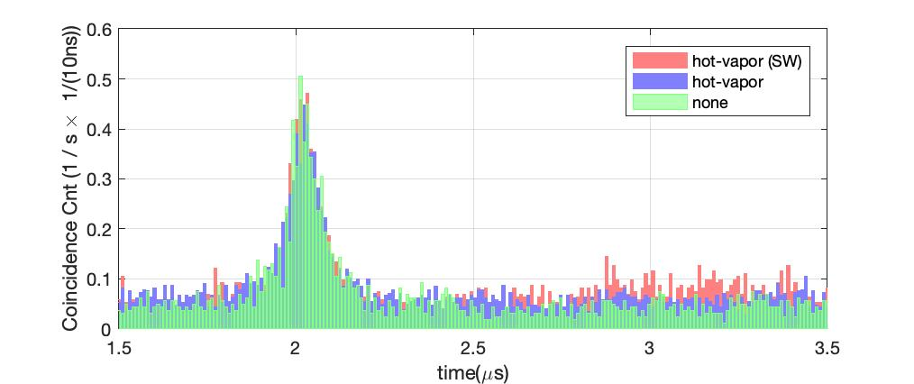
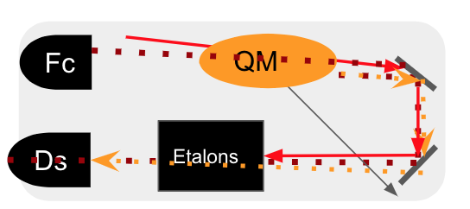
Raman-induced noises

Slide 50
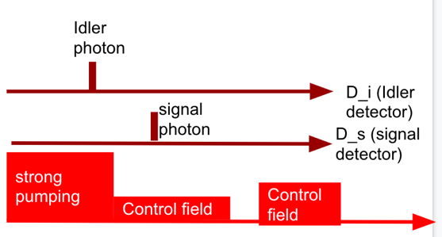
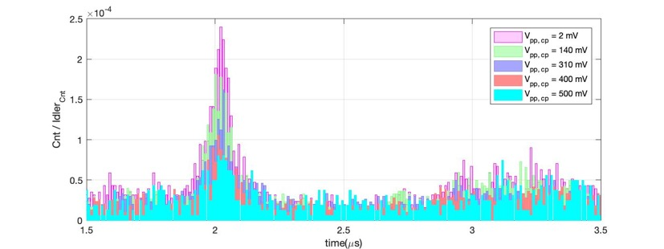
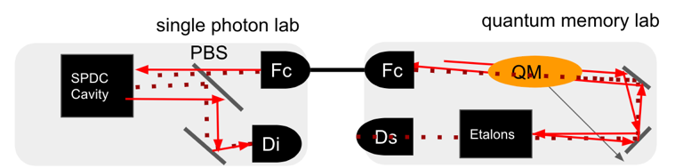
Retro-reflected pumping photons - false trigger by idler photon counter

Slide 51
Results – Quantum Storage

Slide 52
Using Heralded Idler Photon as QM’s control
Single Photon Lab
Optical Switch
Control
PBS
crystals
Probe
oscilloscope
Idler
Detector
Quantum Memory Lab
Function Generator
Detector
Coupling (R)
Coupling (W)
Storage
2 mus
Burst
Signal
Idler
Electronic Signal

Slide 53
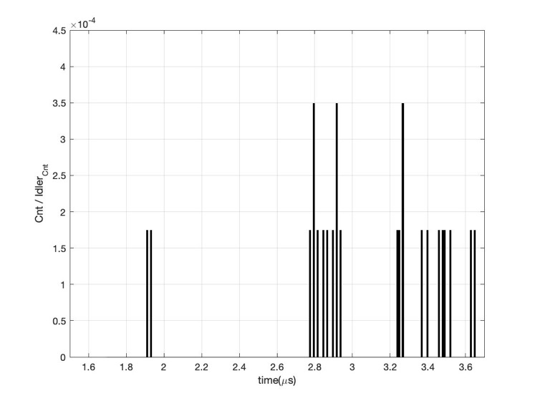

Slide 54
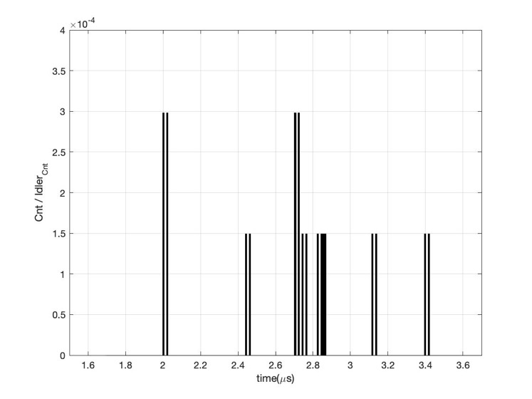

Slide 55
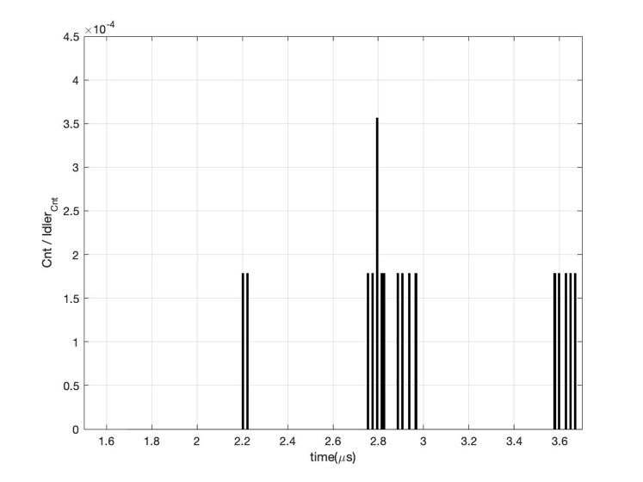

Slide 56


Slide 57


Quantum Storage
Storage
Input Single
Photon
Retrieval Single Photon
Graph Ref : https://www.conceptdraw.com/examples/diagram-of-a-stop-watch

Slide 58




Shaping single photon waveform
Control field
retrieval
Store
Time
$$\frac{Ω_{read}^{2}}{Ω_{write}^{2}}=14$$
$$\frac{Ω_{read}^{2}}{Ω_{write}^{2}}=7.5$$
$$\frac{Ω_{read}^{2}}{Ω_{write}^{2}}=1.5$$
Without shaping
Input Field

Slide 59




$g_{input}^{\left(2\right)}$ Range
$$g_{si, after storage }^{\left(2\right)}(t=t_{retrieval})$$
Classical Regime

Slide 60



$g_{input}^{\left(2\right)}$ Range
$$g_{si, after storage }^{\left(2\right)}(t=t_{retrieval})$$
Classical Regime
$$\frac{g^{\left(2\right)}{\left(t_{retrieval}\right)}_{After Storage}}{g^{\left(2\right)}{\left(t_{input}\right)}_{input}}≈0.17$$
Free from N-type photon switch
SE remains constant, g2 keeps rising
$$\frac{g^{\left(2\right)}{\left(t_{retrieval}\right)}_{After Storage}}{g^{\left(2\right)}{\left(t_{input}\right)}_{input}}≈1$$
Ref. [1]
Pin-Ju Tsai, Ya-Fen Hsiao, and Ying-Cheng Chen, Phys. Rev. Research 2, 033155

Slide 61


Longer times storage
$$τ$$
QM
QM
QM
Graph Ref : https://www.conceptdraw.com/examples/diagram-of-a-stop-watch

Slide 62

Longer times storage

Slide 63



$$SE_{fit}=SE_{max}e^{(−\frac{t^{2}}{τ^{2}})}$$
$$τ_{fit}=18 μs$$

Slide 64


Longer times storage
A figure of merit: Delay Bandwidth Product
DBP $≈126$
Previous work, DBP=457 [2]
(attenuated coherent light)
$≡Max \{t_{store}\}×$ Bandwidth
$$τ$$
QM
QM
QM
Lvovsky, A., Sanders, B. & Tittel, W. Optical quantum memory. Nature Photon 3, 706–714 (2009)
Y.-C. Wei, Y.-F. Hsiao, and Y.-C. Chen, Demonstration of high performance on broadband storage with Electromagnetically induced transparency based cold atom memory, arXiv:2003.00945 [physics.atom-ph].
Graph Ref : https://www.conceptdraw.com/examples/diagram-of-a-stop-watch
[Note]
1. Here, we define the maximum storage time
as when non-classical property decreases to half of its maximum value
2. DBP in classical light is defined by Storage efficiency.

Slide 65

Longer times storage
A figure of merit: Delay Bandwidth Product
DBP $≈126$
Previous work, DBP=457 [2]
(attenuated coherent light)
Issue:
  Raman noises
  Very long time average signal:
  systematic influence
    Classical light ~ 16 seconds
    Single photon ~ 1 week
  Sequential multiplexing (max: 60 $μs$)
$≡Max \{t_{store}\}×$ Bandwidth
$$τ$$
QM
QM
QM
Lvovsky, A., Sanders, B. & Tittel, W. Optical quantum memory. Nature Photon 3, 706–714 (2009)
Y.-C. Wei, Y.-F. Hsiao, and Y.-C. Chen, Demonstration of high performance on broadband storage with Electromagnetically induced transparency based cold atom memory, arXiv:2003.00945 [physics.atom-ph].
Graph Ref : https://www.conceptdraw.com/examples/diagram-of-a-stop-watch
[Note]
1. Here, we define the maximum storage time
as when non-classical property decreases to half of its maximum value
2. DBP in classical light is defined by Storage efficiency.

Slide 66


Comparison of quantum storage of heralded single photons generated by cavity-enhanced SPDC source
3
2
4
6
5
$$\frac{g^{\left(2\right)}{\left(t_{retrieval}\right)}_{After Storage}}{g^{\left(2\right)}{\left(t_{input}\right)}_{input}}≈1$$
1
7
K. Akiba, K. Kashiwagi, M. Arikawa, and M. Kozuma, New J. Phys. 11, 013049 (2009).
C. Clausen, I. Usmani, F. Bussières, N. Sangouard, M. Afzlius, and H. de Riedmatten, Nature (London) 469, 508 (2011).
H. Zhang, X.-M. Jin, J. Yang, H.-N. Dai, S.-J. Yang, T.-M. Zhao, J. Rui, Y. He, X. Jiang, F. Yang, G.-S. Pan, Z.-S. Yuan, Y. Deng, Z.-B. Chen, X.-H. Bao, S. Chen, B. Zhao, and J.-W. Pan, Nat. Photonics 5, 628 (2011).
D. Rieländer, K. Kutluer, P. M. Ledingham, M. Gündogan, ˘ J. Fekete, M. Mazzera, and H. de Riedmatten, Phys. Rev. Lett. 112, 040504 (2014).
A. Seri, G. Corrielli, D. Lago-Rivera, A. Lenhard, H. de Riedmatten, R. Osellame, and M. Mazzera, Optica 5, 934 (2018).
A. Seri, D. Lago-Rivera, A. Lenhard, G. Corrielli, R. Osellame, M. Mazzera, and H. de Riedmatten, Phys. Rev. Lett. 123, 080502 (2019).
Pin-Ju Tsai, Ya-Fen Hsiao, and Ying-Cheng Chen, Phys. Rev. Research 2, 033155 (2020)

Slide 67
Future Plan
Spatial Mode 1
Entanglement
Tomography
Measure Fidelity of the retrieval photon
Using Dual-rail Method
Spatial Mode 2
Quantum Memory

Slide 68



Conclusion
Experimental Design
  Narrowband single photon source
  Ultrahigh optical depth cold atomic system to reach high storage efficiency
EIT-based Quantum Memory
  Preserve non classical property, $g_{si, after storage}^{\left(2\right)}\left(t=t_{retrieval}\right)≈g_{si, input}^{\left(2\right)}\left(t=t_{idler}\right)$
  Demonstrate high storage efficiency (70 %), Delay-Bandwidth product = 126
Input Single Photon
Storage
Retrieval Single Photon
Graph Ref : https://www.conceptdraw.com/examples/diagram-of-a-stop-watch

Slide 69

Acknowledgement

Slide 70
Thank you for listening

