Slide 1
Efficient Generation of sub-MHz bi-photons by Controlled Quantum Interference using cold atomic ensembles
Ravikumar Chinnarasu
Department of Physics,
National Tsing Hua University.
08/27/2020
Young Quantum Information Researchers Forum 2020

Slide 2
Outline
Motivation
Narrow band Entangled Photons
Entangled Photons generation in Cold atomic ensemble
Efficient bi-photon Generation by Quantum interference
Conclusion

Slide 3
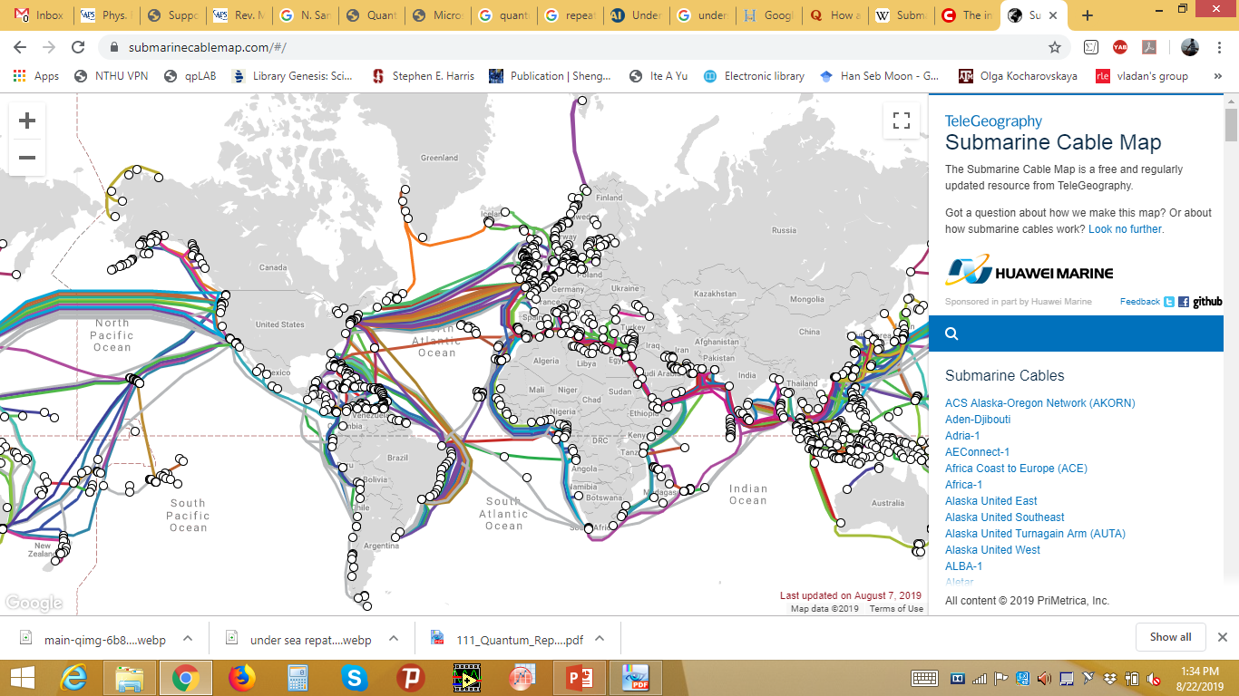
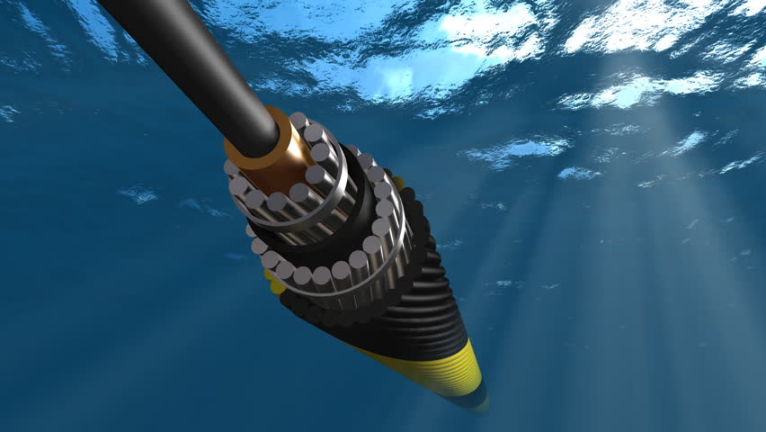
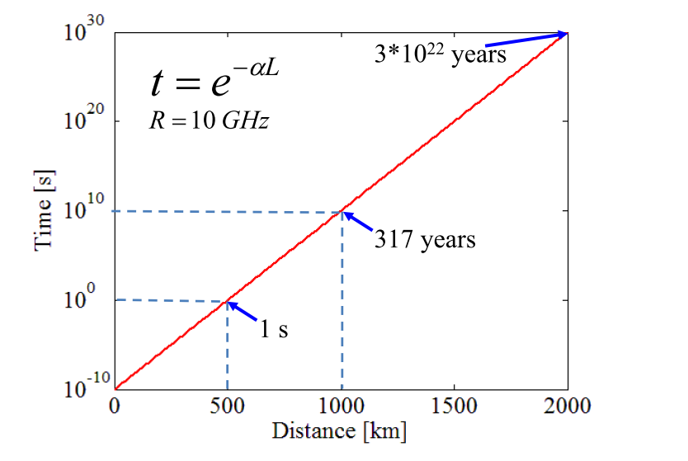
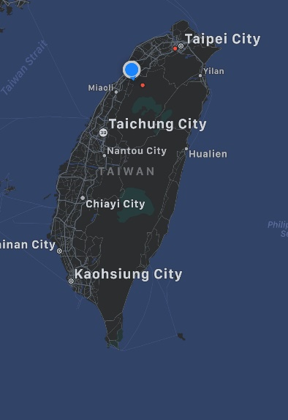
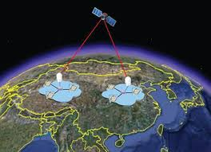
Motivation
Submaraincablemaps.com
Havanalive.com

Slide 4
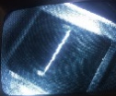

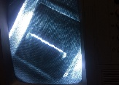
Motivation
Long distance Quantum Communication
BSM
BSM
Alice
Bob
BSM
Alice
Bob
Alice
Bob
Quantum memory
Detectors
Entangled photon-source

Slide 5
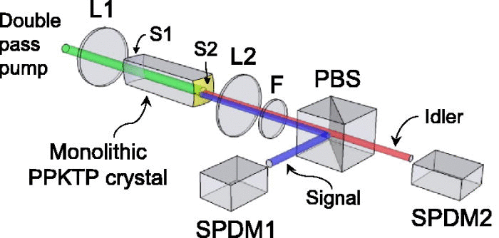







Entangled Photon generation (SPDC)
Non-linearity
SPDC
$$χ(2)$$
$\vec{P}=ϵ0χ\vec{E}+ϵ0χ(2)\vec{E\vec{E}}$ $+ϵ0χ(3)\vec{E}$ $\vec{E}\vec{E}$ $+ ……….$
Momentum
conservation
In SPDC
process
Band-width usually in the order of ~ THz
Energy
conservation
$$\vec{kp}$$
$$\vec{ks}$$
$$\vec{ki}$$
$ω$_{s}
$ω$_{p}
$ω$_{i}
4.5 MHz
C.-H. Wu, T.-Y. Wu, Y.-C. Yeh, P.-H. Liu, C.-H. Chang, C.-K. Liu, T. Cheng, and C.-S. Chuu, Phys. Rev. A 96, 023811 (2017).

Slide 6
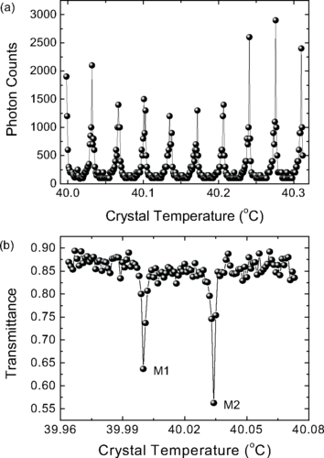
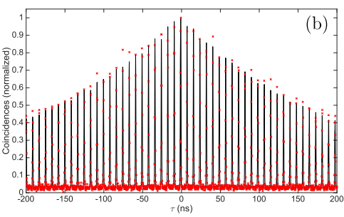
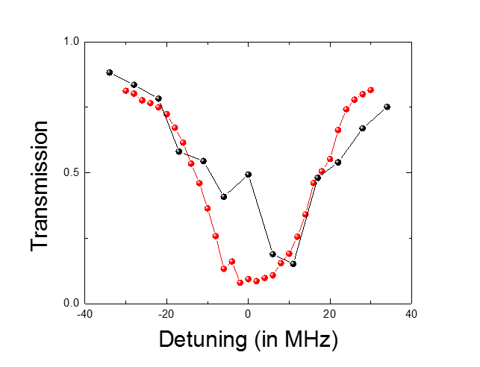
Cavity SPDC(Narrow band entangled photons)
Group | SPDC | Bandwidth
Chuu et al, | Monolithic - PPKTP | 4.5 MHz
Rambach et al. , | Cavity-PPKTP | 666 KHz
C.-H. Wu, T.-Y. Wu, Y.-C. Yeh, P.-H. Liu, C.-H. Chang, C.-K. Liu, T. Cheng, and C.-S. Chuu, Phys. Rev. A 96, 023811 (2017).
Single photon
Absorption
Markus Rambach et al. ,
APL Photonics 1, 096101 (2016)

Slide 7
Why cold atomic ensembles ?
Sub-natural
Tunable
Line-width
Resonant,
Exact,
Tunable,
Single mode
Frequencies
Arbitrary shaping,
Shaping by modulating
Input fields,
Shaping

Slide 8
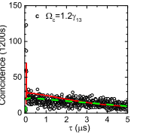
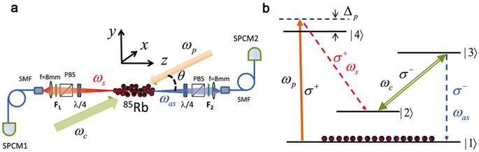
SFWM in cold atoms
0.38 MHz
Z. Han, P. Qian, L. Zhou, J. F. Chen, and W. Zhang, Sci.Rep.5,9126 9 (2015).
Drawbacks
Requires optical depth of 100 and even higher
Not scalable
Suffers with Duty
cycle
Requires Larger Optical
Depths
What can we do?

Slide 9
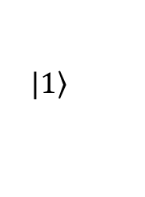

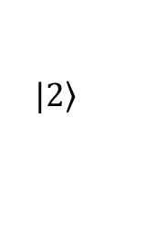


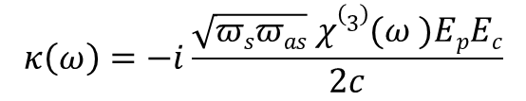
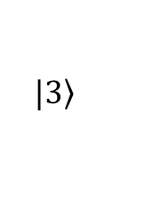

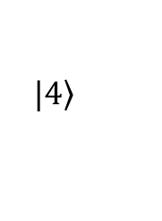
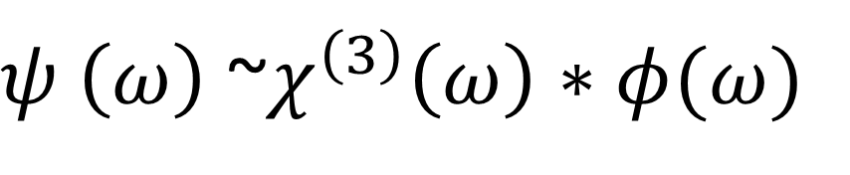


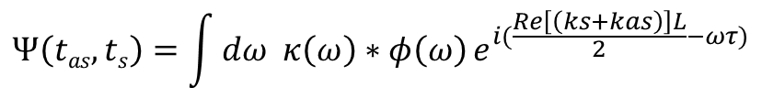
Spontaneous Four wave mixing
$$Ψ\left(tas, ts\right)=\int{dω κ\left(ω\right)∗φ\left(ω\right)}e^{i(\frac{Re\left[\left(ks+kas\right)\right]L}{2}−ωτ)}$$
$$κ\left(ω\right)=−i\frac{\sqrt{πsπas} χ(3)(ω )EpEc}{2c}$$
$φ\left(ω\right)=Sinc(\frac{ΔkL}{2}$)$e^{−Im[\left(ks+kas\right)L/2}$
Rabi oscillation regime (Third order
nonlinear susceptibility
Dominating )
Biphoton generation
$$Δωp$$
$$|\left.4\right\rangle$$
Group delay regime
(Phase matching controlled )
$$|\left.3\right\rangle$$
$$ωp$$
$$ωs$$
$ω$_{c}
$ω$_{as}
$ψ \left(ω\right)$ ~$χ^{\left(3\right)}\left(ω\right)∗φ(ω)$
$$|\left.2\right\rangle$$
$$|\left.1\right\rangle$$

Slide 10
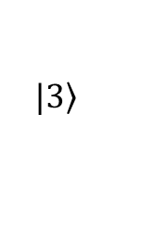




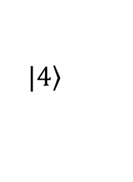






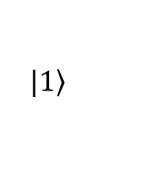

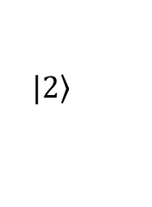


Spectral characteristics – Resonant case
$$|\left.4\right\rangle$$
$$Δωp$$
$$δ+$$
$$|\left.3\right\rangle$$
$$Ωc$$
$Ωc>γ$_{e}
$$δ−$$
$$ωp$$
$$ωs$$
$ω$_{as}
$$|\left.2\right\rangle$$
$$Ωc$$
$$δ+$$
$$δ−$$
$$γ±=\frac{(γ\text{13}+γ\text{12}\text{)}}{2}$$
$$|\left.1\right\rangle$$
$$χ\left(3\right)\left(ω\right)=\frac{−2π Nμ13μ32μ24μ41}{ε0h 4(Δp+iγ13)(ω−\frac{Ωe}{2}+iγe)(ω+\frac{Ωe}{2}+iγe)}$$
$$G\left(τ\right)\sim e^{−2γeτ} (1−Cos(Ωe τ))$$

Slide 11
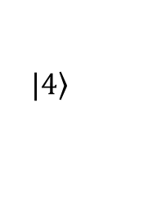





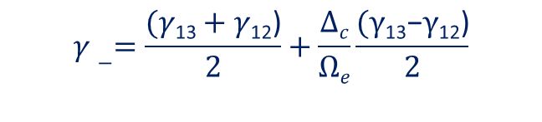
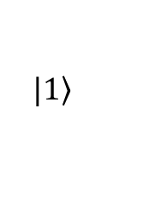

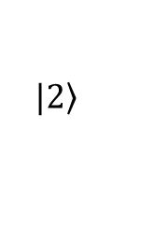


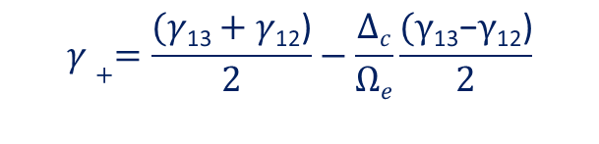
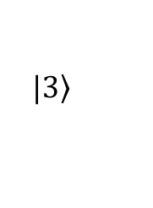



Spectral characteristics – Non resonant case
$$|\left.4\right\rangle$$
$$γ−=\frac{(γ\text{13}+γ\text{12}\text{)}}{2}+\frac{Δc}{Ωe}\frac{(γ\text{13}\text{−}γ\text{12}\text{)}}{2}$$
$$Δωp$$
$$δ+$$
$$|\left.3\right\rangle$$
$$Δωc$$
$$δ±=\frac{Δc± Ωe }{2}$$
$$Ωe$$
$$δ−$$
$$ωp$$
$$ωs$$
$ω$_{as}
$$δ+$$
$$|\left.2\right\rangle$$
$$Δωc$$
$$δ−$$
$$γ+=\frac{(γ\text{13}+γ\text{12}\text{)}}{2}−\frac{Δc}{Ωe}\frac{(γ\text{13}\text{−}γ\text{12}\text{)}}{2}$$
$$|\left.1\right\rangle$$
$$G\left(τ\right)\sim e^{−2(γ_{+})τ}+e^{−2(γ_{−})τ}−{2e}^{−2(γ_{+}+γ_{−})τ}Cos(Ωe τ))$$

Slide 12

FWM resonance & linewidth – Non resonant case
$$γ\text{12}$$

Slide 13
Key idea –Spectral selection
Can control the quantum interference

Slide 14
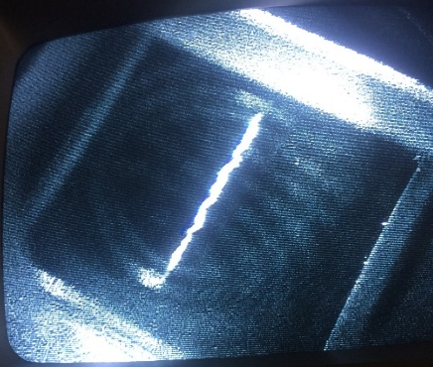
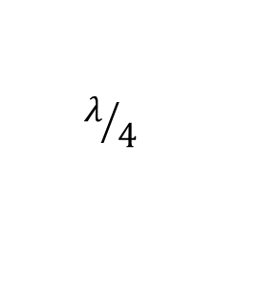
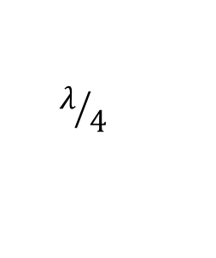
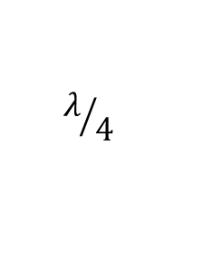
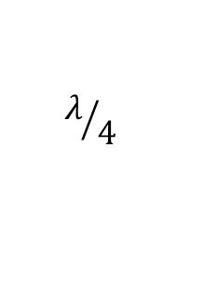
Schematic experimental set up
OD=5
PBS
$$λ/4$$
Pump
$$λ/4$$
$$λ/4$$
PBS
F2
F1
PBS
M1
⁸⁷Rb
Stokes
M2
Anti-Stokes
$$λ/4$$
Etalon
Coupling
PBS
Etalon
MMF
MMF
Coincidence counter
SPCM
SPCM

Slide 15





Controlled Quantum Interference
OD=5,$Ω\text{c}\text{=14.8 }\text{γ}\text{13}$
$$Δc=0$$
$$Δc=16.7\text{γ}\text{13}$$
$$Δc=28.37\text{γ}\text{13}$$
$$Δc=\text{45 }\text{γ}\text{13}$$
R. Chinnarasu, C.-Y. Liu, Y.-F. Ding, C.-Y. Lee, T.-H. Hsieh, I. A. Yu, and C.-S. Chuu, Phys. Rev. A 101, 063837 (2020).

Slide 16
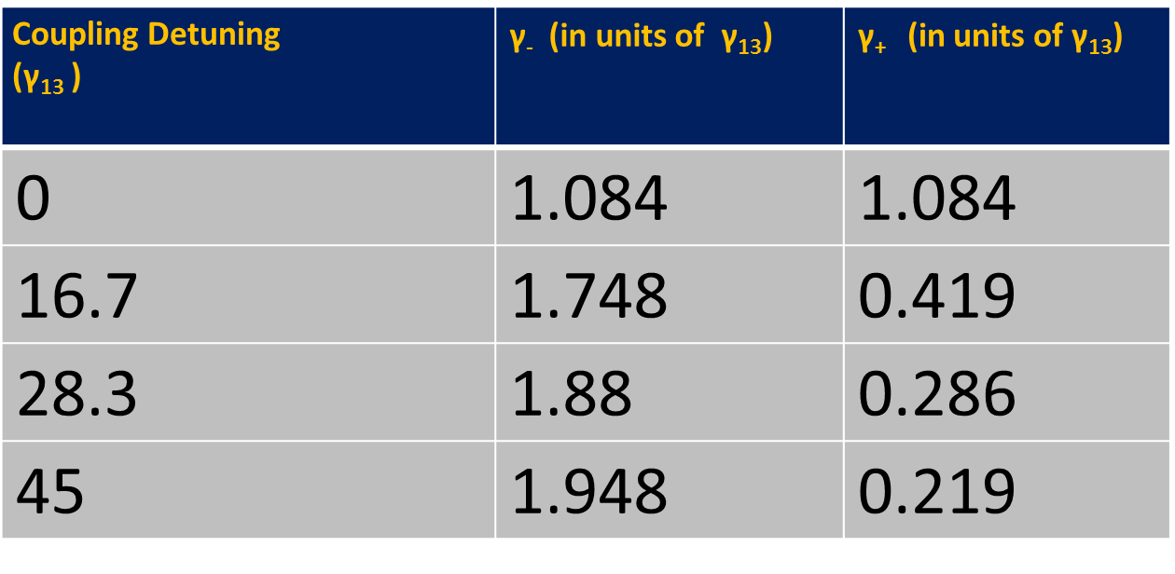
Linewidths of Measured spectrum
Coupling Detuning (${\text{γ}\text{13}}_{ }$) | γ₋ (in units of γ₁₃) | γ₊ (in units of γ₁₃)
0 | 1.084 | 1.084
16.7 | 1.748 | 0.419
28.3 | 1.88 | 0.286
45 | 1.948 | 0.219

Slide 17
Schematic experimental set up
15 MHz ,
22.9 GHz
Pump
Anti-Stokes
Stokes
Etalon
Coupling
Etalon
Bandwidth 500 MHz ,
FSR 13.9 GHz
Coincidence counter
SPCM
SPCM

Slide 18
Results – Sub-MHz biphotons
R. Chinnarasu, C.-Y. Liu, Y.-F. Ding, C.-Y. Lee, T.-H. Hsieh, I. A. Yu, and C.-S. Chuu, Phys. Rev. A 101, 063837 (2020).

Slide 19
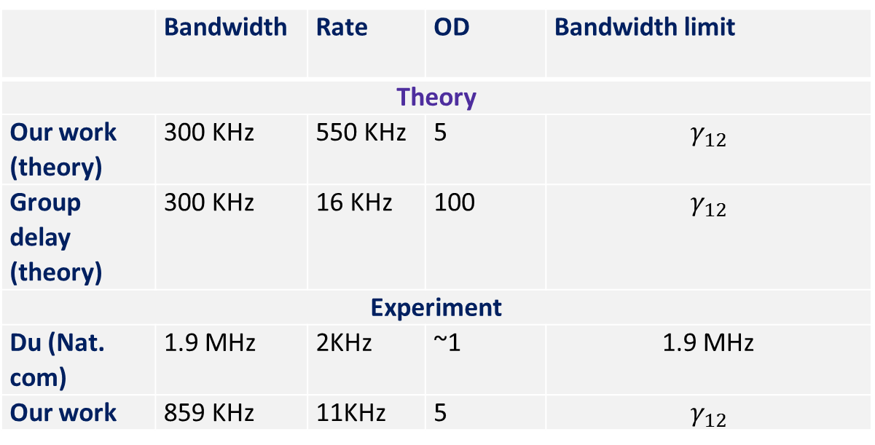
Results – Sub-MHz biphotons
Single mode sub-MHz biphoton
859 KHz
 | Bandwidth | Rate | OD | Bandwidth limit
Theory
Our work (theory) | 300 KHz | 550 KHz | 5 | $$γ_{12}$$
Group delay (theory) | 300 KHz | 16 KHz | 100 | $$γ_{12}$$
Experiment
Du (Nat. com) | 1.9 MHz | 2KHz | ~1 | 1.9 MHz
Our work | 859 KHz | 11KHz | 5 | $$γ_{12}$$

Slide 20
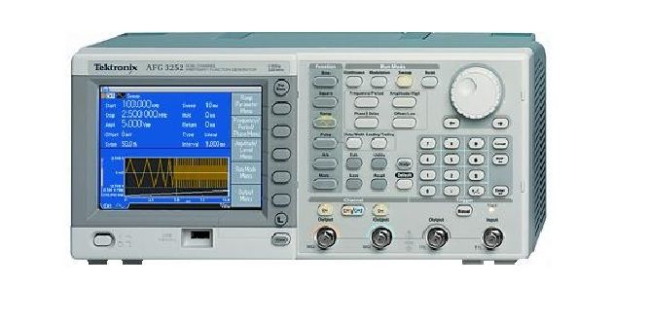

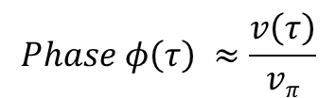


Applications (Electro-Optical-Modulation)
$$G\left(2\right)(τ)=m(τ)G\left(2\right)(τ)$$
$$m\left(τ\right)=Sin\left(φ\left(τ\right)\right)eiαφ τ$$
$$Phase φ\left(τ\right) ≈\frac{v\left(τ\right)}{vπ}$$
⁸⁷Rb
Stokes
Anti-Stokes
Etalon
Coupling
Etalon
MMF
Coincidence counter
SPCM
SPCM

Slide 21
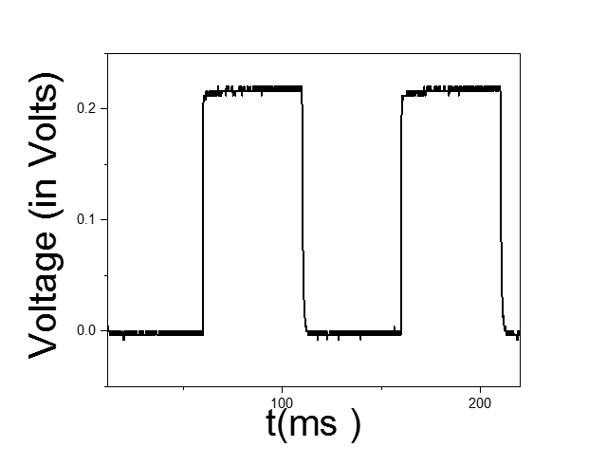
Arbitrary shaping with low OD ensembles
100 ns square
pulses with 50%
Duty cycle
Arbitrary shaping can be possible.
For Efficient light-matter interaction and
Efficient storage

Slide 22
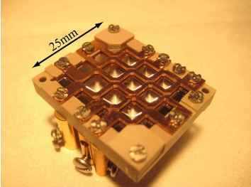
Miniaturization may possible
https://doi.org/10.1364/OE.17.014109
Our method can be used to generate sub-MHZ linewidth biphotons with Miniaturized MOT systems where the low optical depths preferred.

Slide 23
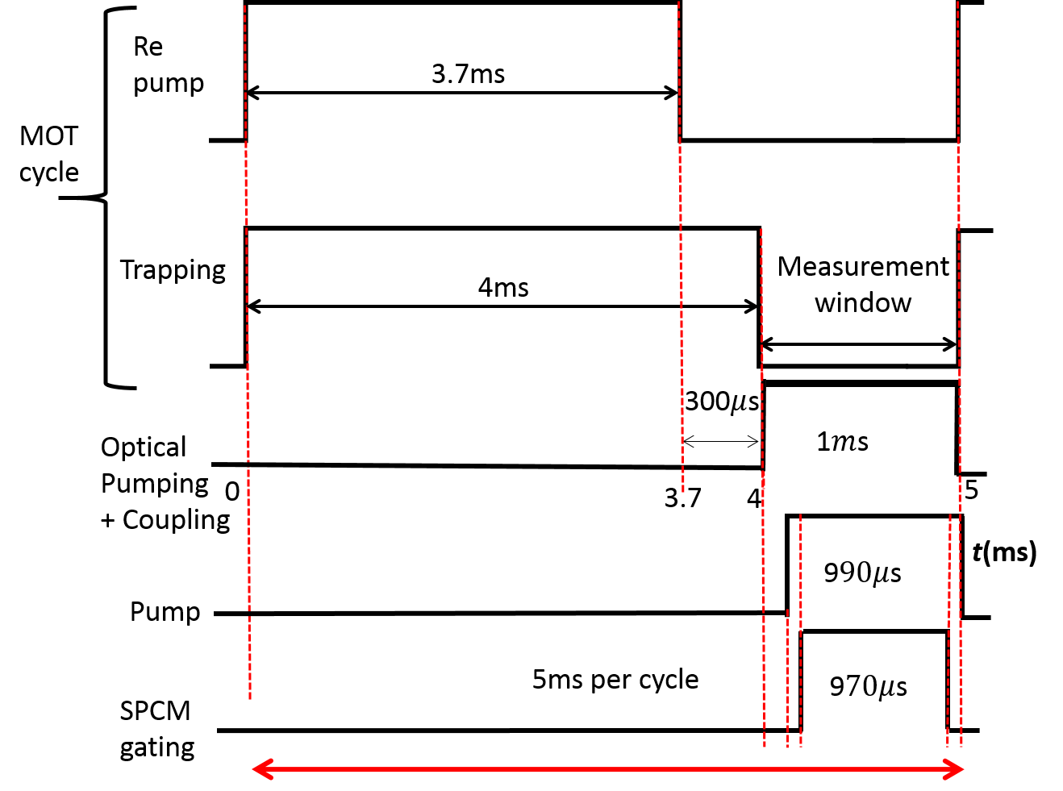
Comment on Duty cycle
Due to the ineffective nature of Optical depths on temporal length, we can operate the duty cycle ~20%, it is possible to increase even further.

Slide 24
Conclusions
We have shown a way to generate ultra narrow band biphotons (in kHz order ) in the low OD atomic ensembles by controlling the quantum interference.
We have demonstrated arbitrary shaping of biphotons in the low depths.
Also our method can be used to generate pulsed biphoton as without using any kind of modulators.
Using our method it’s possible to generate temporally long biphotons with polarization entanglement in simple set up.

Slide 25
Thanks for your kind attention
Q&A

