Slide 1
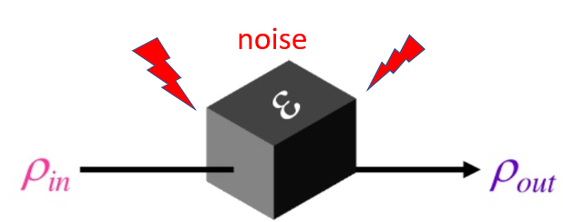
Methods for characterizing quantum gate fidelity
I-Chun Hsu¹ and Hsi-Sheng Goan^{1,2}
¹Department of Physics and Center for Theoretical Physics
National Taiwan University
²Center for Quantum Science and Engineering,
National Taiwan University
What happened inside?
Young Researchers Forum On Quantum Information Science. August 26-28 2020
Notes:
Recently with more and more qubits becoming
available and functional, characterizing the errors on qubit operations
become an urgent issue. Because more qubits and larger circuit length will amplify the noise,
This noise will make our final results unreliable.
To evaluate the error of quantum gates and characterize the noise are necessarily
So that we can identify where the noise occurs and correct them.

Slide 2
Outline
Introduction
Methods to extract noise
Experiment implementation
Simulation result
Outlook and summary
Notes:
At the beginning we will identify where the noise come from
and the following we show nowadays the mainstream methods that we characterize the noise
Next we introduce three the most used methods to characterize noise
And explain its procedure
And next is its the central idea
And the following is silicon qubits RB experiments which was demonstrated by university of New South Wales
Also we present our simulation
Finally we make a conclusion and the further direction

Slide 3
Introduction
We care about
Shin Nishio, Overview of Qiskit Ignis
Notes:
Quantum device have error
If the error is large, we cannot get reliable result
However, for small enough error such as under threshold , we can correct the noise by quantum foult tolerance
So it is important to evaluate the noise
as the picture shown, a quantum circuit is composed of three part
first Input state preparation ,
Second gate operation ,
the final is measurements
Each part have different errors
We only care about the gate operation error

Slide 4
Steve Flammia. QIP Tutorial,14 January 2017
Notes:
many methods are shown at this picture
While the left hand side is simpler, the trade off is less information on noise
The left endpoints, we see the randomized benchmarking is here
At the right endpoints, is full tomography also called quantum process tomography
The two methods are dia’metrically opposed
So we take the two as quintessence of methods to characterize noise

Slide 5
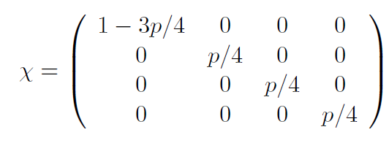
Quantum Process Tomography(QPT)
Goal: find χ-matrix
The χ-matrix completely determines the noise Є
noise
χ is a d² × d² complex-valued matrix, d = 2^{n}
n: the number of qubit
Example: single qubit depolarizing noise
$⊗$n
1) Size of χ grow exponentially ~O(16^{n})
2) exponential resource requirement ~O(16^{n})
n: the number of qubit
Andreas Dewes, UPMC / CEA, 15/11/2011
Notes:
Quantum Process Tomography is a technique used to reconstruct an unknown quantum process which contains noise information
and to test the process of a quantum simulation
(see the black box)
The idea behind Quantum Process Tomography is to determine the completely positive map E, which represents the process acting on an arbitrary input state
(see the equation)
Our goal is to find the ket matrix once we know the ket matrix , we can understand what the black box inside is
For example, single qubit depolarizing channel a kind of noise channel
However, to reconstruct this ket matrix , it requires exponentially resources
For example, the ket mat have exponentially growing elements sixteen to power of n
Second the resources such as measurements and preparation of input states are also sixteen to power of n

Slide 6
Randomized benchmarking(RB) vs Quantum Process Tomography(QPT)
 | Error source | Resource requirement: Input state preparation | Parameter to estimate
Randomized benchmarking | Separate gate error and state preparation and measurement error | Single type of input state | Single parameter
Quantum process tomography | χ-matrix from quantum process tomography mix the noise | 4^{n} types of input state | χ-matrix with 16^{n} elements
n: the number of qubit
Notes:
Four to the power of n
Sixteen to the power of n

Slide 7
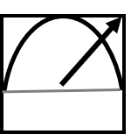
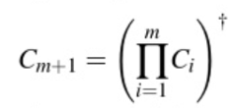
Randomized benchmarking procedure
$$ρ$$
$$C_{1}$$
$$C_{2}$$
$$C_{3}$$
$$…$$
$$C_{m}$$
$$C_{−1}$$
Prepare initial state ρ
Randomly choose m gates from Clifford group
Compute C₋₁ gate from Clifford group that satisfies
Repeatedly execute for the sequence, choose different sequences in length m and vary length m
fit
where A,B absorb state preparation and measurement error
p is related to gate error
C₋₁
Probability of recovery $=A{ p}^{m}+B$
Notes:
Randomized benchmarking (RB) is a technique for evaluating the performance of a quantum hardware which simplifies the error channel of a quantum process such that one can extract the average error per gate of a particular gate-set on this hardware.
This measure is for each gate when it is run as part of a long random computation, a relevant metric for most quantum algorithms that rely on this type of computation.
In its standard form, it relies on the gate-set having a particular distribution, and on being able to efficiently invert a string of gates from the gate-set with one single operator.
A general randomized benchmarking protocol will consist of variants of the following steps:
(1) preparing an initial state ρ_{ψ} = |ψψ| on a quantum device,
2) Randomly choose m gates from Clifford group
(3) Find the c inverse gate such that the system should return to this initial state, in other word it means whole sequence should be identity
4)running very many random sequences of gates of varying lengths m
(5) measuring the recovery probability, and lastly, plotting and fitting the results to a pre-determined decay model that characterizes the average error rate of the gates.

Slide 8
Noise assumptions
Time independent noise
Gate independent noise
Markovian noise
Notes:
In order for the above protocol to really quantify the average error-rate of a gate-set,,
we need to make a number of simplifying assumptions on the type of noise the device has:
the errors should be
gate-independent and
(ii) time-independent,
(iii) the error-channel should be trace-preserving and memoryless

Slide 9
Time independent noise
$$ρ$$
$$C_{1}$$
Λ₁
$$C_{2}$$
Λ₂
$$C_{3}$$
Λ₃
$$…$$
$$C_{m}$$
Λ_{m}
$C_{i}$ideal gate
$Λ_{i}$ noise
Noises followed by the same gates will not change at different orders or at different gate operation time
For example:
If C₁ =C₃ =X-gate then Λ₁ = Λ₃
Notes:
U can see for ideal sequence is here
But once noise occurs, it become this
The noise process should not drift by the course of the experiment
or the reported answer will also be an average over this dependence

Slide 10
Gate independent noise
$U_{i}$ideal gate
$$U_{1}$$
Λ₁
$Λ_{i}$ noise
$$U_{2}$$
Λ₂
$$U_{3}$$
Λ₃
.
.
.
Noises with different gates are all the same
Λ₁ = Λ₂ = Λ₃ …..
$$U_{m}$$
Λ_{m}
Notes:
The noise incurred by each gate cannot depend on
which gate we performed.

Slide 11
Markovian noise
If the noise is Markovian, we can treat noise as completely positive and trace preserving map
Ángel Rivas et al. Rep. Prog. Phys. 77, 094001 (2014)
Notes:
For classical markovian noise, there are three properties:
Normalization, for quantum is trace-preserving
Positivity

Slide 12
Randomized benchmarking(RB) vs Quantum Process Tomography(QPT)
First central idea
 | Error source | Resource requirement: Input state preparation | Resource requirement: Parameter to estimate
Randomized benchmarking | Separate gate error and state preparation and measurement error | one type of input state | One parameter
Quantum Process Tomography | χ-matrix from Quantum Process Tomography contains every noise source | 4^{n} types of input state | χ-matrix with 16^{n} elements
n: the number of qubit
Notes:
Why randomized benchmarking can separate gate error and state preparation and measurement error

Slide 13
First central idea of randomized benchmarking
Separate gate error and state preparation and measurement error(SPAM)
equal to
=
$$ρ$$
$$C_{1}$$
$$C_{2}$$
$$C_{3}$$
$$…$$
$$C_{m}$$
$$C_{−1}$$
$$ρ$$
$$\text{I}$$
I : identity
ideal
noisy
~
$$ρ$$
$$\tilde{ρ}$$
$$C_{1}$$
Λ₁
$$C_{2}$$
Λ₂
$$C_{3}$$
Λ₃
$$…$$
$$C_{m}$$
Λ_{m}
$$C_{−1}$$
SPAM error
SPAM error
$$C_{i}$$
Ideal gate
Λ_{i}
Gate error
$$C_{−1}$$
Inverse gate satisfying C₁C₂…C_{m}C₋₁=I , I : identity
Notes:
Let see the ideal gate operation , randomized benchmarking sequences is shown
If ideal, gate sequence is equal to identity which remain the input state unchanged, that means the recovery probability always equal to one
However, if with noise, such as state preparation and measurement error and gate error,
The randomized benchmarking sequences will become like that
The situation change
First the input state change
For example we prepare ground state, but with noise, it become excited state
Second, the gate error lambda one is followed by the ideal gate c one
Measurement become unreliable
With these noise, the recovery probability would decay , because it cannot recover to input state

Slide 14
~
$$\tilde{ρ}$$
$$C_{1}$$
Λ₁
$$C_{−1}$$
data
fitting
SPAM error
SPAM error
~
$$\tilde{ρ}$$
$$C_{1}$$
Λ₁
…
$$C_{−1}$$
Recovery probability
SPAM error
SPAM error
~
$$\tilde{ρ}$$
$$C_{1}$$
Λ₁
…
$$C_{i}$$
Λ_{i}
…
$$C_{−1}$$
SPAM error
SPAM error
1
i
j
….
gate length
Notes:
This is randomized benchmarking fitting picture
the y axis is recovery probability
The x axis is gate length
Randomized benchmarking sequence varies sequence length and each data contains fixed state preparation and measurement error
That only thing change is gate length and its gate error
for example, as u see when gate length equal to one, it contains c one gate and its inverse gate
When the gate length increases to I , j , its gate error increase, however state preparation and measurement error do not
Because state preparation and measurement error are independent of the length of a sequence, That why Randomized benchmarking can separate gate error and state preparation and measurement error

Slide 15
Randomized benchmarking(RB) vs Quantum Process Tomography(QPT)
Second central idea
 | Error source | Resource requirement: Input state preparation | Resource requirement: Parameter to estimate
Randomized benchmarking | Separate gate error and state preparation and measurement error | one type of input state | One parameter
Quantum Process Tomography | χ-matrix from Quantum Process Tomography contains every noise source | 4^{n} types of input state | χ-matrix with 16^{n} elements
n: the number of qubit

Slide 16
Second central idea of randomized benchmarking
What?
Why?
Randomly sampling:
randomized benchmarking use a specific gate set which is reliable and efficient to represent the whole unitary gate

Slide 17
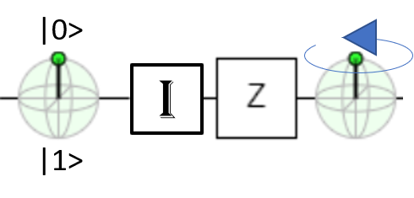
Average error
average error over pure states
Ideal gate
$$\text{I}$$
$$z$$
|0> |0>
$$\text{I}$$
Different input states have different responses to noise
|0>
|+> |->
$$\text{I}$$
$$z$$
|1>
noise
Notes:
Let consider Average gate error : when we apply a gate, there are many possible input states,
some may be robust against the gate error , some may be not. So we should consider all the pure state as input and average over them
For example
Input is zero state, and ideal gate is identity the noise is z gate
As u can see after this sequence zero state remain unchanged
However, plus state will become mius state
|0> state is robust against the z noise
|+> state is NOT

Slide 18
Unitary 2-design
But! Constructing an arbitrary unitary
is difficult ~O(n²4^{n}) gates
A discrete set U_{k} satisfying this property is called a unitary 2-design
Olivia Di Matteo, CS 867/QIC 890,
Yoshifumi Nakata Phys. Rev. X 7, 021006
Notes:
However, Choosing a random unitary over the integral is very difficult - an n-qubit quantum circuit
engineered to perform this task would need n square multiply four to the power of n 1- and 2-qubit gates [8]. So far is just Simply choosing one unitary, not to mention integrating over all possible unitaries is an impossible task.
As picture show integral is related to whole red region
Instead, what if, in the some designs, we could just average over a representative set?
The solution is unitary 2-design
Its main idea is a set of unitary matrices that approximate the entire unitary group
Although randomized benchmarking only use one kind of input state, this randomly choose from this discrete set can transform input state into any unitary state
For example, even the input state is ground state, this representative set will take input state into any unitary state
As shown picture b
==============================

Slide 19
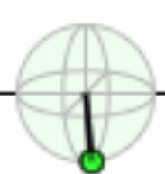
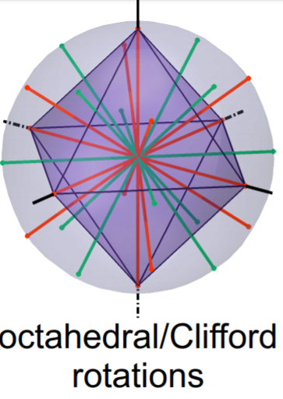
Clifford group
Clifford group is unitary 2-design
Concept: a set of unitary matrices(Clifford group) that approximate the entire unitary group
n=1, single qubit Clifford elements
J T Muhonen et al 2015 J. Phys.: Condens. Matter 27 154205
Notes:
Here is Clifford group definition
It map every Pauli element to Pauli elements
By some calculation, one can check that Clifford group is unitary 2-design
The gray sphere represent every unitary
, and the lines is the rotation axis of Clifford group
U can see the Clifford group distribution over the unitary group
And how it approximate the whole unitary group
=========================
Pictures is single qubit Clifford group elements
For example, label 3 is x-gate which rotates around x-axis

Slide 20
Randomized benchmarking(RB) vs Quantum Process Tomography(QPT)
Third central idea
 | Error source | Resource requirement: Input state preparation | Resource requirement: Parameter to estimate
Randomized benchmarking | Separate gate error and state preparation and measurement error | one type of input state | One parameter
Quantum Process Tomography | χ-matrix from Quantum Process Tomography contains every noise source | 4^{n} types of input state | χ-matrix with 16^{n} elements
n: the number of qubit

Slide 21
Third central idea of randomized benchmarking
How?
Randomized benchmarking sequence have some properties that map any noise channel into single parameter noise channel
What?

Slide 22
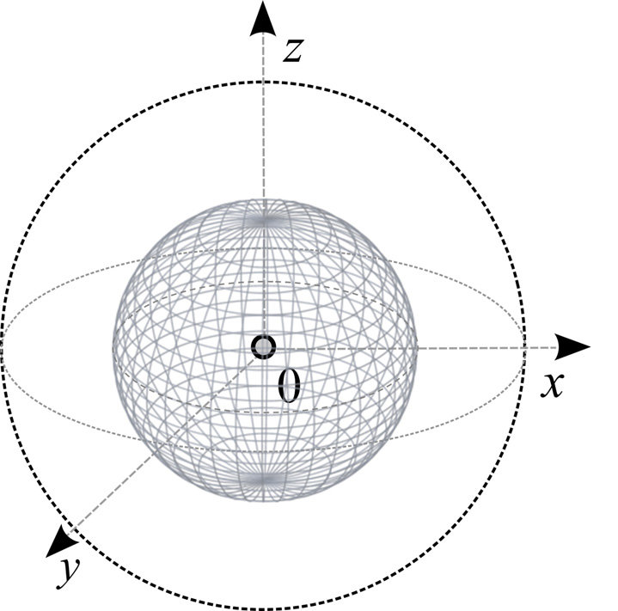
Depolarizing channel
$$Λ\left(ρ\right)=pρ+\left(1−p\right)\frac{\text{I} }{d}$$
I : identity
Pure state
d=2^{n}
n: the number of qubit
Maximally mixed state
i.e. For a single qubit at |0> , depolarization is
given by the quantum map
$$Λ_{dⅇp}\left(ρ\right)=pρ+\frac{1−p}{2}\text{I}$$
$=p\left[\begin{matrix}1 & 0 \\ 0 & 0\end{matrix}\right]+\frac{1−p}{2}\left[\begin{matrix}1 & 0 \\ 0 & 1\end{matrix}\right]$=$\left[\begin{matrix}p+\frac{1−p}{2} & 0 \\ 0 & \frac{1−p}{2}\end{matrix}\right]$
Mixed state
recovery probability
error probability
Depolarizing channel project every pure states
onto mixed states (green line)
In fact, average error rate is related to depolarizing parameter p
$p=1−\frac{d}{d−1}r r=\frac{(1−p)(d−1)}{d}$
Notes:
In fact, the single parameter channel is depolarizing channel.
A depolarizing channel is a simple quantum channel of the following form:
See the definition ,a input state goes to a completely mixed state
with probability 1-p,
and does nothing with probability p.
It describes a noise process
where information is completely lost with probability 1-p.
for example
Zero become zero
Zero become one
===========
So one can directly get average error that we define previously from p

Slide 23
Mapping noise into depolarizing channel
$$ρ$$
$$C_{1}$$
Λ
$$C_{2}$$
Λ
$$C_{3}$$
…
$$C_{m}$$
Λ
$$C_{−1}$$
$$C_{1}^{+}$$
$$C_{1}$$
$C_{i}$ideal gate
Λ noise
Notes:
Now, let me explain how randomized benchmarking sequence map noise into depolarizing channel
Without noise, randomized benchmarking sequence is like that
With input rho, operation gate and finally measurement
Now ,noise occurs, it become this
next we insert the c one gate and c one inverse
Their combination is identity, so the whole sequent remain the same

Slide 24
Mapping noise into depolarizing channel
$$ρ$$
$$C_{2}$$
Λ
$$C_{3}$$
…
$$C_{m}$$
Λ
$$C_{−1}$$
$$C_{1}$$
Λ
$$C_{1}^{+}$$
$$C_{1}$$
$$D_{1}≡C_{1}$$
Notes:
After inserting, it become this
Let change the notation c one to d one

Slide 25
Mapping noise into depolarizing channel
$$ρ$$
$$C_{2}$$
Λ
$$C_{3}$$
…
$$C_{m}$$
Λ
$$C_{−1}$$
$$D_{1}$$
Λ
$$D_{1}^{+}$$
$$C_{1}$$
$$D_{1}≡C_{1}$$
$$D_{2}≡C_{1}C_{2}$$
Notes:
The d one lambda d one inverse become a small union
Next change notation d two to c one combinate with c two

Slide 26
Mapping noise into depolarizing channel
…
$$C_{m}$$
Λ
$$C_{−1}$$
$$ρ$$
$$D_{1}$$
Λ
$$D_{1}^{+}$$
$$D_{2}$$
Λ
$$C_{3}$$
$$D_{2}≡C_{1}C_{2}$$
$$C_{2}^{+}$$
$$C_{1}^{+}$$
$$C_{1}$$
$$C_{2}$$
Notes:
Now re do the procedure
Insert c two inverse c one inverse c one and c two

Slide 27
Mapping noise into depolarizing channel
$$D_{2}^{+}$$
$$C_{1}$$
…
$$C_{m}$$
Λ
$$C_{−1}$$
$$ρ$$
$$D_{1}$$
Λ
$$D_{1}^{+}$$
$$D_{2}$$
Λ
$$C_{2}$$
$$C_{3}$$
Notes:
Now the new union d two lambda d two inverse occurs

Slide 28
Mapping noise into depolarizing channel
…
$$D_{m}$$
Λ
$$D_{m}^{+}$$
$$ρ$$
$$D_{1}$$
Λ
$$D_{1}^{+}$$
$$D_{2}$$
Λ
$$D_{2}^{+}$$
m
$$ρ$$
$$D_{i}$$
Λ
$$D_{i}^{+}$$
Notes:
One can re do the procedure again and again
u will see the whole sequence become this form
The small union to the power of m

Slide 29
Mapping noise into depolarizing channel
Randomly choose from different sequence
2-design
$$=\frac{1}{|C|}\sum_{j}{C_{j}ΛC_{j}^{+}}=\int{du UΛU}=\overline{Λ}=pρ+(1−p)\frac{\text{I} }{d}$$
$$D_{i}$$
Λ
$$D_{i}^{+}$$
I : identity
d=2^{n}, n: the number of qubits
Schur’s lemma
Depolarizing channel
$$p=1−\frac{d}{d−1}r$$
r: the average error
of the Clifford gates
$$ρ$$
$${\overline{Λ}}^{m}$$
=Ap^{m}+B
Notes:
Each small union in the product is a group average because we randomly choose from different sequence
We can write to this summation
And with 2-design and Schur lemma
It becomes depolarizing channel which have only one parameter p
Now the whole randomized benchmarking sequence become lambda channel to the power of m
By some calculation, u can get A p to the power of m plus B
So we can do the experiment, and fit this famular
Remember that p is related to r, so we can get average error from p

Slide 30
Interleaved RB
What if we want to know the noise of certain gate?
Notes:
Randomized benchmarking allow us to characterize the average error rate
But
The solution is called interleaved randomized benchmarking

Slide 31
m
$$ρ$$
$$C$$
$$C_{−1}$$
From standard RB , we can get average error of entire Clifford group from p
Probability of recovery $=Ap^{m}+B$
m
$$ρ$$
$$C$$
$$U$$
$$C_{−1}$$
Insert target gate,
$p_{u}$: target gate depolarizing parameter
Probability of recovery$=A{\left(pp_{u}\right)}^{m}+B$
Notes:
Interleaved randomized benchmarking is a little different from random benchmarking
It insert target gate into the sequence

Slide 32
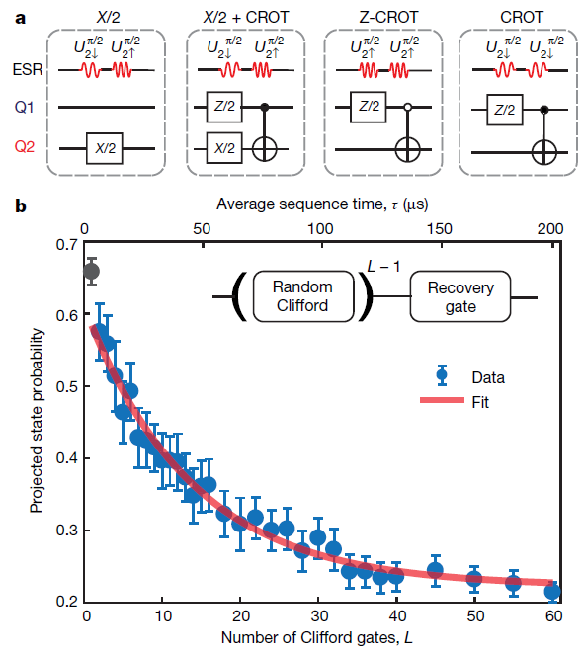
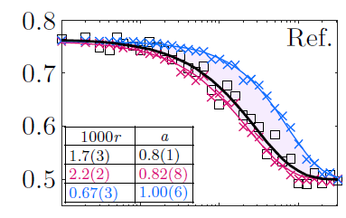
Experiments
Single qubit randomized benchmarking with average error rate 0.17%
Two qubit randomized benchmarking with average error rate 5.3%
Huang, W., et al. Nature 569, 532–536 (2019).
Yang, C.H., et al. Nat Electron 2, 151–158 (2019).
Notes:
Here I show experiments by university of new south wale
Their device is silicon qubit
So randomized benchmarking can work on real device

Slide 33
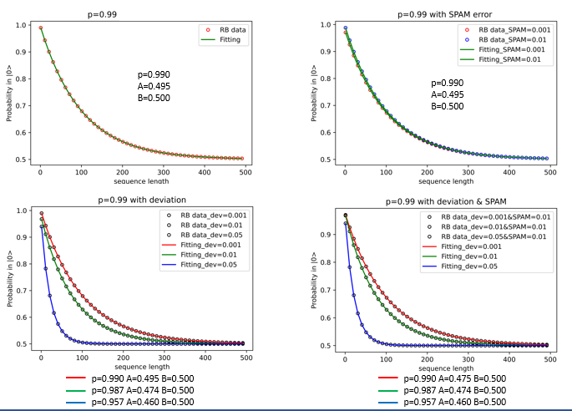
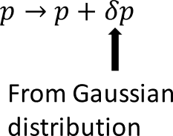
Simulation Results
Notes:
Theory p equal to o.99
First picture is our single qubit simulation without deve and spam error
As u see it fit well as theory expect both are o.99
Second picture add SPAM error, even with different SPAM error
It get the p as expect
Third pict we add deviation which is from gaussian distribution
With deviation become lagrer, the p is far from theory

Slide 34
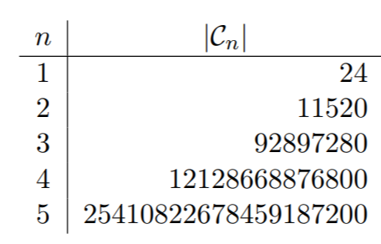
Outlook
The number of Clifford elements become exponentially larger when the number of qubits grows
hard to implement (so far experiment stop at 3-qubit randomized benchmarking)
Recovery probability decay too fast when the number of qubits become larger
the uncertainty of the estimation p will be large
Relaxing assumptions:
gate dependent noise JJ.Wallman arXiv:1703.09835
Clifford group is not universal. A. Carignan-Dugas et.al.,Phys. Rev. A 92, 060302 (2015)
Notes:
When n equal to three, the number of Clifford element would become a nightmare
=================
because the Clifford group is not universal for quantum computation,
The solution is presented by this paper

Slide 35
Summary
Randomized benchmarking and quantum process tomography are methods to characterize noise
The advantage of randomized benchmarking:
robust against state preparation and measurement error
less resource requirement
Single parameter
Randomized benchmarking have been implemented in real devices
Qualifications in randomized benchmarking need to be improved
First central idea
Second central idea
Third central idea

Slide 36
Thank you for listening
碩 三
noise

Slide 37
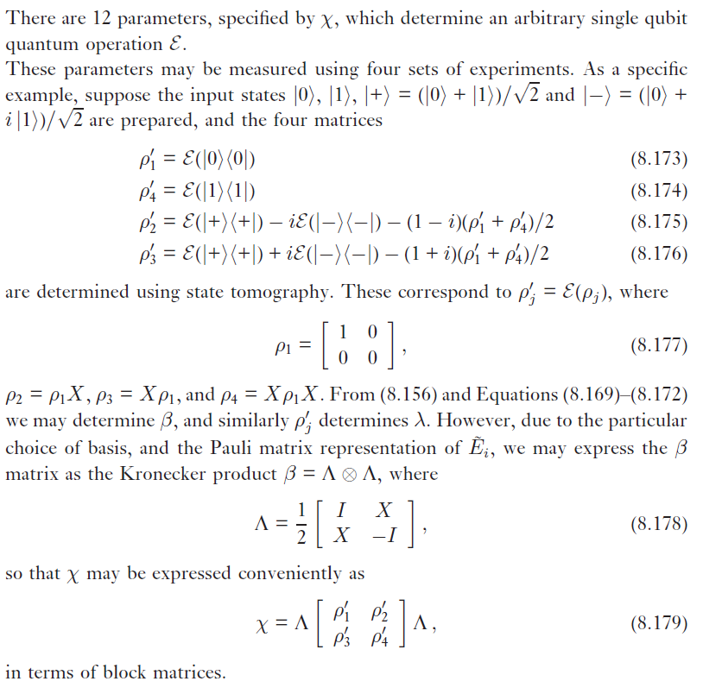
QPT
O(4^{n}) different unitary
Exponential amount of random bits and gates
Unitaries created by poly(n) gates
It can be sampled in poly(n) time
A B absorb

