Slide 1
Rydberg-based quantum sensors and quantum gates using atomic vapors
Yi-Hsin Chen (陳易馨)
National Sun Yat-sen University
2021.08.26 Workshop on QST
Notes:
Thanks for the nice introduction.

Slide 2
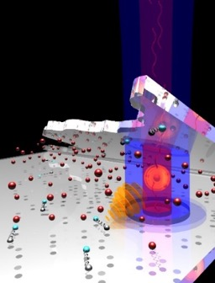
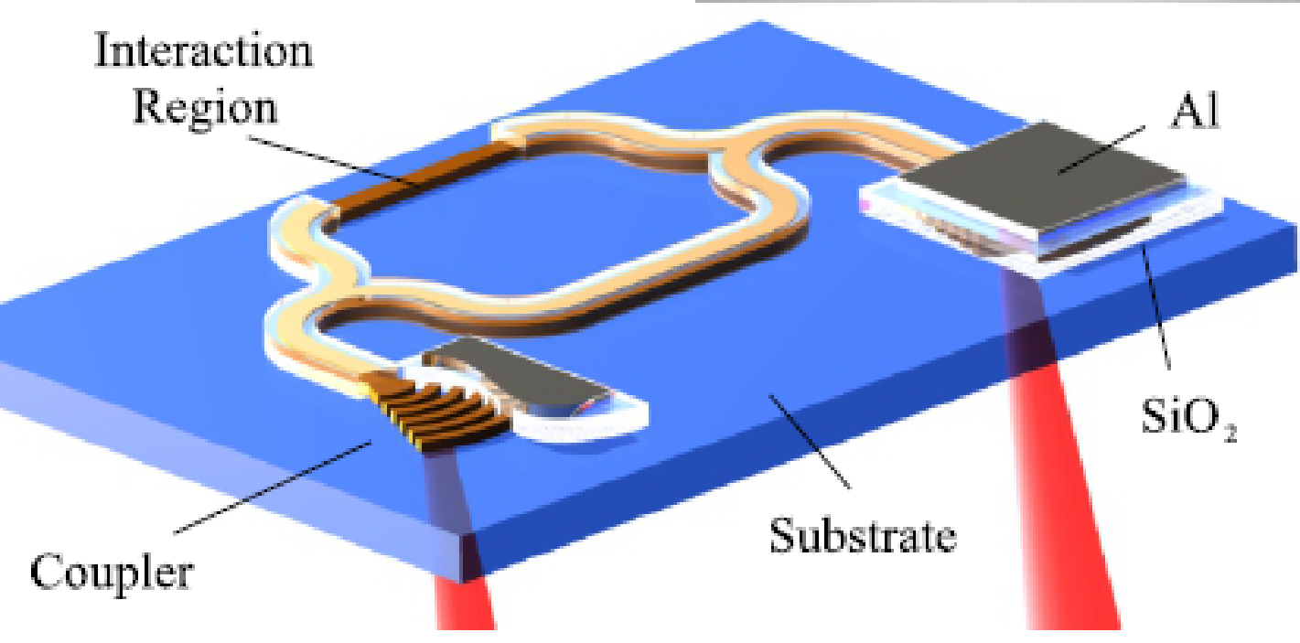
Outline
Research Background
Rydberg-State atoms
Free Space Rydberg-EIT Spectral Measurements
Quantum Metrology
Miniaturized devices
Optical Waveguides
Rydberg Blockade Effect
Single-Photon Transistor
Single-Photon Source
Quantum Sensor and Quantum Manipulation in Waveguides
Rydberg-based quantum sensors and quantum gates using atomic vapors Yi-Hsin Chen 2
Notes:
I will first overview of my research background

Slide 3
Second Quantum Revolution
Dr. 陳蔚然 科技政策觀點
Rydberg-based quantum sensors and quantum gates using atomic vapors Yi-Hsin Chen 3

Slide 4
Quantum Control and Quantum Communication
Optical memory
Photon Switching
Phase Modulation
Ω_{s}
ρ₂₁
Z. Y. Liu, Yi-Hsin Chen et al., PRL 117, 203601 (2016)
PRL 110, 083601 (2013)
PRL 120, 183602 (2018)
Yi-Hsin Chen et al., PRL 108, 073603 (2012)
High NA in free space
Single-photon-level
Nonlinear efficiency = (transition rate) × (interaction time)
transition rate ∝ light intensity
λ
Short interaction length
Rydberg-based quantum sensors and quantum gates using atomic vapors Yi-Hsin Chen 4

Slide 5
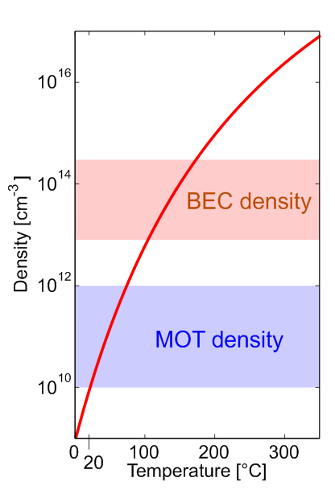
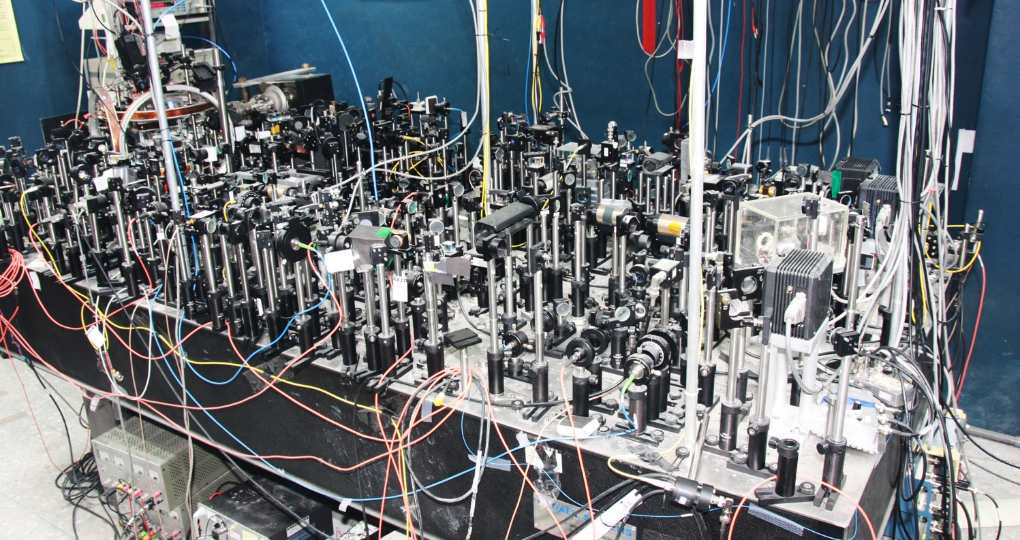
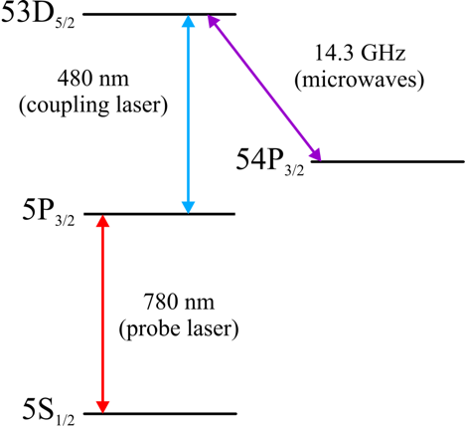
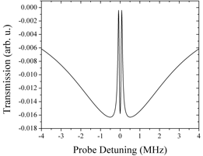
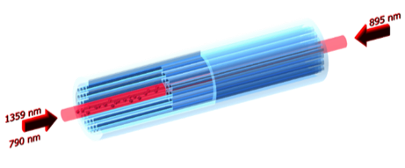
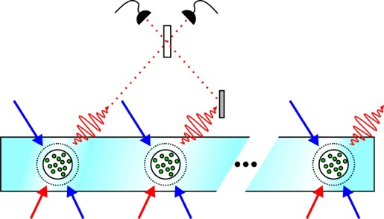
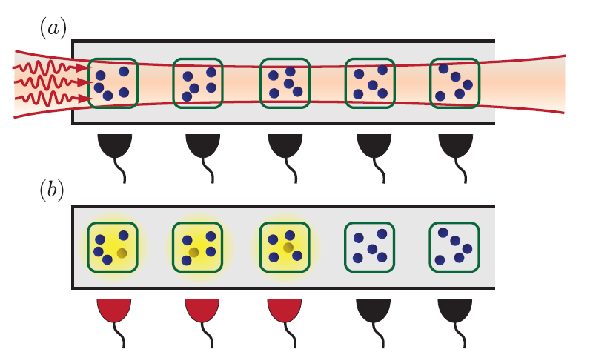
Quantum Metrology and Quantum Sensors
High density
Atomic Vapors
Sensitive electrometers
Low power fast
switches and modulators
MHz to THz
Scalable room-temperature quantum devices
Rydberg-based quantum sensors and quantum gates using atomic vapors Yi-Hsin Chen 5

Slide 6
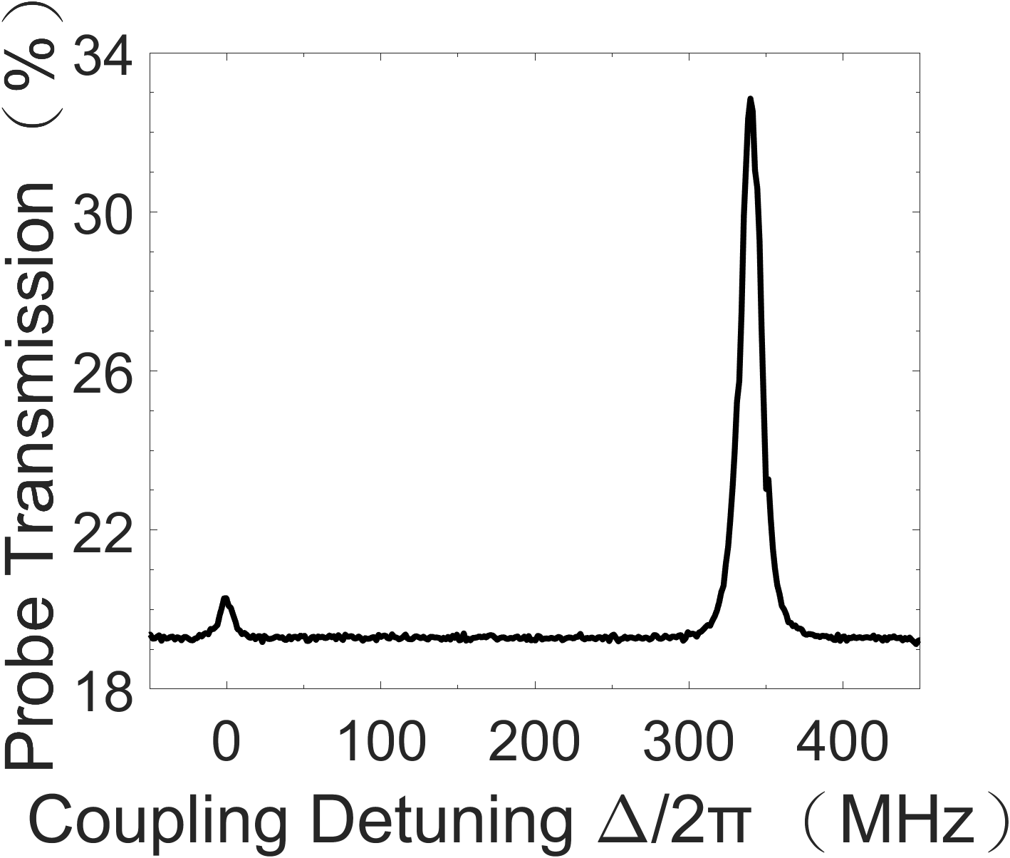
Outline
Research Background
Rydberg-State atoms
Free Space Rydberg-EIT Spectral Measurements
Quantum Metrology
Miniaturized devices
Optical Waveguides
Rydberg Blockade Effect
Single-Photon Transistor
Single-Photon Source
Quantum Sensor and Quantum Manipulation in Waveguides
Rydberg state n>>1
|3〉
Ω_{MW}
Ω_{c}
|4〉
|2〉
Δ
ε_{p}
|1〉
Rydberg-based quantum sensors and quantum gates using atomic vapors Yi-Hsin Chen 2

Slide 7
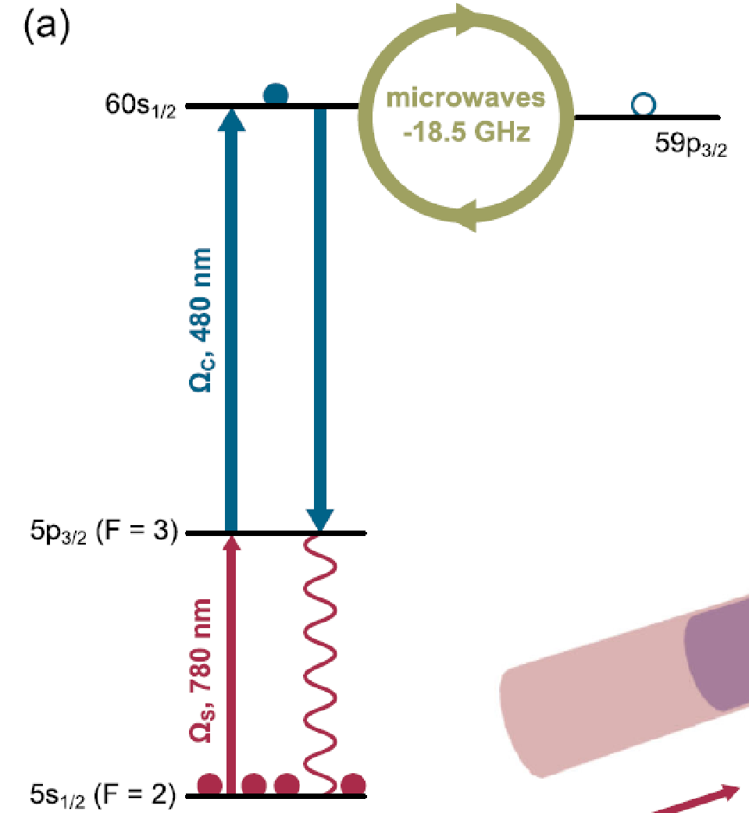
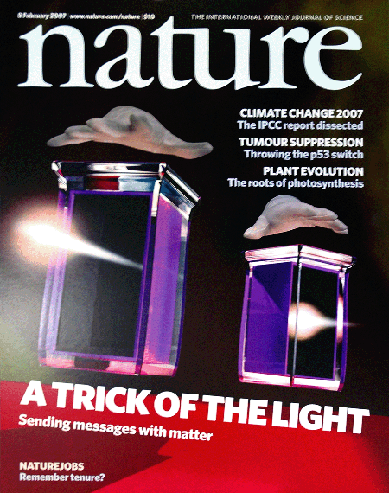
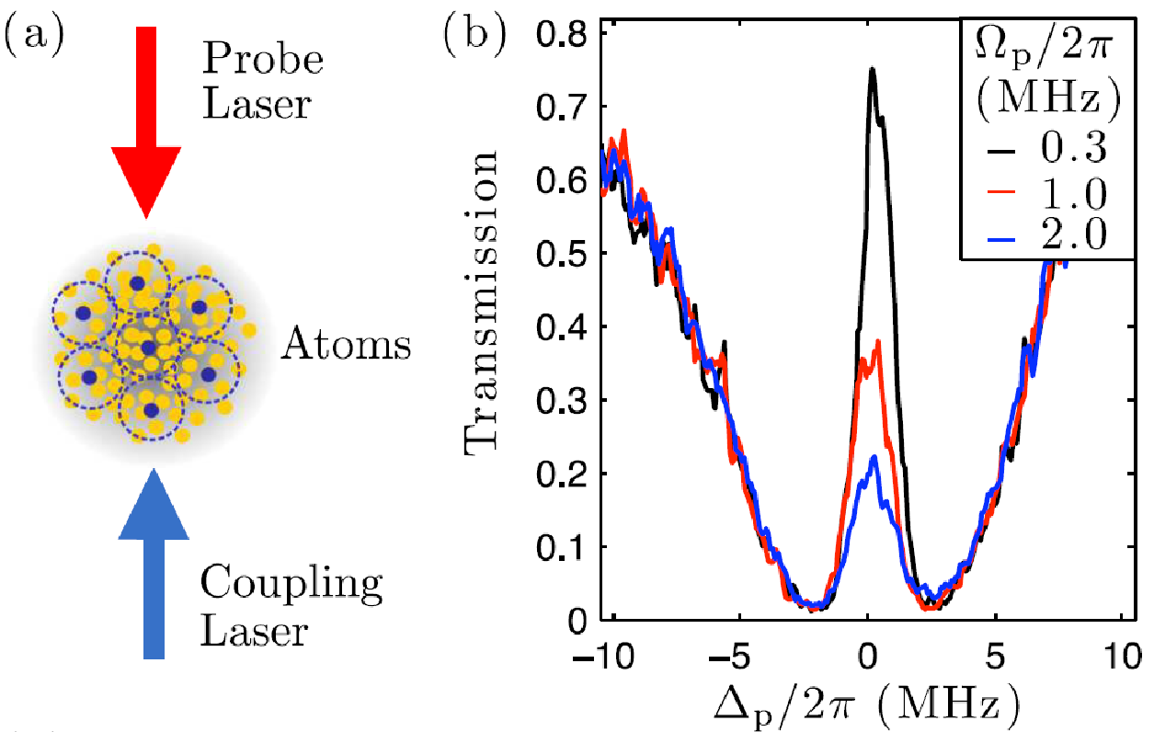
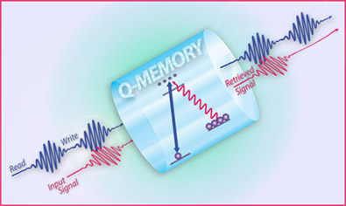
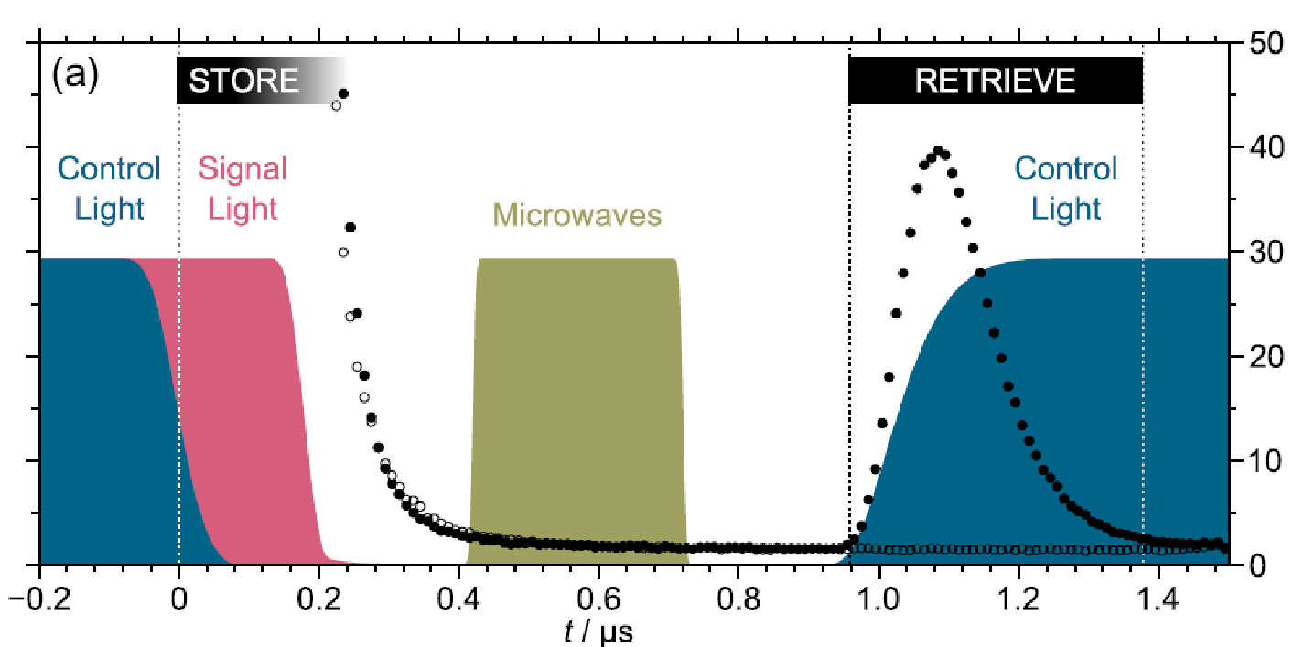
Electromagnetically Induced Transparency (EIT)
Quantum memory -- Λ EIT
Rydberg EIT
nS
Coupling
5P
probe
5S
C. Adams’s group in Durham
PRL 105, 193603 (2010)
PRL 110, 103001 (2013)
Rydberg EIT | Optical waveguide Yi-Hsin Chen 7
Notes:
Quantum memory is a key ingredient for demonstrating long-range quantum information communication. Typical quantum memories are demonstrated in lambda-type EIT systems. The storage efficiency is quiet high and can approach to one.
Due to EIT nonlinear effect, we can use one single photon to switch or phase modulate another single photon.
The single-photon phase shifts measured to date are on the order of 10^−5 rad. If the experimental condition is perfect, the authors predict the phase shift can be 0.05 radius.
However, the switching efficiency and phase shift are not large enough for future application.
One method to increase the nonlinearity is using a case-cade EIT transition, and the upper state is a Rydberg state,
Rydberg EIT and storage and control of optical photons via Rydberg EIT have been demonstrated by Charles Adams’s group in Durham.
Due to the strong interaction, one gate photon can switch more than 100 source photons.
Or one photon imprints a phase shift of pi onto another single photon.
This demonstrates the crucial step towards a photon-photon gat and offers a variety of applications in the field of quantum information processing.

Slide 8
Λ-type EIT
Rydberg EIT
|r〉
|3〉
Ω_{c}
Ω_{p}
Ω_{c}
|3〉
Ω_{p}
|1〉
|1〉
|2〉
Long coherence time
High memory efficiency
One color lasers
Low laser power
Long coherence time
High memory efficiency
One color lasers
Low laser power
Short coherence time
Low storage efficiency
Two color lasers
Strong light-matter interaction
Short coherence time
Low storage efficiency
Two color lasers
Strong light-matter interaction
Phase mismatch!! Δk = k_{p} + k_{c} = 2π/Λ ≠ 0
Λ ~ 3 cm
Λ ~ 1.2 μm
Rydberg EIT | Optical waveguide Yi-Hsin Chen 8

Slide 9
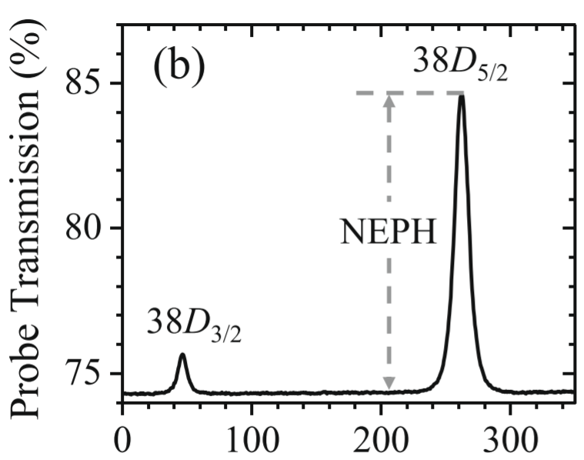
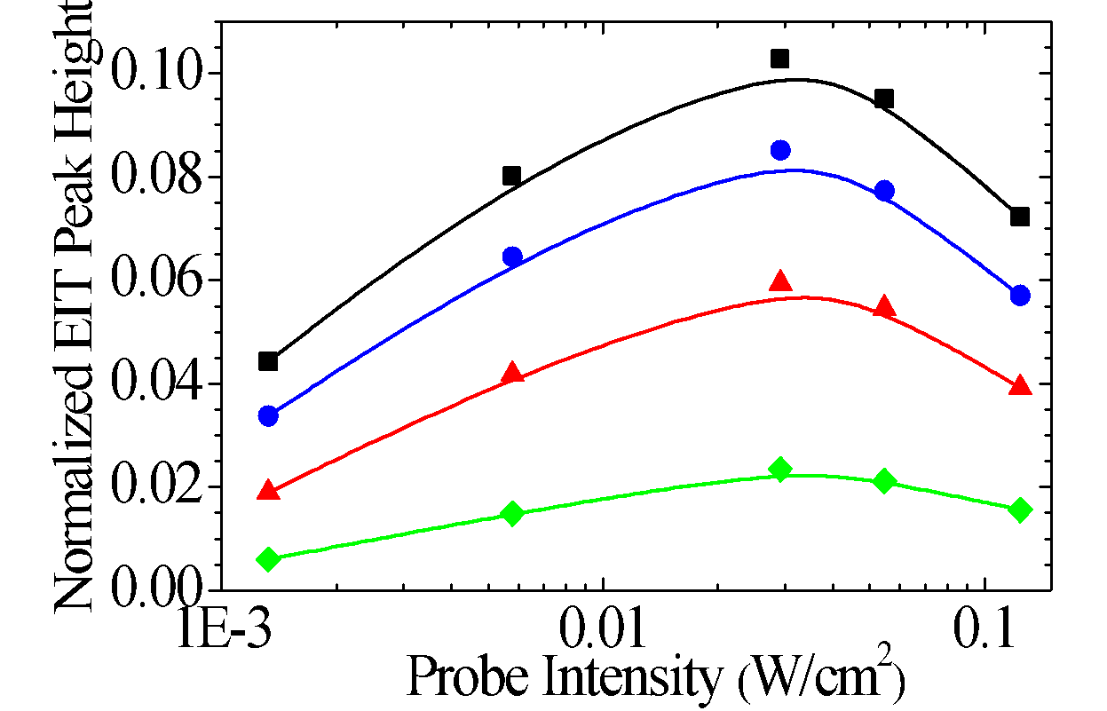
Rydberg EIT
|r〉
Ω_{c}
|3〉
Ω_{p}
|1〉
Two-photon detuning (MHz)
Free space
Require 340 mW coupling laser power from a SHG laser
How to reduce the laser power toward the commercial applications?
I_{c} = 18 W/cm²
9.5
4.6
2.5
B. H. Wu, Y. W. Chuang, Y. H. Chen* et al., Scientific Reports 7:9762 (2017)
Rydberg EIT | Optical waveguide Yi-Hsin Chen 9

Slide 10
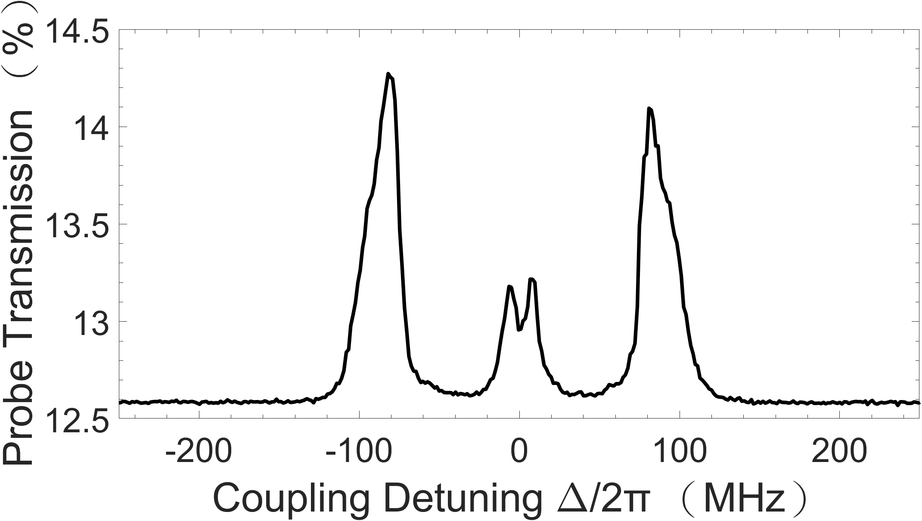
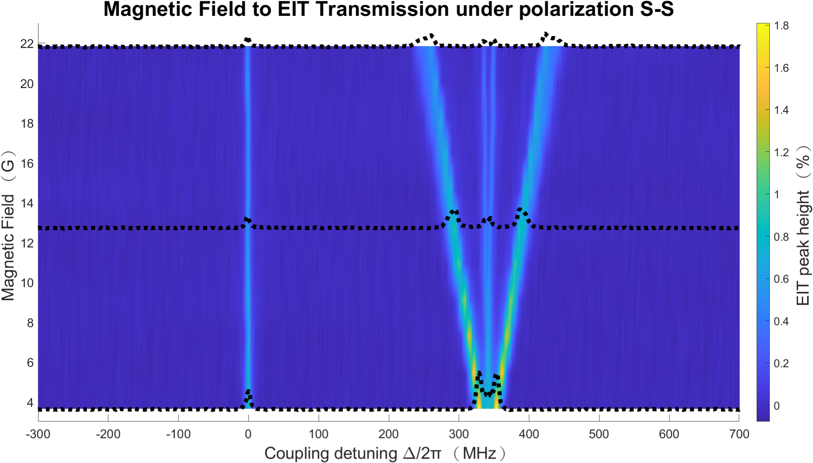
Rydberg EIT
Two-photon detuning (MHz)
Apply 20 mW coupling laser power
The high contrast spectrum will be useful in the application of quantum sensors.
Paper in preparation.
Rydberg EIT | Optical waveguide Yi-Hsin Chen 10

Slide 11
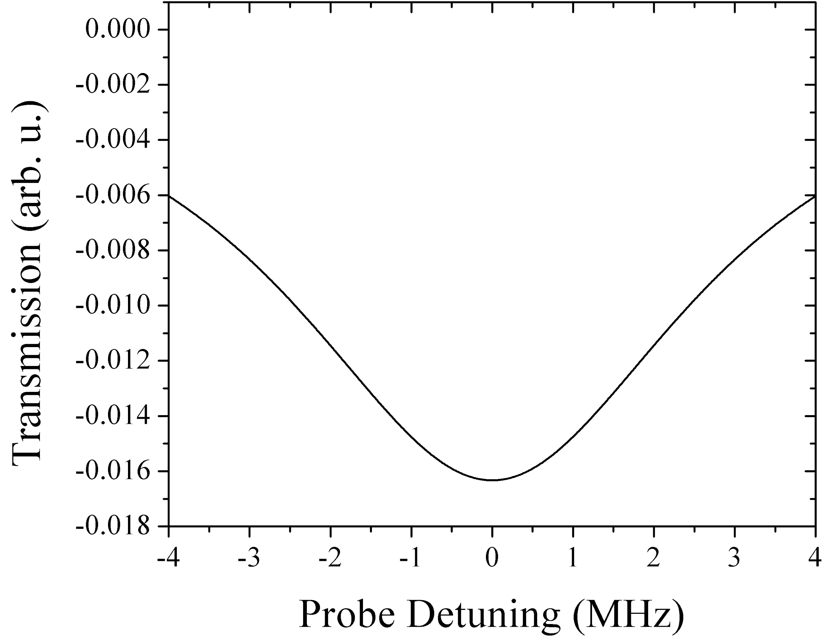
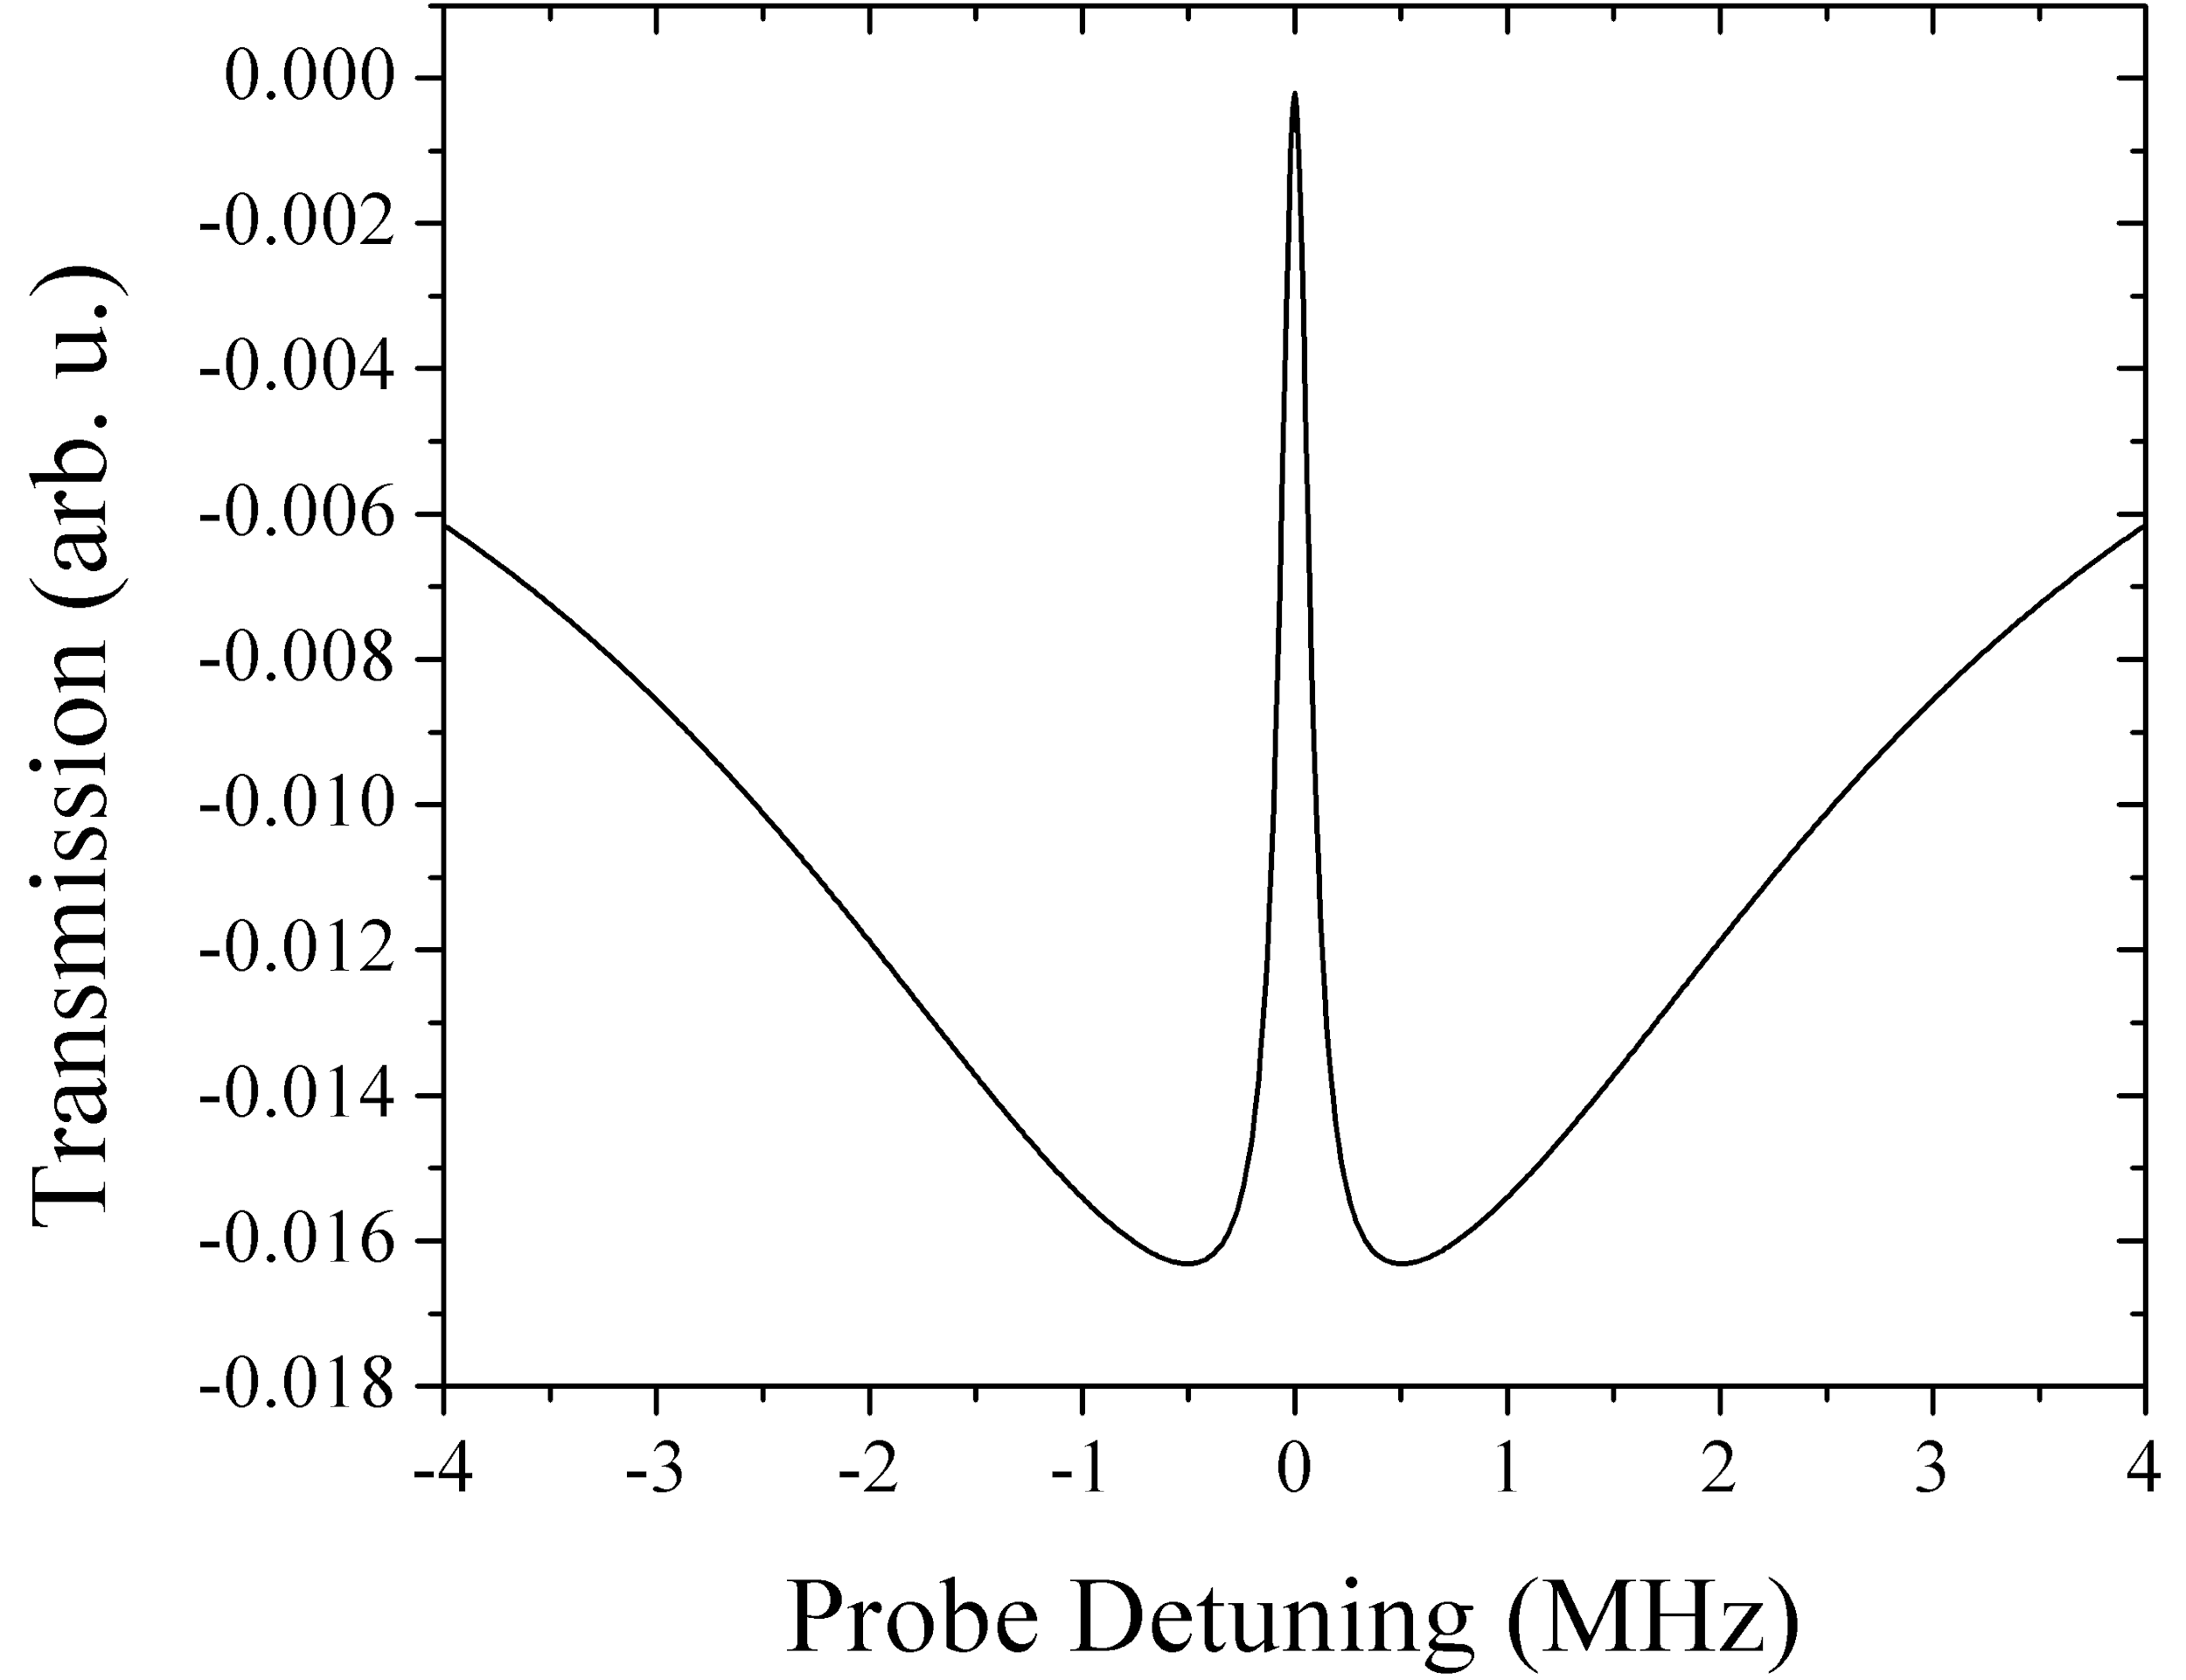
Quantum Metrology
Microwave Electrometry
Rydberg state n>>1
|3〉
Ω_{MW}
Ω_{c}
δ
|4〉
Δ
|2〉
ε_{p}
|1〉
Rydberg EIT | Optical waveguide Yi-Hsin Chen 11

Slide 12
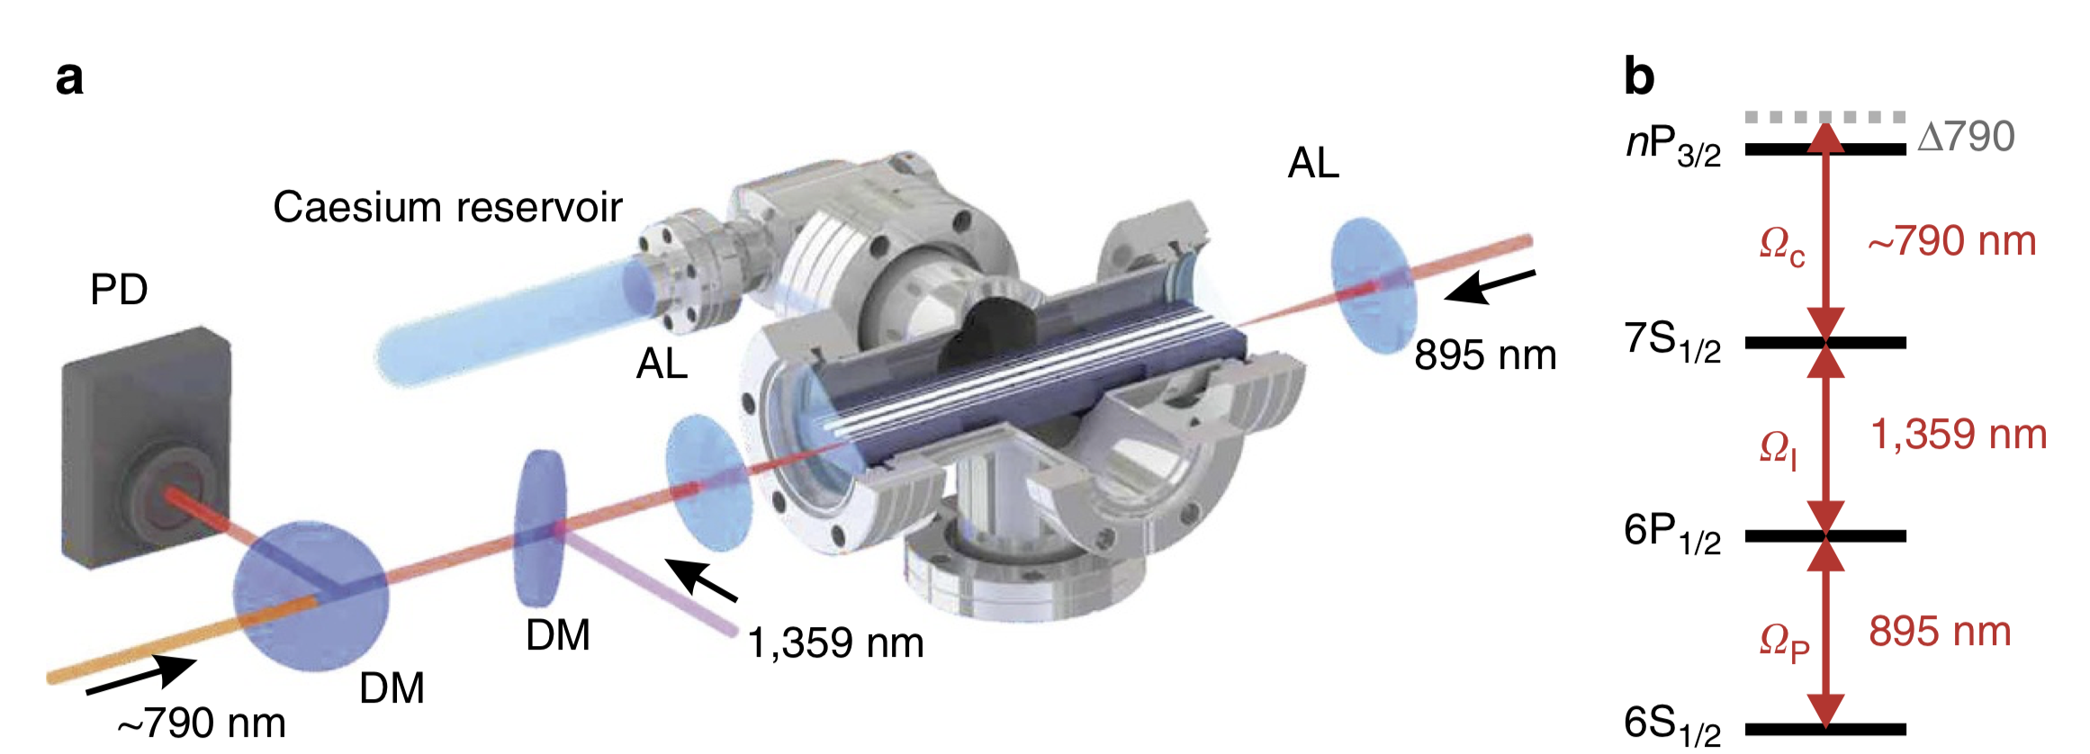
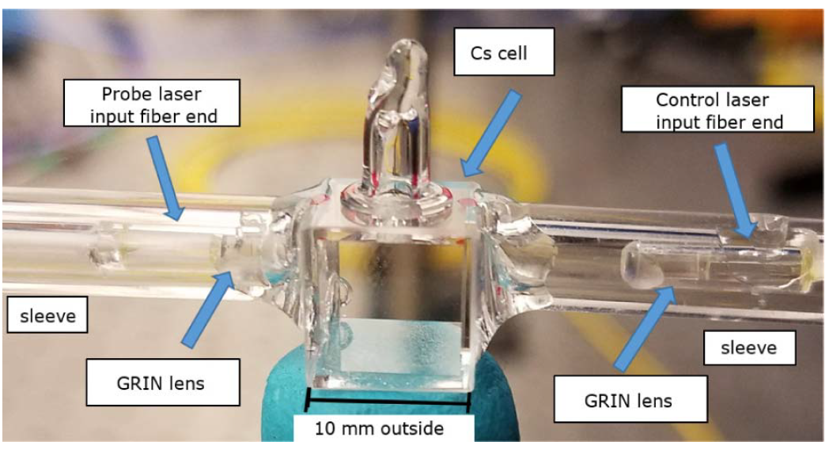
Quantum Metrology
Microwave Electrometry
“Rydberg atoms in hollow-core photonic crystal fibres” Epple et al., Nat. Communi. 5:4132 (2014).
All-fiber quantum devices
n up to 43
852 nm
511 nm
“Fiber-coupled vapor cell for a portable Rydberg atom-based RF electric field sensor” Applied Optics 57, 6456 (2018)
Rydberg EIT | Optical waveguide Yi-Hsin Chen 12

Slide 13
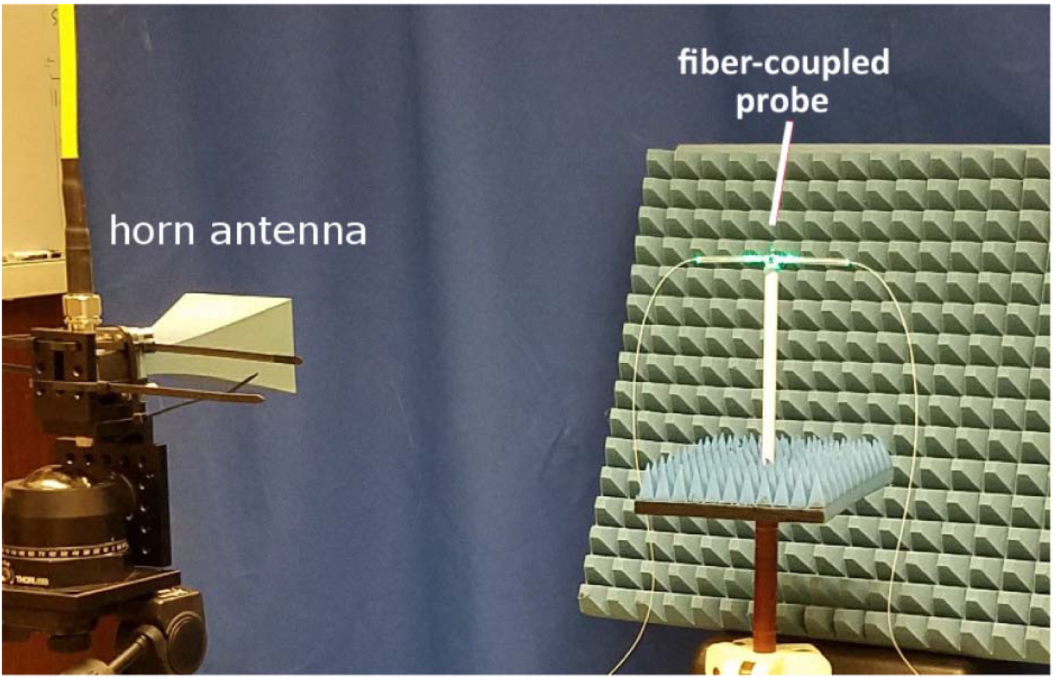
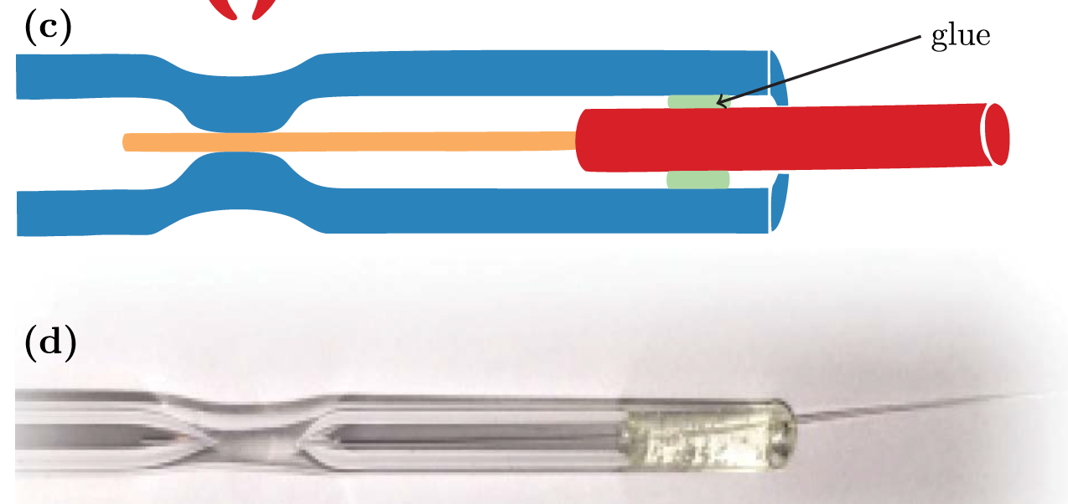
Quantum Metrology
Microwave Electrometry
Rydberg state n>>1
|3〉
Ω_{MW}
Ω_{c}
|4〉
|2〉
Δ
ε_{p}
|1〉
All-fiber quantum devices
n up to 43
“Fiber-coupled vapor cell for a portable Rydberg atom-based RF electric field sensor” Applied Optics 57, 6456 (2018)
“High vacuum compatible fiber feedthrough for hot alkali vapor cells” Applied Optics 56, 1546 (2017)
Rydberg EIT | Optical waveguide Yi-Hsin Chen 13

Slide 14
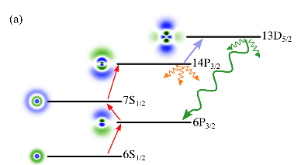
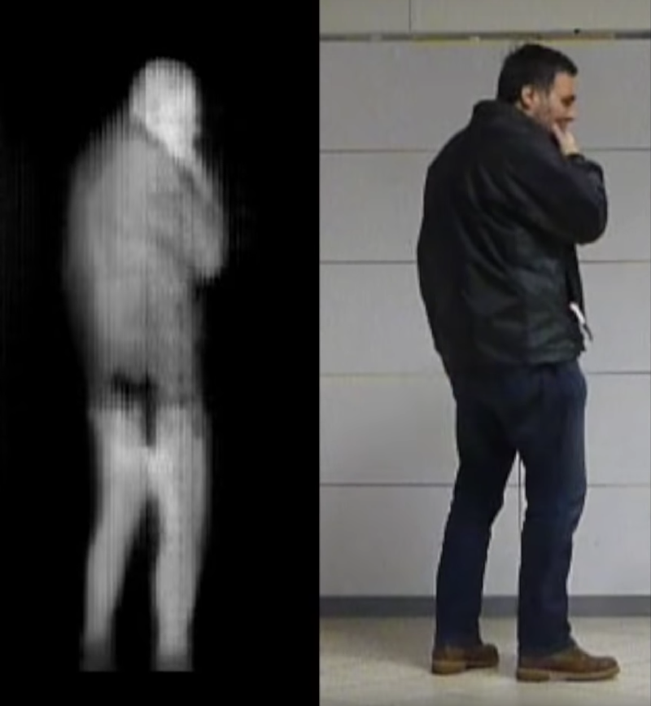
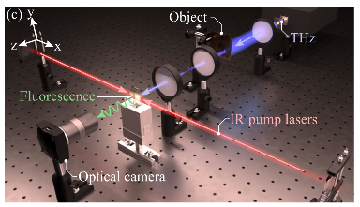
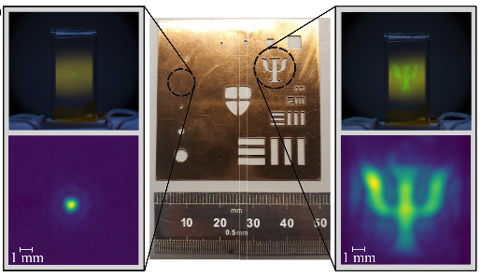
Quantum Metrology
THz image
K. J. Weatherill’s group, “Full-Field Terahertz Imaging at Kilohertz Frame Rates Using Atomic Vapor,” PRX 10, 011027 (2020).
Rydberg EIT | Optical waveguide Yi-Hsin Chen 14

Slide 15
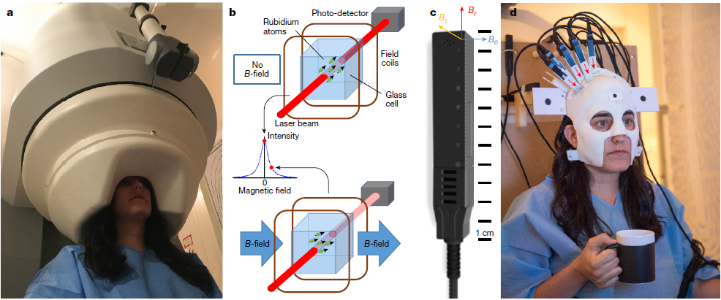
Future Applications in this Study
穿戴式腦磁測量頭盔問世！腦神經研究領域即將大革新？
From 泛科網 written by 林發暄 台大醫工所教授
Nature 555, 657–661 (2018)
Rydberg state n>>1
|3〉
Ω_{RF}
Ω_{c}
|4〉
|2〉
Δ
ε_{p}
|1〉
Cryogenic MEG system (SQUIDs)
450 kg
Fixed sensor array
OPM MEG system (SQUIDs)
0.905 kg
Flexible
Rydberg EIT | Optical waveguide Yi-Hsin Chen 15

Slide 16
A OM in
OWGs

Slide 17
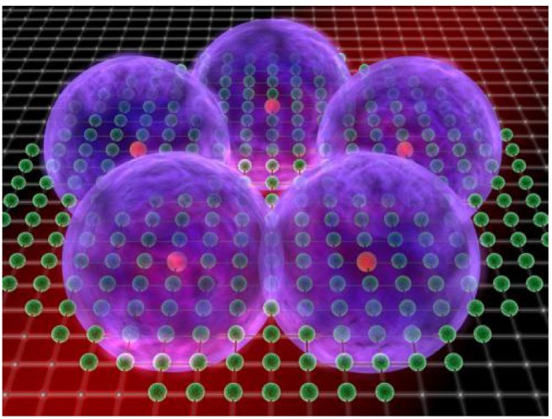
Outline
Research Background
Rydberg-State atoms
Free Space Rydberg-EIT Spectral Measurements
Quantum Metrology
Miniaturized devices
Optical Waveguides
Rydberg Blockade Effect
Single-Photon Transistor
Single-Photon Source
Quantum Sensor and Quantum Manipulation in Waveguides
Rydberg-based quantum sensors and quantum gates using atomic vapors Yi-Hsin Chen 16

Slide 18
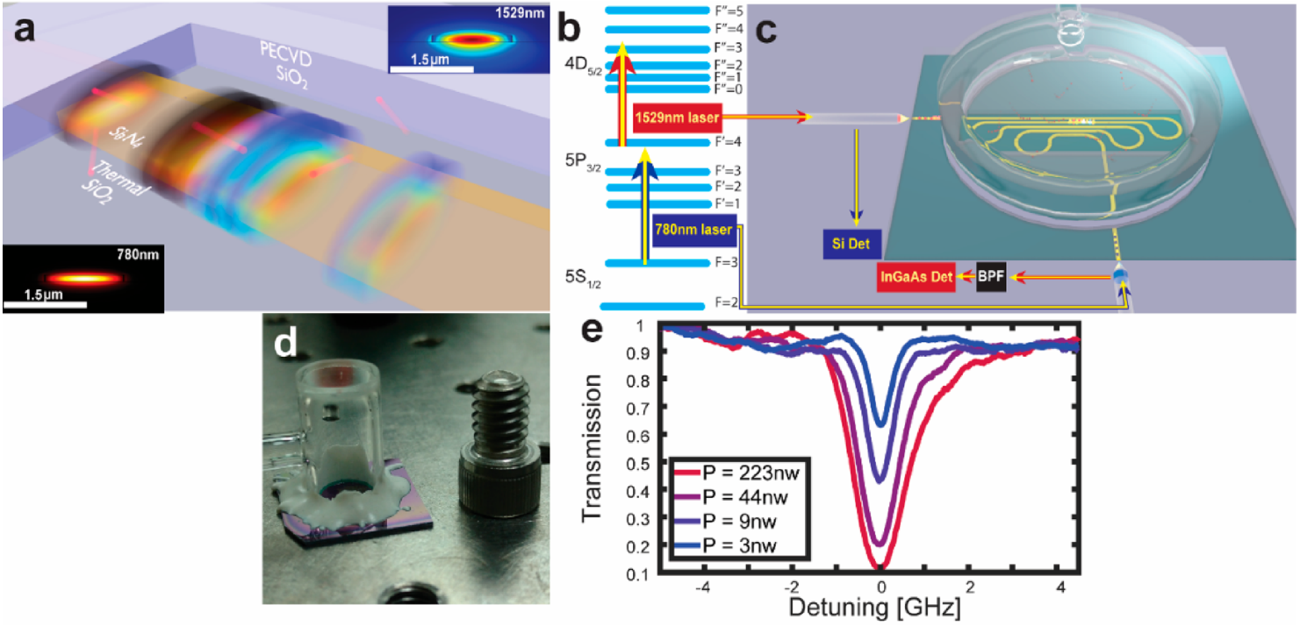
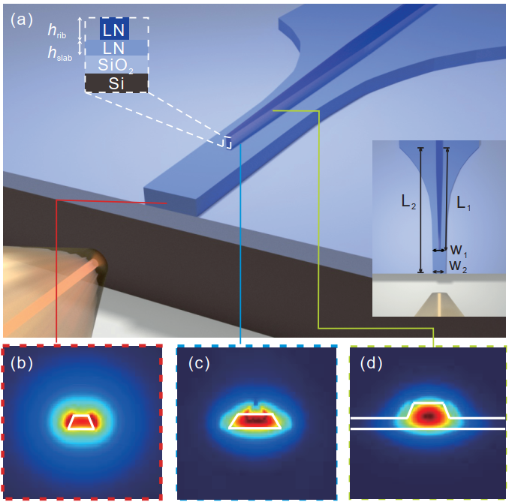
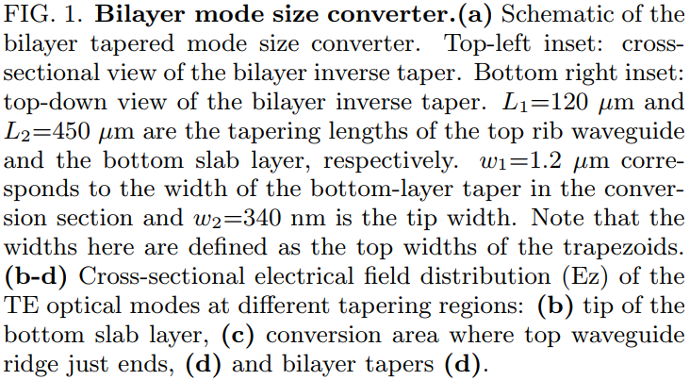
Optical Waveguides
Optics Letters 44, 2314 (2019)
ACS Photonics 8, 879 (2021)
Rydberg EIT | Optical waveguides Yi-Hsin Chen 18

Slide 19
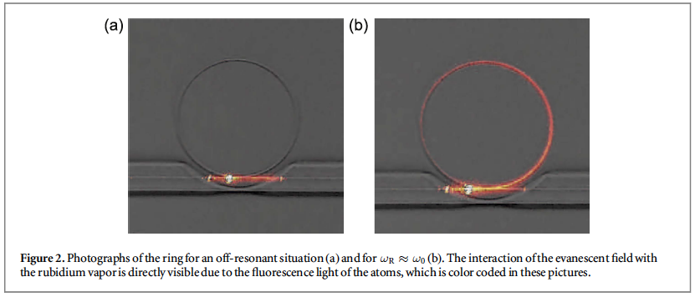
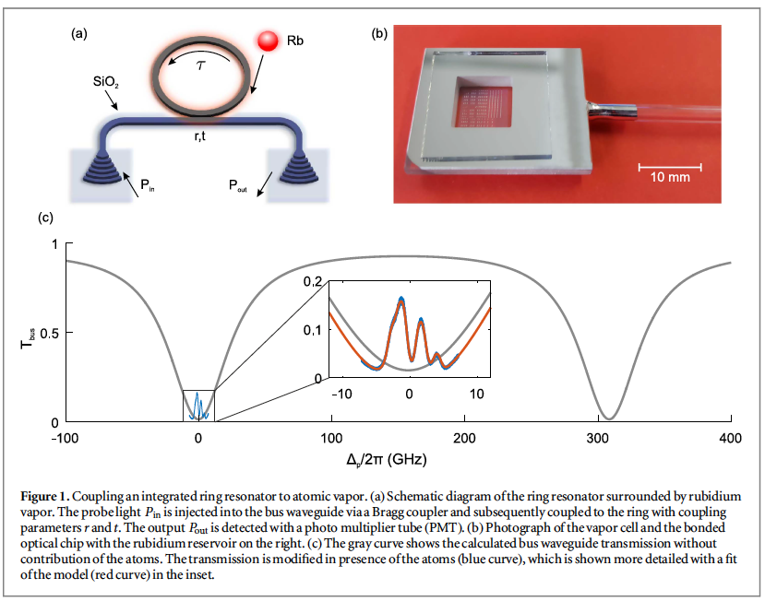
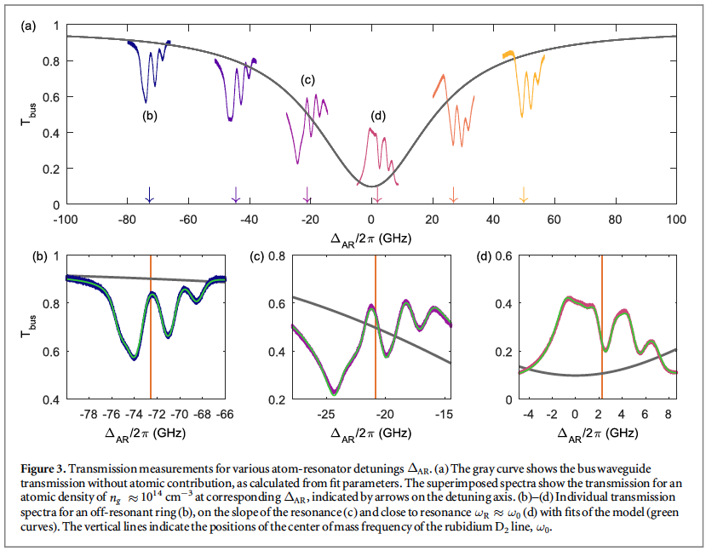
Ring Resonators
Rydberg EIT | Optical waveguides Yi-Hsin Chen 19

Slide 20
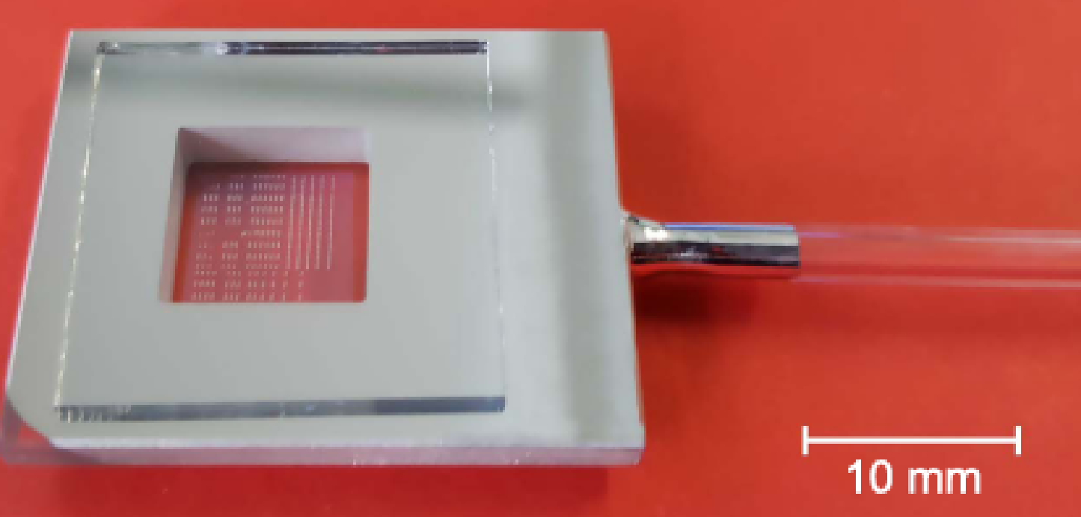
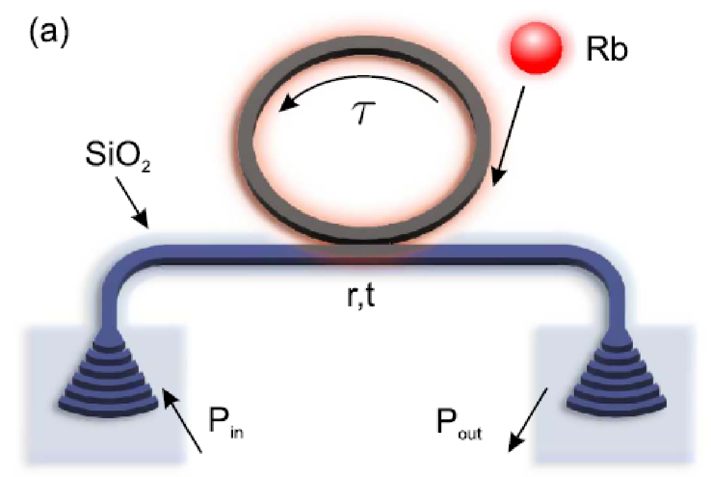
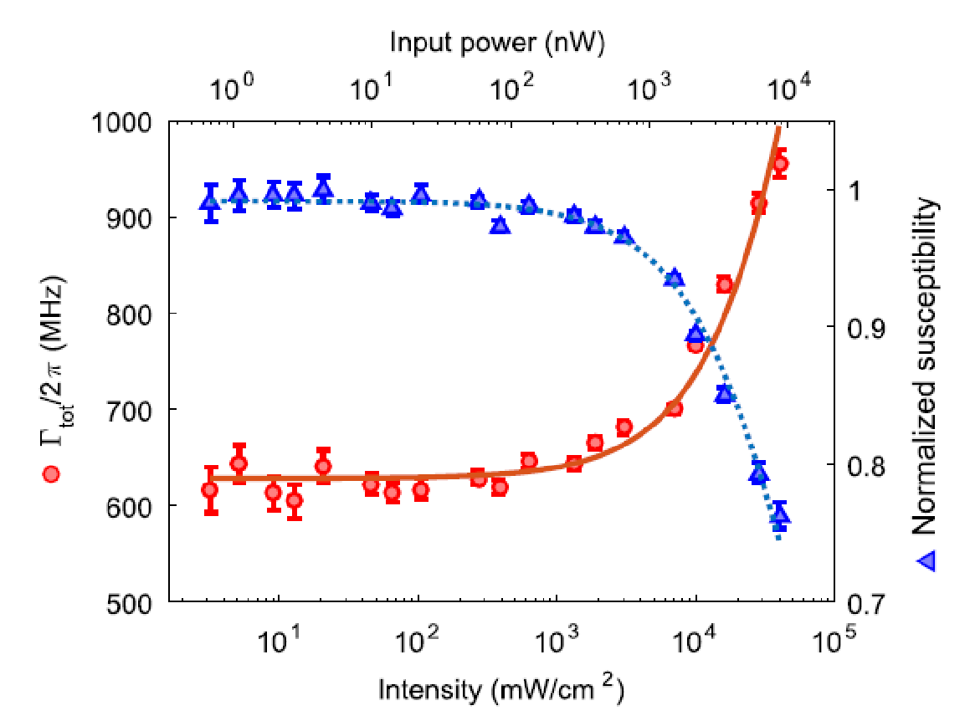
Integrated Ring Resonators
Δp/2π (GHz)
Q = 7*10³
Probe power (nW)
R. Ritter et al., New J. Phys. 18, 103031 (2016)
To reach more narrow lines
EIT spectroscopy
Buffer gas
Intensity mW/cm²
Rydberg EIT | Optical waveguides Yi-Hsin Chen 20

Slide 21
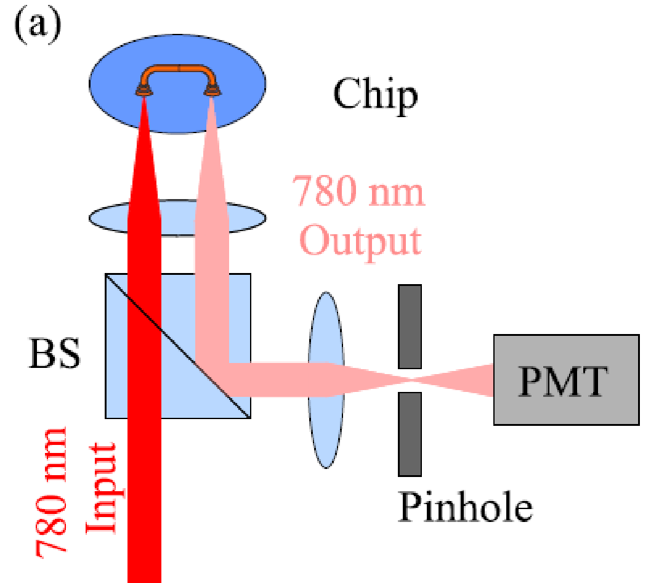
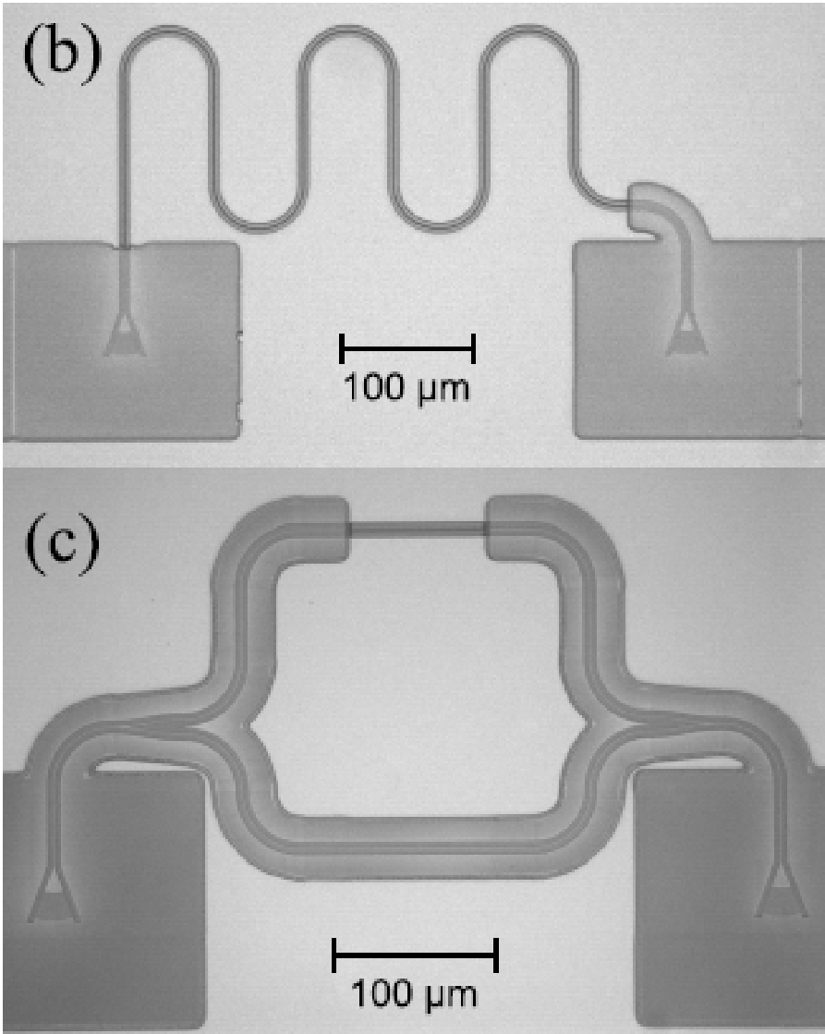
Integrated Photonic Waveguides
Dimension:
4 mm*38 mm
180 nm Si₃N₄ layer
Width of 1.1 μm
Height of 180 nm
⁸⁵Rb : Hey, I am here!
Grating coupler
R. Ritter et al.,
APL 107, 041101 (2015)
4.5% transmission
Rydberg EIT | Optical waveguides Yi-Hsin Chen 21
Notes:
We fabricated several waveguide geometries for spectroscopy applications. The guided light is coupled to a vapor of Rb atoms via the evanescent mode.
multi-step electron beam lithography
Si3N4 waveguide
600 nm thick layer of SiO2 to restrict the atom-light interaction
100 nm Al to prevent to excite many atoms in the cell. Fluorescence

Slide 22
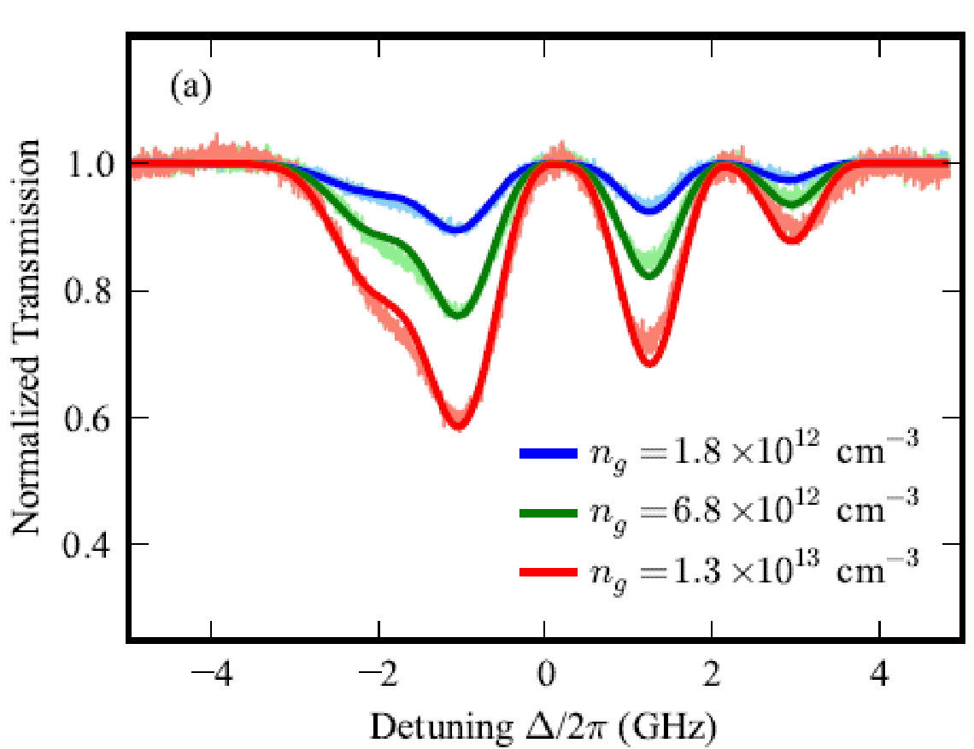
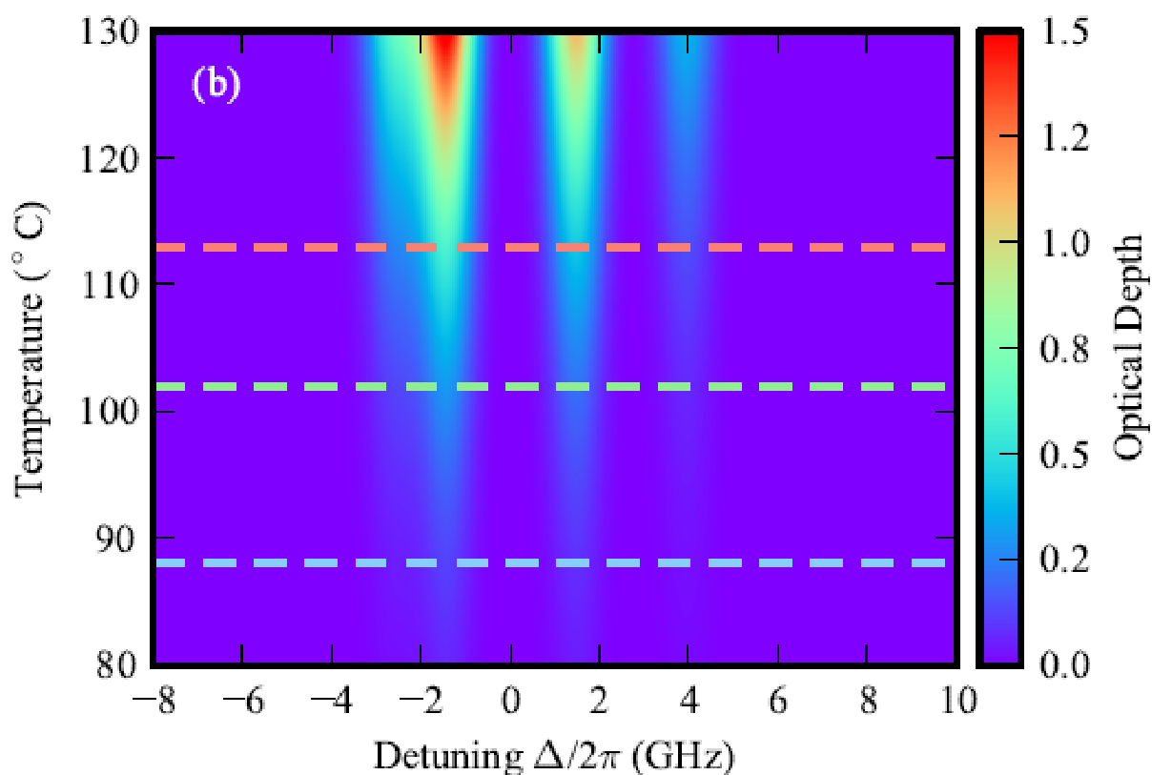
Overall efficiency 2.5*10⁻³
17% TE mode interact with vapors
Integrated Photonic Waveguides
Transmission
OD of 1
⁸⁵Rb |5S_{1/2}, F=3> to 5P_{3/2}
1.2 mm waveguide
OD > 1
17% of TE mode interact with atoms
Detuning of probe/2π (GHz)
Optical Depth
Temperature (°C)
R. Ritter et al.,
APL 107, 041101 (2015)
Detuning of probe/2π (GHz)
Rydberg EIT | Optical waveguides Yi-Hsin Chen 22

Slide 23
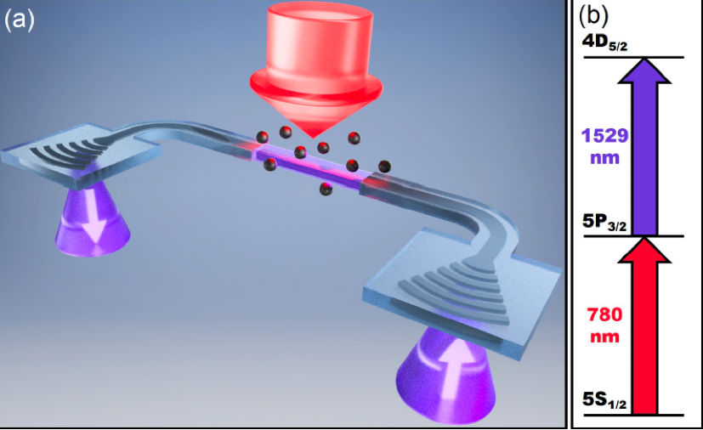
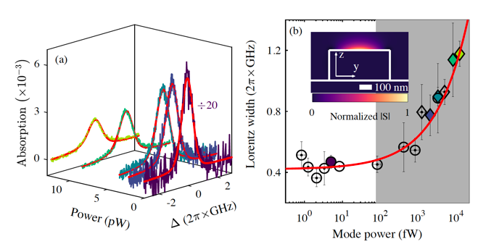
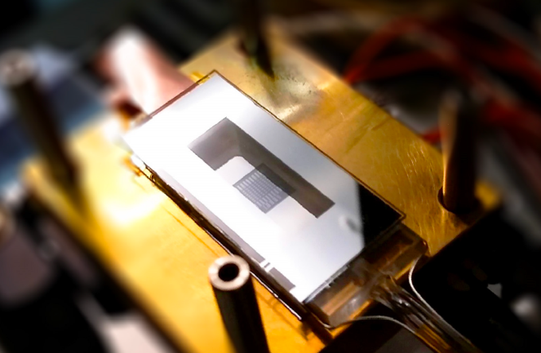
Integrated Photonic Waveguides
A. Skljarow et al.,
Optics Express 28, 19593 (2020)
The extension of the evanescent field can be enhanced by tapering the waveguides facilitating two-photon excitation to the Rydberg levels, creating large optical non-linearity.
Rydberg EIT | Optical waveguides Yi-Hsin Chen 23

Slide 24
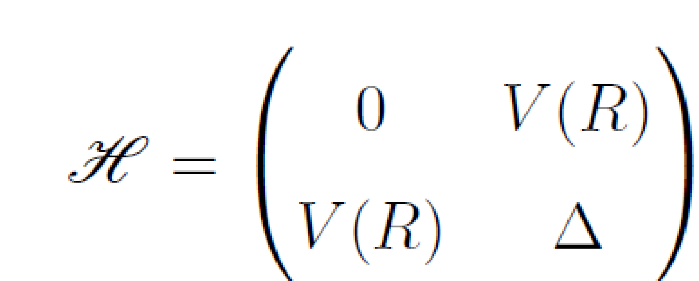
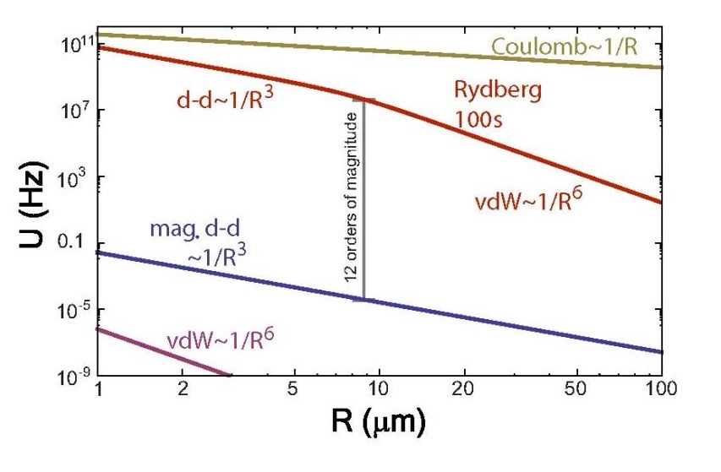
Properties of Rydberg Atoms
Polarizability | ∝ n⁷ | 8 MHz (V/cm)⁻²
Highly excited atom n >> 1
Saffman et al., Rev. Mod. Phys. 82, 2313 (2010)
Quantity | Scaling | 43S-State of ⁸⁷Rb
Radius | ∝ n² | 2384 a₀
Lifetime | ∝ n³ | 50µs
D-D interaction n⁴/R³,
vdW interaction n¹¹/R⁶
The interactions between Rydberg states are
strong (12 order)
long-range (μm)
tunable
switchable
Interaction Energy
R
Rydberg EIT | Optical waveguides | Rydberg blockade Yi-Hsin Chen 24
Notes:
Ground state atoms vdW interaction
The polarizability in isotropic media is defined as the ratio of the induced dipole moment of an atom to the electric field that produces this dipole moment.
Van der Waals are off-resonant, temporary, second-order interactions, and dipole-dipole interactions are on-resonant, permanent, first-order interactions.

Slide 25
Rydberg Blockade
Highly excited atom n >> 1
E
Rydberg excitations form ordered structures in a quantum gas due to long-range interactions
V(R)
|r,r〉
Γ
Ω
Ω’
|g,r〉
Ω
|g,g〉
R
~μm
R_{b}
Phys.org. 23 Nov 2012
Rydberg EIT | Optical waveguides | Rydberg blockade Yi-Hsin Chen 25
Notes:
Rydberg atom is highly excited atom. The strong interaction between Rydberg states leads to a blockade effect. which only allows for one excitation into a Rydberg state within the blockade volume. When one atom is excited by a laser to a Rydberg state, it slightly shift the other atom’s energy levels so that the second atom cannot be excited by the same laser to the same state.
Based on this idea. We can excite one atom to Rydberg state. When the atomic excitation converts back into light, we get exactly one photon.

Slide 26
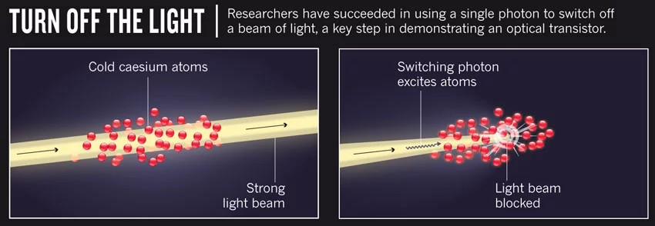
Single-Photon Transistor
Rydberg polaritons
Rydberg blockade
|r〉
|r〉
Ω_{c}
Ω_{c}
|e〉
|e〉
Ω_{p}
APS Physics viewpoint
Ω_{s}
|g〉
|g〉
Manipulation
Rydberg EIT | Optical waveguides | Rydberg blockade Yi-Hsin Chen 26

Slide 27
Single-Photon Sources
|4〉
Pulsed four-wave mixing
Micrometer cell (μm-cell)
480 nm
474 nm
M. M. Müller et al.,
PRA 87, 053412 (2013)
B. Huber et al.,
PRA 90, 053806 (2014)
|2〉
|3〉
795 nm
H. Kübler et al., Nat.
Photonics 4, 112 (2010)
|1〉
⁸⁵Rb
One Rydberg polariton
~ µm
R_{b}
Huber et al., PRL 107, 243001 (2011)
Baluktsian et al., PRL 110, 123001 (2013)
Rydberg EIT | Optical waveguides | Rydberg blockade Yi-Hsin Chen 27
Notes:
How to generate a deterministic single photon sources. We combine the Four-wave mixing effect and Rydberg blockade effect. According the FWM effect and phase matching condition, the generated sum frequency is strongly directional emission. Another selling point is that we use a micrometer scale microcell to tightly confine our atom.
The blockade radius is on the scale of few um. If we can confine the superatom into a micrometer scale cell, which allow only one Rydberg excitation can be generated and only one single-photon can be created.

Slide 28
Single-Photon Source
touching point
500 µm
Newton Ring
Rydberg EIT | Optical waveguides | Rydberg blockade Yi-Hsin Chen 28
28
Coherent Optical Detection of Highly Excited Rydberg States
Using Electromagnetically Induced Transparency
A. K. Mohapatra, T. R. Jackson, and C. S. Adams
PRL 98, 113003 (2007)

Slide 29
Single-Photon Source
4.7 ns
f = 3.89 mm
F. Ripka et al., Science 362 446(2018)
Rydberg EIT | Optical waveguides | Rydberg blockade Yi-Hsin Chen 29
Notes:
In ladder excitation scheme, there is a large wavevector mismatch, causing the imprinted spin-wave has a periodic phase in the light propagating direction. During storage, the atoms move a certain distance due to the thermal motion. When the stored coherence is recalled, the signal is mixed up because of the random phase.

Slide 30
Single-Photon Source
F. Ripka et al., Science 362 446(2018)
D1
BS
D2
Cell length < 1.16 um (characteristic length according to RRI)
Upper time < 2ns according to the correlation time
Rydberg EIT | Optical waveguides | Rydberg blockade Yi-Hsin Chen 30
Notes:
In ladder excitation scheme, there is a large wavevector mismatch, causing the imprinted spin-wave has a periodic phase in the light propagating direction. During storage, the atoms move a certain distance due to the thermal motion. When the stored coherence is recalled, the signal is mixed up because of the random phase.

Slide 31
Optical Waveguides
A. Skljarow et al.,
Optics Express 28, 19593 (2020)
The extension of the evanescent field can be enhanced by tapering the waveguides facilitating two-photon excitation to the Rydberg levels,
Creating large optical non-linearity.
Rydberg EIT | Optical waveguides | Rydberg blockade Yi-Hsin Chen 31

Slide 32
Optical Waveguides
Quantum manipulation with Rydberg atoms
Rydberg state n>>1
|3〉
Ω_{c}
|2〉
Δ
A. Skljarow et al., Optics Express 28, 19593 (2020)
ε_{p}
|1〉
Rydberg EIT | Optical waveguides | Rydberg blockade Yi-Hsin Chen 32

Slide 33
Optical Waveguides
Floorplan
30 designs in a 10 × 6 mm² chip
More than 100 designs in a 4.8 × 5.3 mm² chip
Collaborated with Prof. Chun-Ta Wang in NSYSU.
Optical waveguides has been delivered.
Collaborated with Prof. Yung-Jr Hung in NSYSU.
Optical waveguides will be fabricated by IMEC.
Rydberg EIT | Optical waveguides | Rydberg blockade Yi-Hsin Chen 33

Slide 34
Current Status
Design the optical waveguides
Optical system
Transmission efficiency
Insert the WG in a vapor cell full of Rb atoms
Absorption spectrum and Rydberg EIT measurements
Rydberg EIT | Optical waveguides | Rydberg blockade Yi-Hsin Chen 34

Slide 35
Summary
Rydberg EIT measurement
EIT study in optical waveguides
Quantum manipulation in OWG
Application on the RF, MW, THz metrology
Rydberg-based quantum sensors and quantum gates using atomic vapors Yi-Hsin Chen 35
Notes:
Come to summary. We have observed GHz Rabi oscillation to a Rydberg state. Extend to a four-level scheme, we have detected the four-wave mixing signal. To realize our main goal of a non-classical single-photon light source, we need to reduce the excitation volume to Rydberg blockade sphere. We change our light alignment to a high NA setup. However, the signal-to-noise ratio is not good enough in this measurement due to the slow de-excitation. Hence, we propose to use two pulse amplified laser fields. We except 3 order improvement can be achieved.

Slide 36
Thanks for your attention
Rydberg-based quantum sensors and quantum gates using atomic vapors Yi-Hsin Chen 36

Slide 38
We have cold atoms since October in 2019.
PD
Fiber feedthrough
M
M
atoms
We fabricated a fiber with $a$ = 1.5 μm in May.
MOT
Insert the nanofiber to the MOT system
Trapping beam
Probe beam
Fiber feedthrough
Rydberg atoms in miniaturized devices Yi-Hsin Chen 43
PD
Fiber feedthrough
M
M
Nanofiber (200 ~ 400nm)
atoms
Figure is credit by HTC.
Fiber feedthrough
Trapping beam
Probe beam

Slide 39
All-Optical Manipulation
Single-Photon Transistor
Nat. Commun. 7, 12480 (2016)
Single-Photon Phase Modulation
Science Advances, 2, e1600036
(2016)
Quantum Manipulation in Micro- and Nano-Structures Yi-Hsin Chen 13

Slide 40
Integrated Nanostructure Waveguides
Δφ(π)
Mach Zehnder interferometer
Width of 1.1 μm
Height of 180 nm
Δφ
Δφ of π
Temperature (°C)
R. Ritter et al.,
APL 107, 041101 (2015)
Nanostructure | Rydberg | Nanofibers | Applications Yi-Hsin Chen 11

Slide 41
Cold atoms
Hot atoms
UK National Quantum Technology Hub in Sensors and Metrology
Germany Tilman Pfau’s gorup
300 μK
Doppler free media
Simple theory
Fundamental research
High efficiency
High cost
300 - 400 K
Doppler broadened media
Complicated theory
Applied research
Low cost
Scalability and integrability
Ultralow-light-level manipulation with thermal vapors in miniaturized devices Yi-Hsin Chen 8

