Slide 1
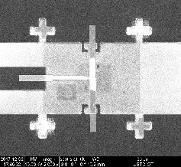
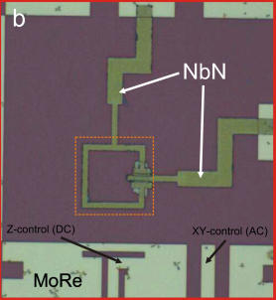
Material-based superconducting quantum circuits
Graphene circuit
Weyl semimetal circuit
Kuei-Lin Chiu
Department of Physics, National Sun Yat-sen University
2021/08/25

Slide 2
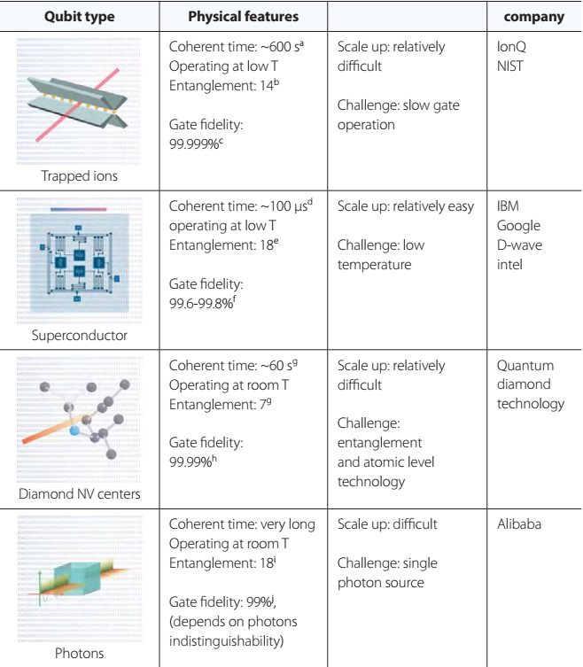
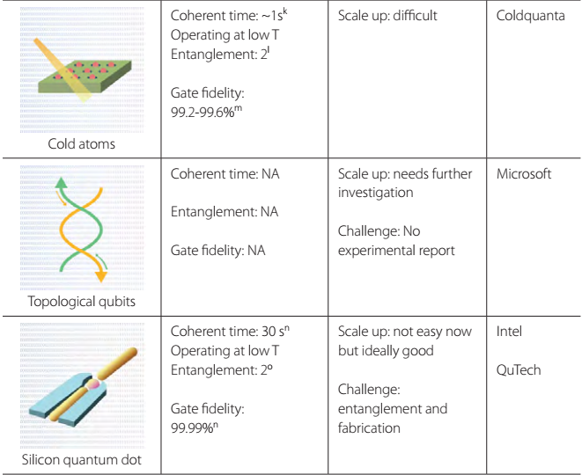
Qubit platforms (updated until January 2020)
Ching-Ray Chang, Yeu-Chung Lin, Kuei-Lin Chiu, Tsung-Wei Huang;
AAPPS Bulletin, Feature Article, Vol. 30, No. 1, 2020

Slide 3
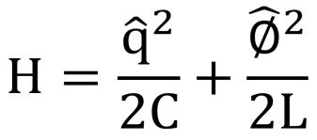
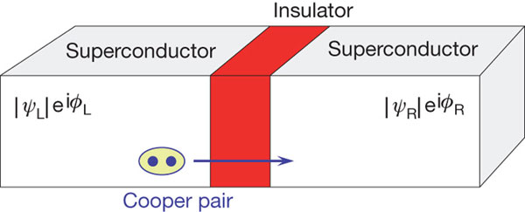
Superconducting qubit
A quantum LC resonator using Josephson junction as an inductor provide anharmonic states for a two-level system
dI/dt =cosφ 2πV I_{c}/$Φ_{0}$
I=φ/L
自感定義
Quantized electrical harmonic oscillator
Josephson junction
LC resonator with L replaced by JJ
Capacitive energy
inductive energy
q → capacitor charge (momentum p)
φ → inductor flux/phase (position x)
Number of charge on the capacitor
Charge number induced by Vg
Josephson energy

Slide 4
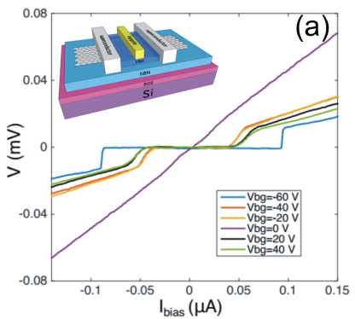
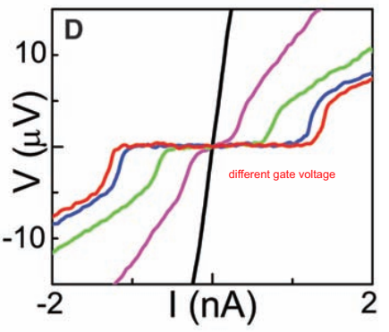
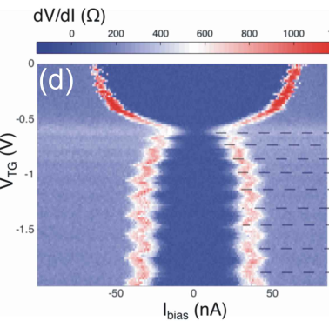
SC-Semiconductor-SC junction
Al-InAs-Al junction
Al-Graphene-Al junction
Joel Wang Thesis (2016)
Science 309 (5732), 272-275 (2005)
Tunable by gate
Gate-tunable critical current
Superconducting gap of SC

Slide 5
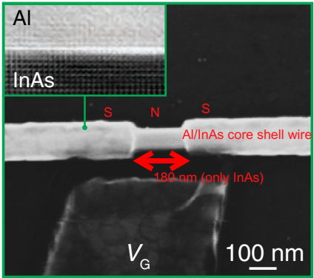
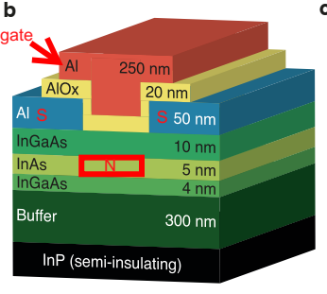
S-N-S Based-Gatemon
InAs nanowire, 2DEG, graphene, topological materials
E_{J} = ћI_{C}/2e
At the regime E_{J} >> E_{C}, the qubit transition frequency is given by:
Gate tunable superconducting qubit
PhysRevLett.115.127001 (2015)
Nature Nanotechnology 13, 915-919 (2018)
Nature Nanotechnology 14, 120–125 (2019)
InAs nanowire
2DEG
Graphene

Slide 6
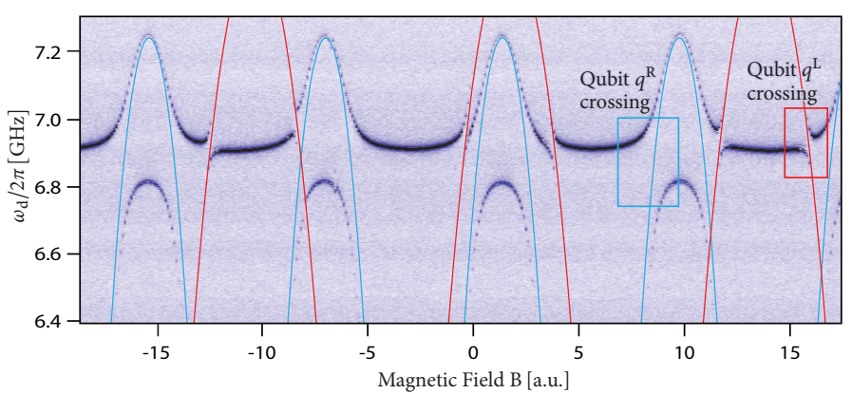
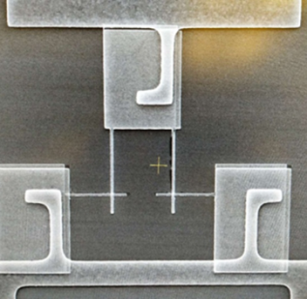
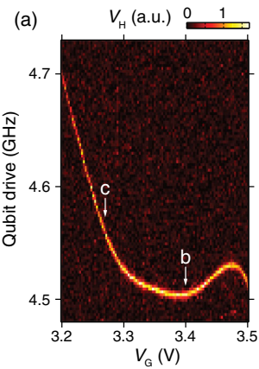
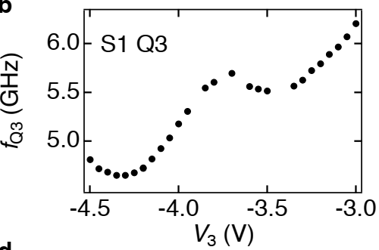
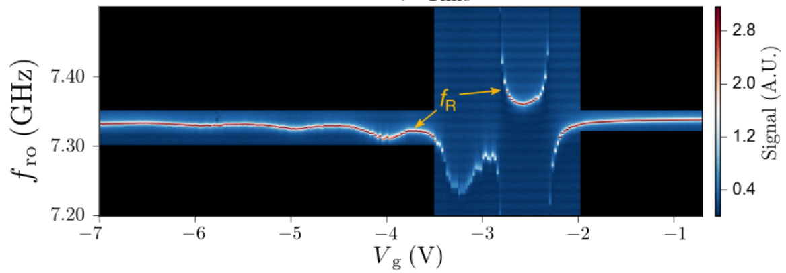
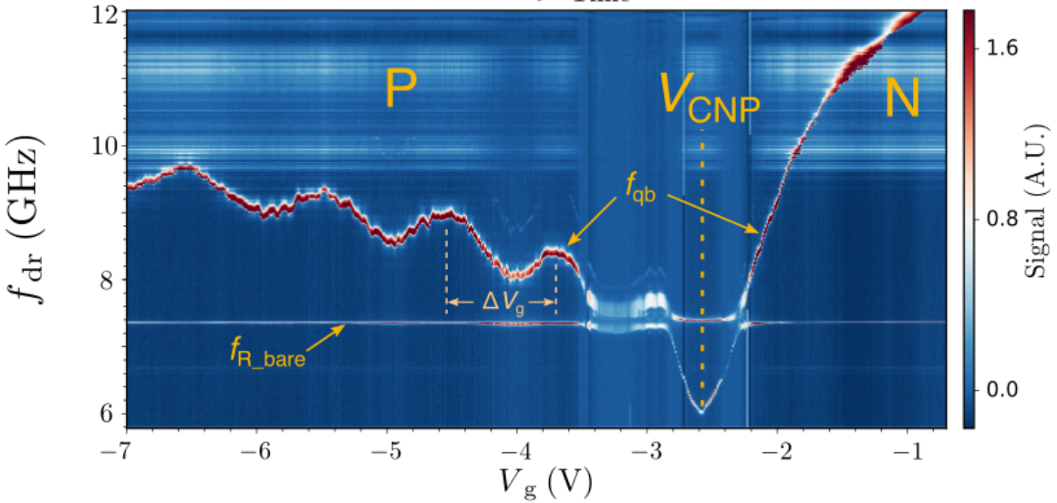
Gate-tunability
Flux-tunability
Jerry Chow thesis, Yale (2010)
JJ
S-I-S based qubit
InAs nanowire
2DEG
Graphene (MIT)

Slide 7
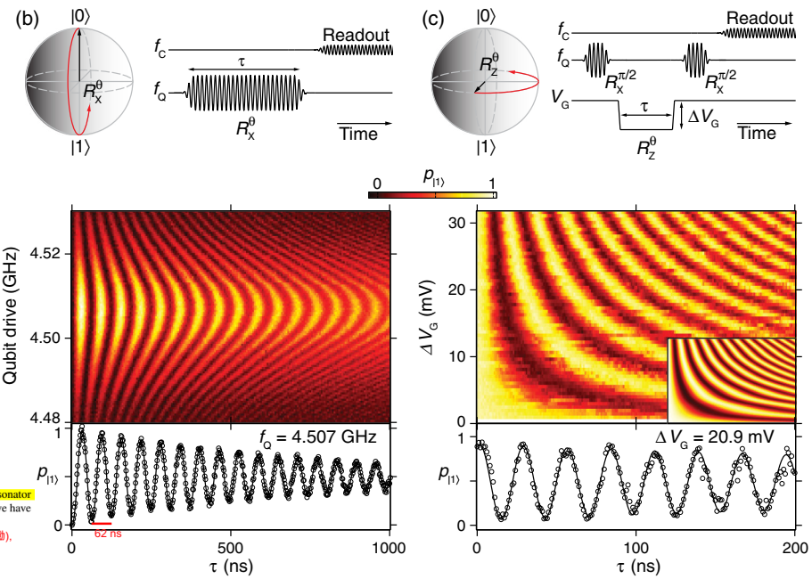
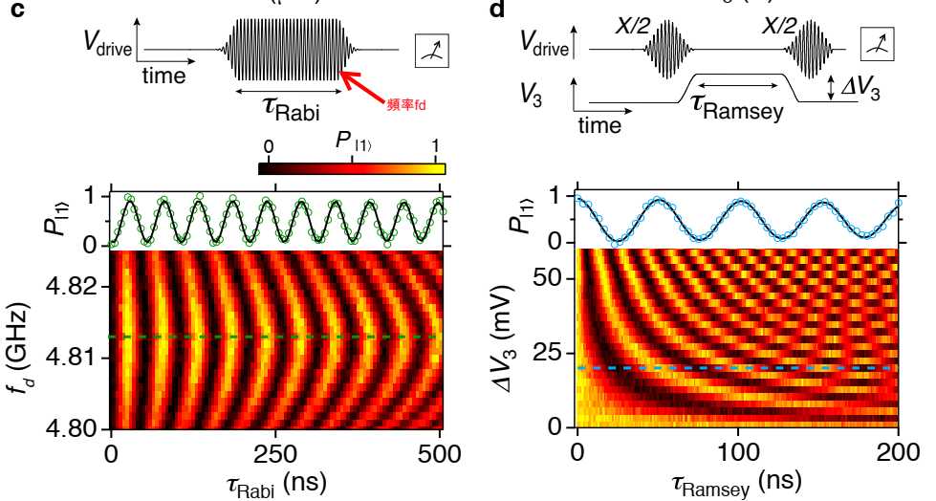
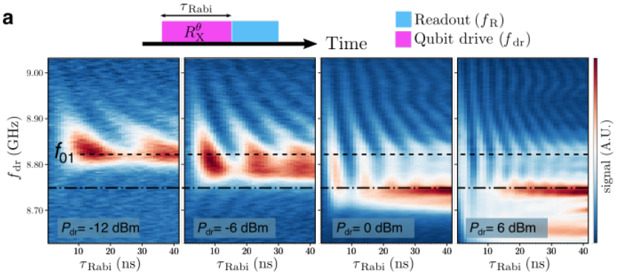
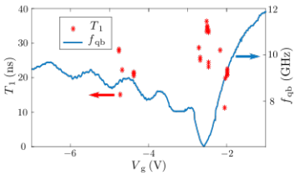
Rabi, T₁&T₂
InAs nanowire
(T1~0.83 us, T2*~0.73 us)
2DEG
(T1~1.1 us, T2*~0.4 us, T2_{echo}~2.2 us)
Graphene (MIT)
(T1~36 ns, T2*~51 ns)

Slide 8
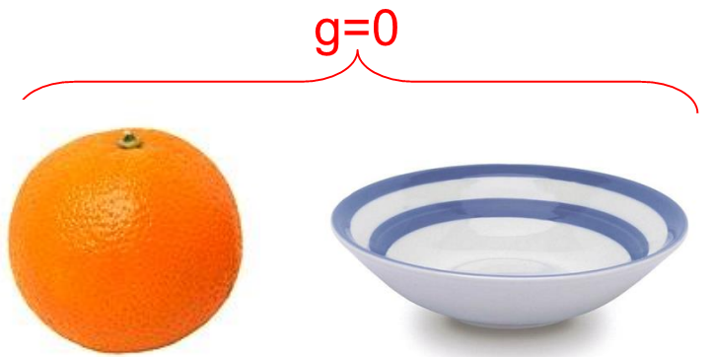
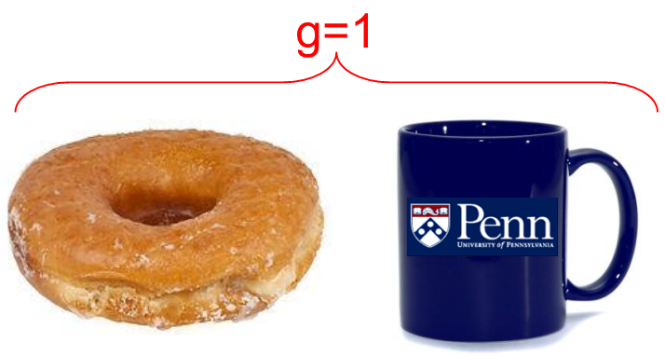
Geometric topology
The form of an object can be distinguished by genus, g, which is essentially the number of holes in the object (for a sphere, g = 0; for a torus, g = 1).
Gauss-Bonnet theorem
characterizes the local radii of curvature
拓樸性可看成一個物體(object)内秉的天性，因此可以用來區分物件
Notes:
Our research is to use topological materials for SNS junction, but before that, let’s give a bit motivation
球體的高斯區率為定值1/R^2, 而球面積為4*pi*R^2

Slide 9
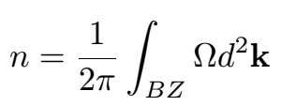
Topology in condensed matter physics
In analogy to geometric topology, materials can be identified as topologically equivalent if they can be transformed into one another by slowly changing their Hamiltonian
Berry phase (Ƴ_{C}) and Chern number (n) are useful for characterizing the topology of a given Hamiltonian (決定一個漢密頓是球還是甜甜圈)
Surface area created by C
Closed loop
Chern number is defined as the Berry phase acquired after encircling the Brillouin zone boundary
u is the periodic part of the Bloch wavefunction
Berry phaes就是一個state繞一closed loop得到的相位,而Chern number就是此loop為Brillouin zone邊界下之特例(再除以2π)，為一個拓樸不變量。
Notes:
把Berry curvature當磁場來看就很明白了, 而Berry phase就是磁通量….n就是妳繞BZ一圈得到的Berry phase再除以2π

Slide 10
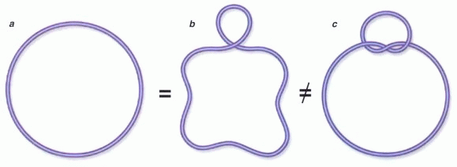
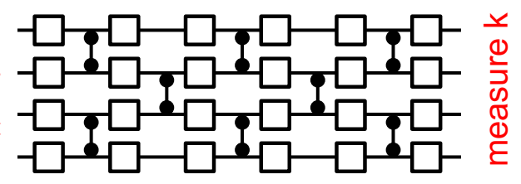
Bosons
Fermions
1
2
Anyons
Topology is robust, same for condensed matter systems!
others
Non-abelian Anyons
time
q1
q2
q3
q4
Time
Annihilate pairs and read out
Braid
Braid
Braid
$$σ_{2}σ_{1}≠σ_{1}σ_{2}$$
non-commutative exchange relation
Create pairs
We can encode information by braiding knots

Slide 11
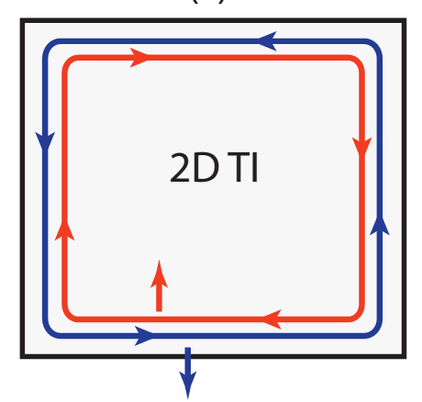
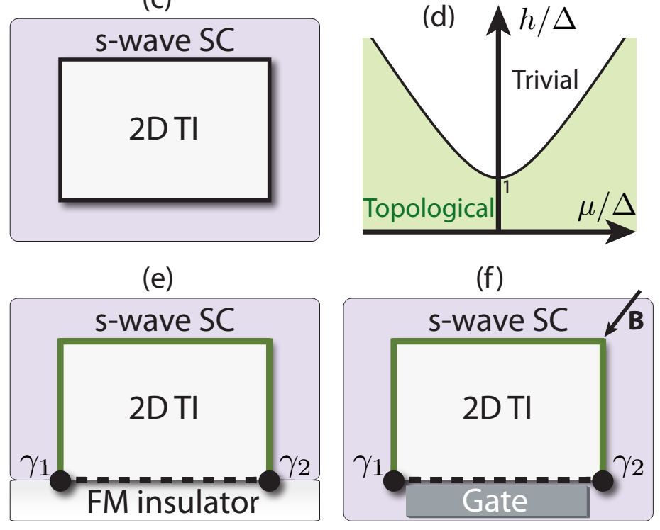
Majorana Fermions
1,2
1,2
Fermion
粒子和反粒子擁有質量及自旋相同,電荷及能量相反的特性,故若要自己=自己的反粒子, 則此粒子必定不可帶電, 且處在zero energy
An example
Superconductors provide pairing and topological insulators (TIs) provide spin nondegenerate states
MFs
MFs
Rep. Prog. Phys. 75, 076501 (2012)
Notes:
電子和電洞電性相反, 不合格, 超導體中, 一堆cooper和一個電子, 一堆cooper pair和一個電洞, 電荷可視為相等 γ1 Ψ和Ψ+ 共鄂加轉置後只是交換, 而γ2是將i換成-i, 而Ψ和Ψ+ 共鄂加轉置後也只是交換……In second quantization language, 波函數和其共鄂在二次量子化時對應的是粒子的產生和湮滅算符, 故自己為自己的反粒子, 說明MF的產生與湮滅其實是一樣的, 消滅一個和產生一個是一樣的, 不滿足粒子數守衡, 但超導體中就可以, 因為cooper pair number並非是conserved (cooper pair是配對既有的電子, 所以你有1個和10個cooper pair, 其實你的電子數還是守衡的)

Slide 12
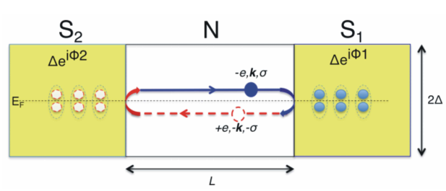
Andreev reflection in ballistic junction
Dynamic phase
Andreev Bound states (ABS)
Determine the short and long-junction limits
K. L. Chiu*, book chapter, arXiv:1804.02870 (2018)

Slide 13
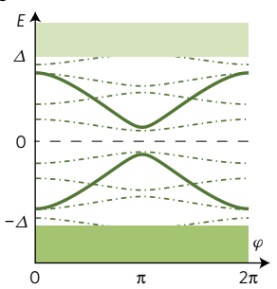
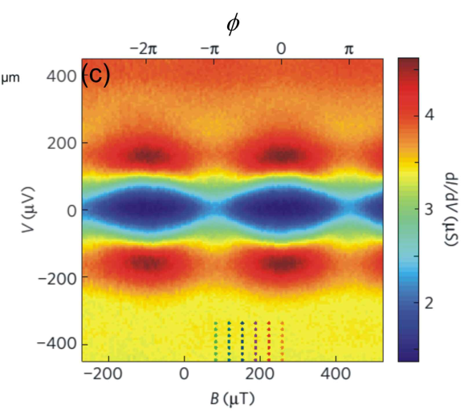
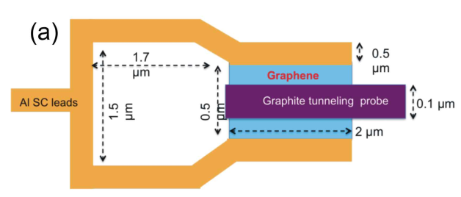
Long junction limit (multiple ABS)
Short junction limit (a pair of ABS)
Nature Physics 13, 756 (2017)
Notes:
改變carrier density相當於populating superconducting裡面的ABS, 造成超流的改變

Slide 14
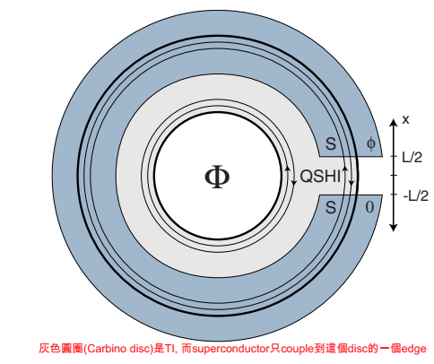
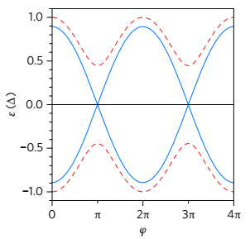
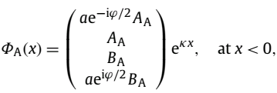
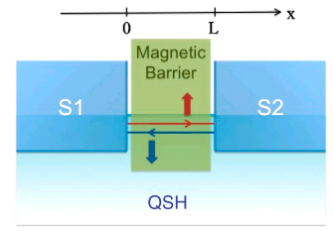
Edge and surface states result in new physics
2D TI + superconductor (SQUID geometry) = 4 pi periodic current-phase relation
C.R. Physique 14, 840 (2013)
4 pi
Edge state
Superconductivity
Magnetic barrier
Theory: Liang Fu, PRB 79, 161408 (2009)
Break TRS, to create a boundary for TI edge state on the interface
At D=0, B_{A}=D_{A}=-e^{-iψ/2} A_{A}, C_{A}=A_{A}, satisfying
γ₁₍₂₎=γ₁₍₂₎⁺
γ₁
γ₂
Transmission probability ~ 1/M
Notes:
Zero energy Majorana bound states will exist at the interface between regions with gaps. Experimentally, the suppression of the n ¼ 1 step is usually more significant than other odd steps, probably due to the finite capacitive effect or Joule overheating

Slide 15
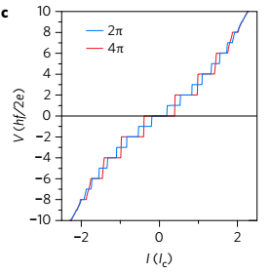
AC Josephson effect – Shapiro step
For a fixed n_{A}, it is 4π-periodic
bound state occupation
In thermal equilibrium (within μs), the averaged supercurrent is 2π-periodic
2nd Josephson equation
τ_{s}>τ_{R} for the 4π to happen (see next page)
For a given RF with frequency f
Normal S-N-S junction
Topological junction
(Step appearing only at even number)
An oscillation frequency of about 5 GHz causes A dc voltage of 10 µV
Notes:
若有電壓, 則產生一個時變的phase (電壓越大, 變率越大), 這時變phase代入第一J-eq則會產生一個正弦波型式的超導電流, 而此a.c. current可看成(Josephson)radiation, 所以他的反過程就是你若打入一個RF wave, 他就會對應到一個VDC, 而此VDC跟你入射RF的頻率成正比

Slide 16
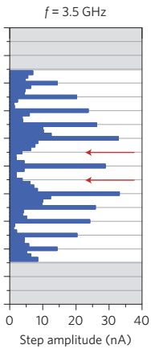
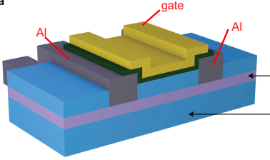
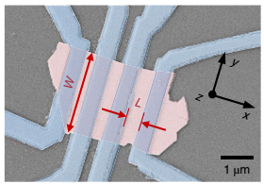
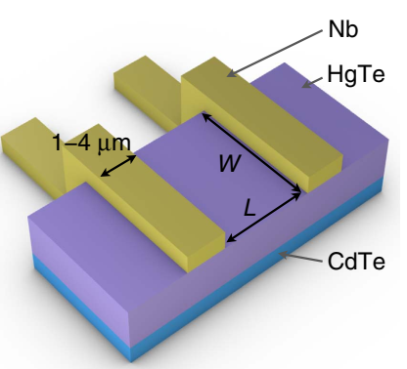
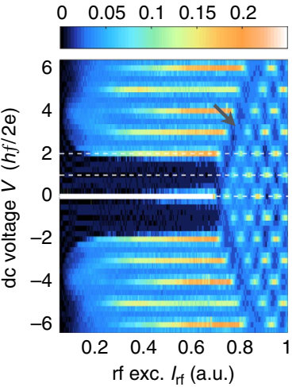
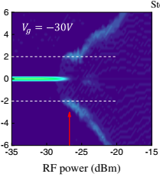
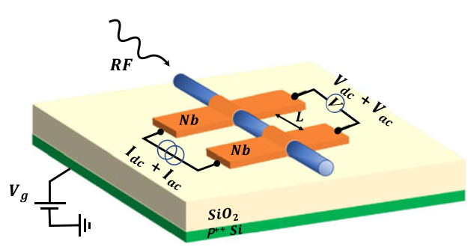
Missing n=1 step in Shapiro response
2D TI HgTe
Dirac semimetal Bi_{0.97}Sb_{0.03}
HgTe
Hg_{0.3}Cd_{0.7}Te
Nat. Material,17, 875–880 (2018)
Nature Nanotechnology 12, 137–143 (2017)
2D TI HgTe
Dirac semimetal Cd₃As₂ nanowire
PRL 121, 237701 (2018)
Nature Communications 7, 10303 (2016)

Slide 17
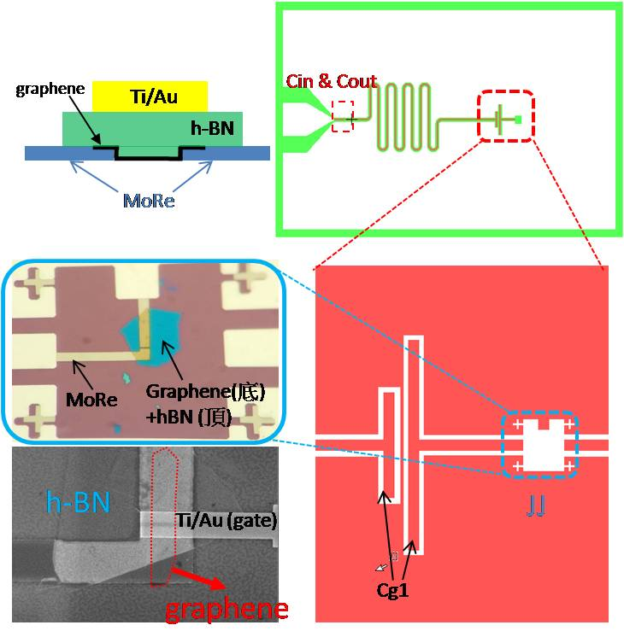
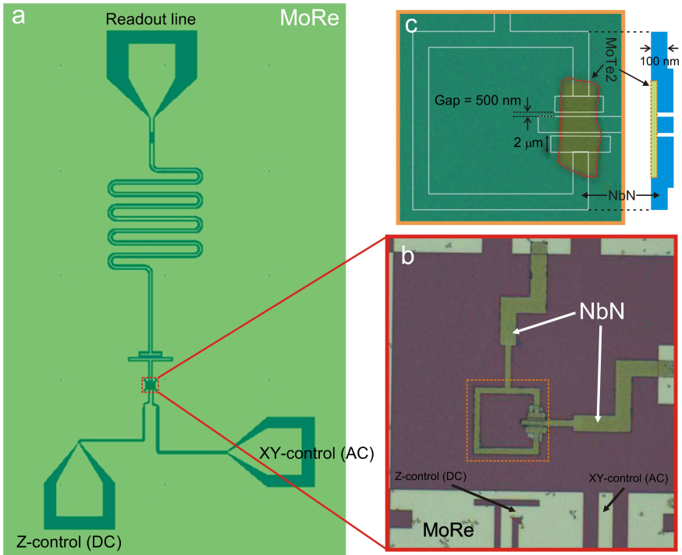
2D material based quantum circuit
Kuei-Lin Chiu* et al., Nano Letters, 20, 12, 8469–8475 (2020)
Graphene (done at USTC)
Weyl semimetal MoTe₂ (done at SUSTech)

Slide 18
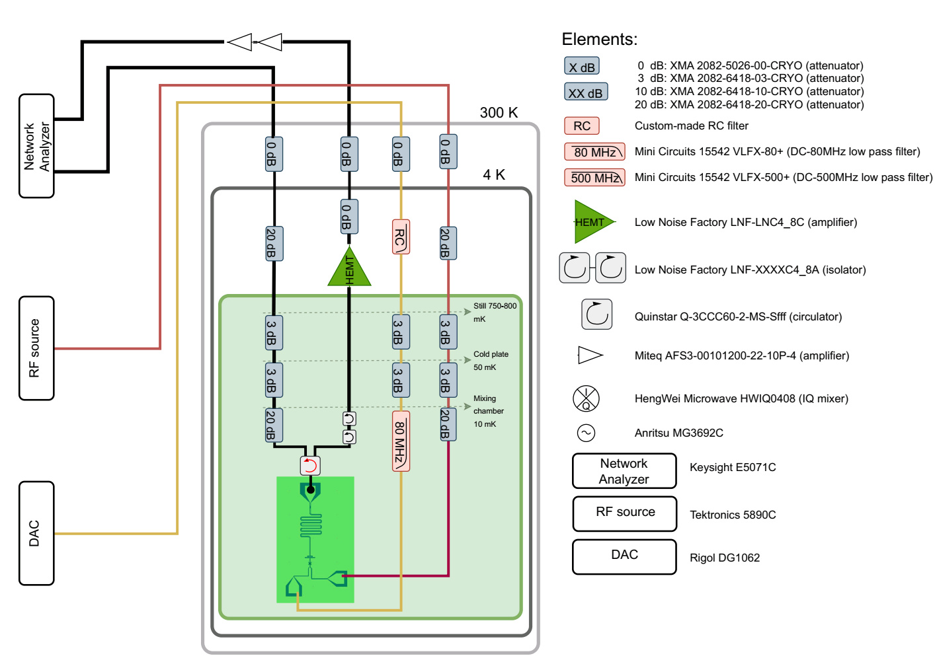
Measurement setup for one qubit

Slide 19
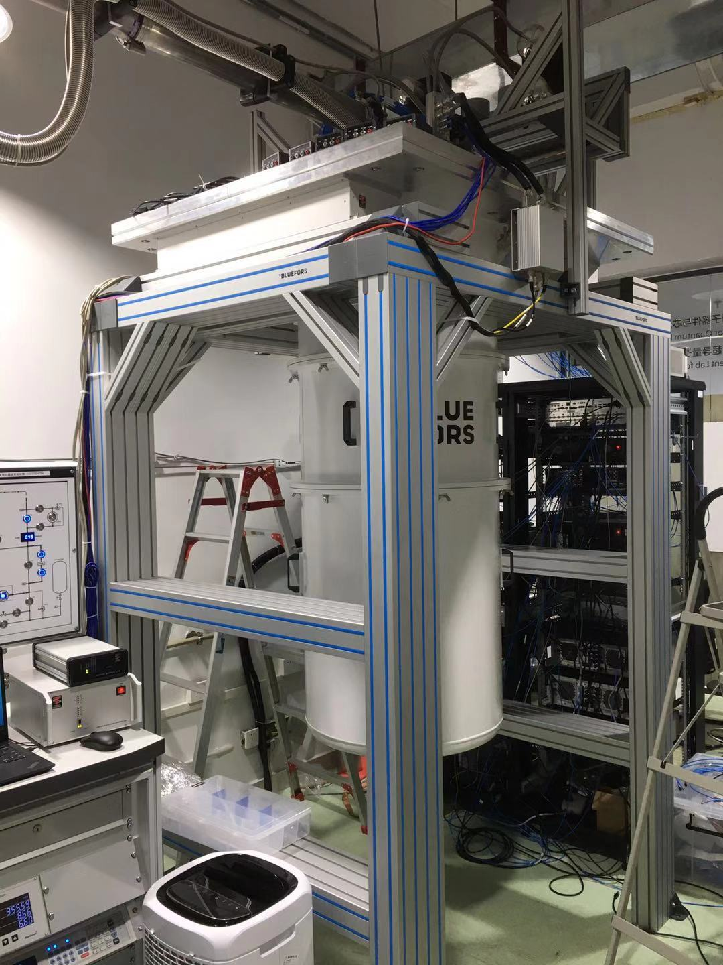
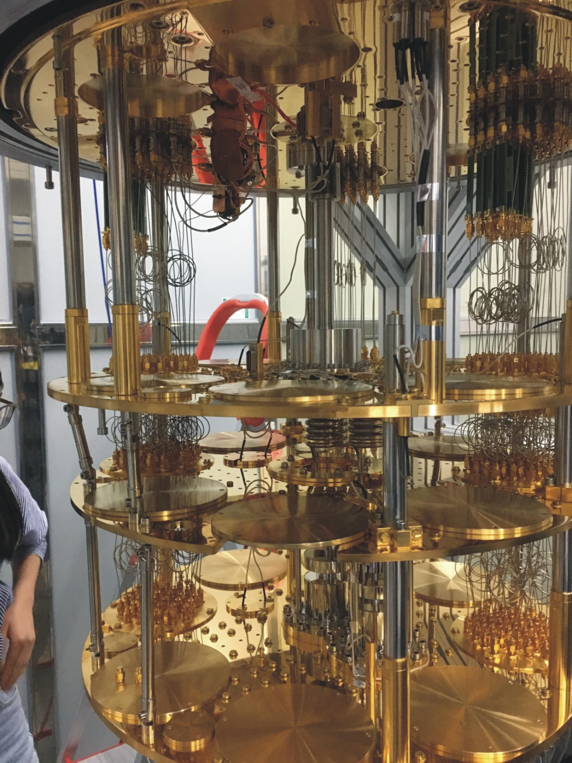
Readout line
RC-filter
HEMT
Readout-in
Circulators
Qubit Package (quantum chip inside)

Slide 20
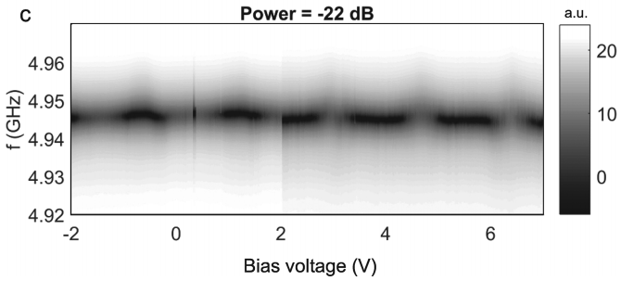
Graphene
MoTe₂
K-L Chiu* et al., Nano Letters (2020)
Gate-tunability
Flux-tunability
State dependent cavity shift by two-tone
No state dependent cavity shift

Slide 21
Fourier transformation analysis
One dominating component which should correspond to 2π. If 4π exists, it should be around half the 2π frequency
For a topological junction:
4π
2π
For a SQUID of two topological junctions
4π
2π
The resulting overall supercurrent is single-period if one of the component (i.e., either I_{S2A} or I_{S2B}), dominates the supercurrent. However, if the weight of 2π and 4π component is similar (I_{S2A} ≈ I_{S2B}), the supercurrent can exist an flux oscillation with unequal spacing between neighboring peaks.
Notes:
只看到一個peak是事實, 你可假定他是4 pi or 2 pi, 若他是4 pi, 而在他2倍頻處應該看到一直存在的2 pi (但沒看到); 所以只有可能是2 pi

Slide 22
On-going measurements in Taiwan
Collaborations in Taiwan:
Device fabrication @ Dr. Chii-Dong Chen lab (Academia Sinica):
Dr. Yen-Chun Chen, Li-Han Hung (NSYSU)
Measurements:
one sample tested @ Prof. Io Chun Hoi lab (NTHU);
two samples tested @ Prof. Watson Kuo lab (NCHU):
Yu-Han Chang, Kai-Ming Hsieh (NSYSU)
Single-qubit device
Two-qubit device

Slide 23
Single-qubit device
Power dependence
Qubit frequency modulated by flux (Two-tone)
Frequency shift ~0.2MHz
Q~7600
(twice better compared to that in NanoLett.)
-1.5
0
1.5
Bias Current (mA)
Flux tuning of cavity frequency
Two-tone measurements (in another cool down)

Slide 24
Two-qubit device
Power dependence
Frequency (GHz)
Flux tuning (forward and backward sweep)

Slide 25
Material choice for topological junction
2D Weyl (Type I) semiconductor
Dirac semimetal nanowires
2π
4π
Nature Nano. 15, 585–591, 2020
PRL 121, 237701 (2018)
Cd₃As₂ nanowire (oxide layer 4 nm thick)
Collaboration with Wenzhou Wu group @ Purdue University
Notes:
Local perturbation只會讓Weyl 點有偏移, 部會消失, 因此Weyl點是被保護著得, 因此Weyl 點附近low energy的Weyl fermion就部會消失, 而這些Weyl Fermion是帶有手性的, 而此手性和超導體搭配形成的MBS也會是被保護的, 而他們的non-ablien交換性也被保證, 故他們編織的運算也是被保護的

Slide 26
Gate-tunable 2D TI and Superconductivity in the same material
Monolayer WTe2
Science 359,76–79 (2018)
Science 362, 926–929 (2018)

Slide 27
Acknowledgement
USTC (graphene qubit):
Di Liu (PhD)
Long Yuan (PhD)
XinXin Yang (PhD)
Duan Peng (PhD)
GuanMing Xue (Engineer)
SUSTech (MoTe2 qubit):
Chien Der Gui (RA)
Wei Yang Liu (post-doc)
Cheng Chun Tang(Engineer)
Qiu Ming Song (Engineer)
Tong Xing Yan(post-doc)
Taiwan:
Device fabrication: Dr. Yen-Chun Chen, Dr. Chii-Dong Chen
(Academia Sinica), Li-Han Hung (NSYSU)
Measurements: Prof. Io-Chun Hoi (NTHU); Prof. Watson Kuo, Yu-Han Chang (NCHU), Kai-Ming Hsieh (NSYSU)

