Slide 1
Real time quantum state tomography with machine learning
Workshop on Quantum Science and Technology
Student : Hsieh Yi Hsieh
Advisor : Ray Kuang Lee
Tsing Hua University, Taiwan

Slide 2
Outline
Introduction to quantum state tomography(QST)
Machine learning tomography
Simulation technique for quadrature data
Real time Wigner flow reconstruction
Quantum optics package developed by our lab

Slide 3
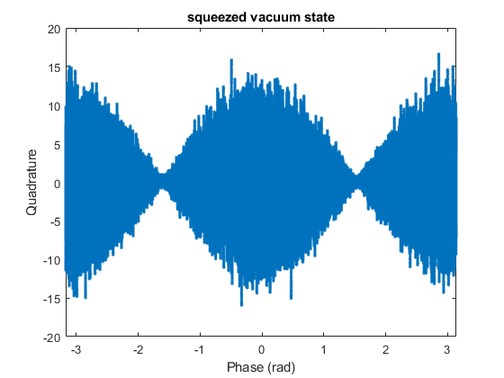
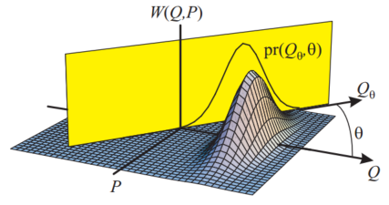
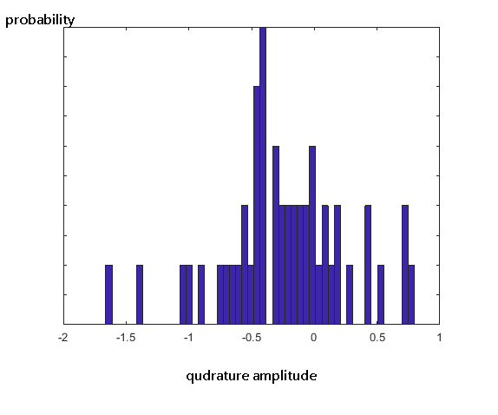
Quantum state tomography(QST) in homodyne EXP
◎ Develop algorithm to reconstruct wave function by doing projective measurements.
◎ The reconstructed wave function is the Wigner function or the density matrix
Continuous-variable optical quantum state tomography
A. I. Lovovky

Slide 4
Quantum state estimation

Slide 5
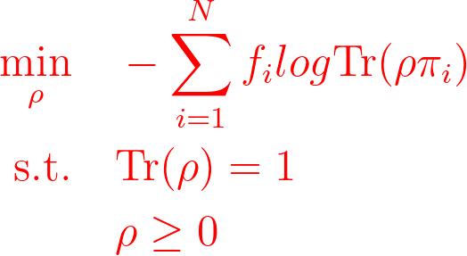
Advantages and disadvantages of maximum likelihood estimation
Advantages:
◎ By analyzing the likelihood of “data” , you can always estimate arbitrary quantum states.
◎ You can use less data than traditional linear inverse method.
Disadvantages:
◎ Its not straightforward to reduce the estimation space even if you have prior knowledge in experiments.
◎ This is always time consuming. You need to solve optimization problem every time when facing new data.

Slide 6
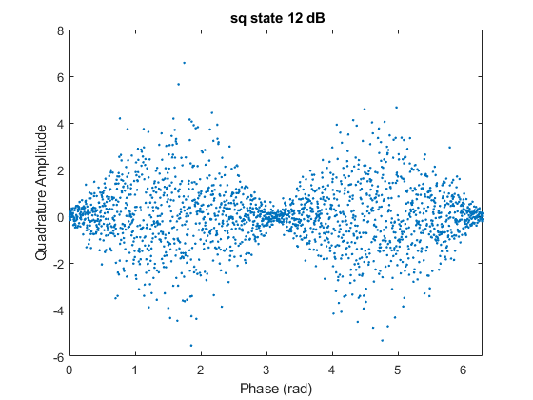
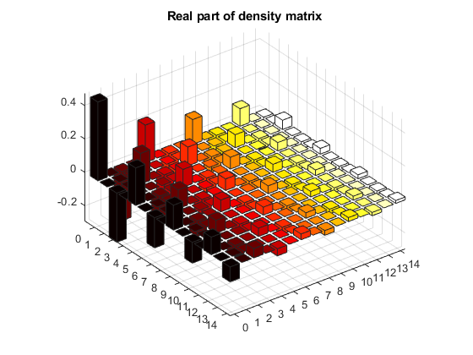
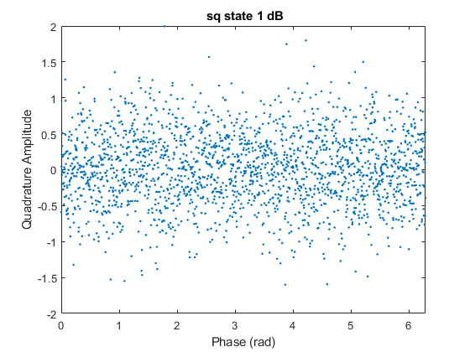
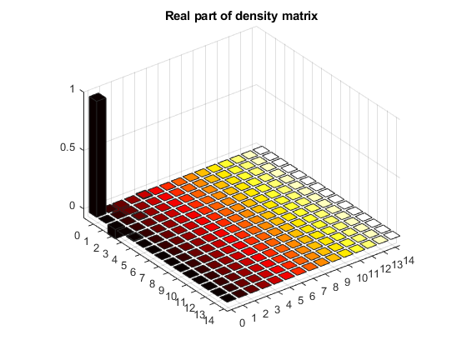
◎ We want to train a model to do quantum state reconstruction especially for squeezed states in real experiments
Only take 2048 quadrature values!
Training process

Slide 7
Only take 2048 quadrature values!
Training process

Slide 8
Our SQ-learner architecture
$$\hat{y}=…f^{4}\left(f^{3}\left(f^{2}\left(f^{1}\left(x,w^{1}\right),w^{2}\right),w^{3}\right),w^{4}\right)…$$
$$loss:C=\frac{1}{N}\sum_{i=1}^{N}{{(y_{i}^{}−\hat{y_{i}})}^{2}} \\ training:w^{t+1}=w^{t}−α∇_{w}C \\ y_{i} is the element of density matrix$$
arXiv : 2106.04058

Slide 9
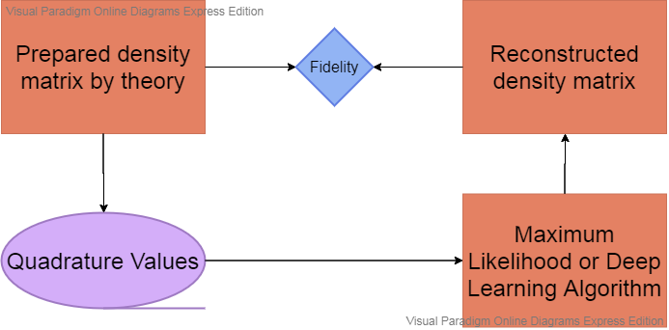
Fidelity analysis
$$simulation!$$

Slide 10
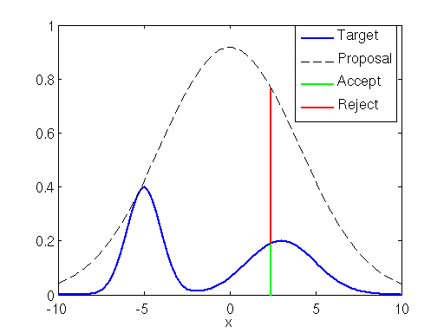
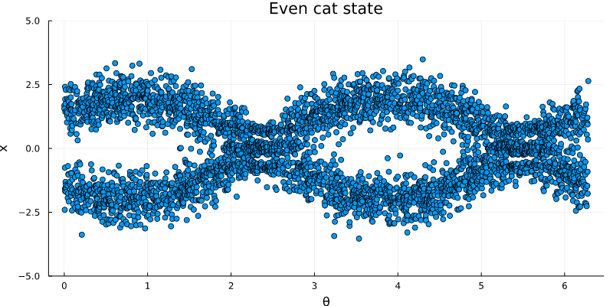
Simulation method : rejection sampling(towards non Gaussian)
Algorithm :
1.Generate random number “ x₀ ” based on proposal probability distribution q(x) that is easy to generate.
2.Generate uniform random number “ u ” in [ 0 , k*q(x₀) ]
3. If u > p(x₀) reject
If u < p(x₀) accept
https://theclevermachine.wordpress.com/2012/09/10/rejection-sampling/
k*q(x)
p(x)
If we have density matrix $ρ$:

Slide 11
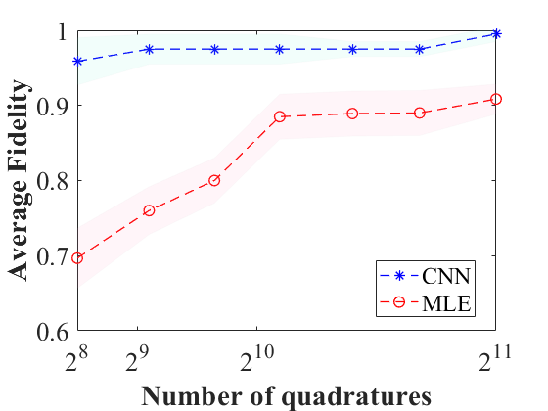
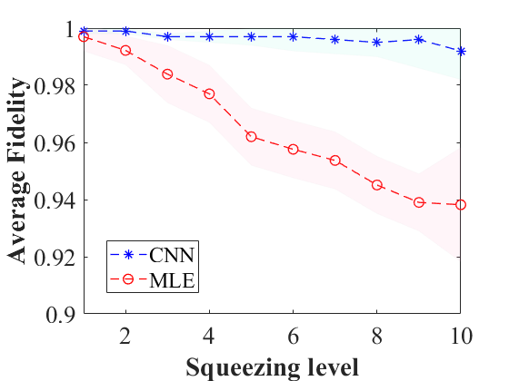
Fidelity comparison for 2 different kinds of reconstruction
arXiv : 2106.04058

Slide 12
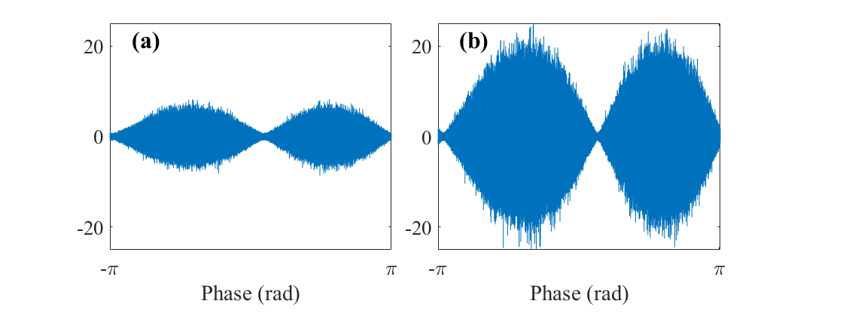
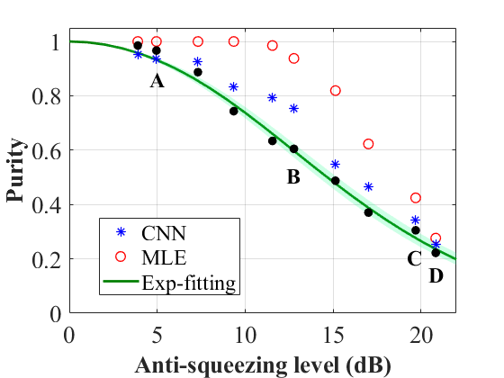
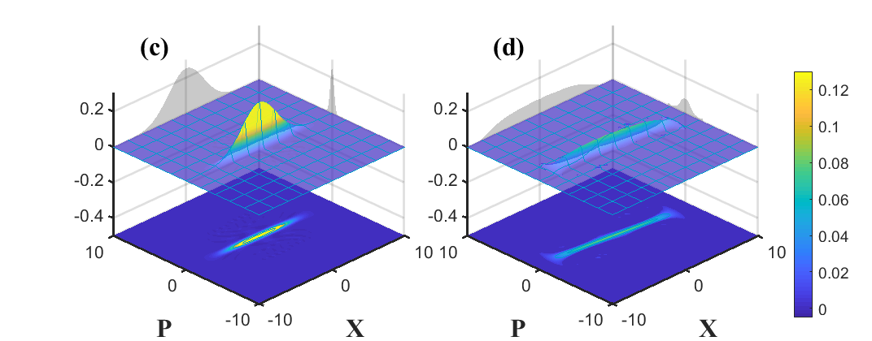
arXiv : 2106.04058
Examples of experimental data
7dB squeezing , different anti-squeezing!

Slide 13
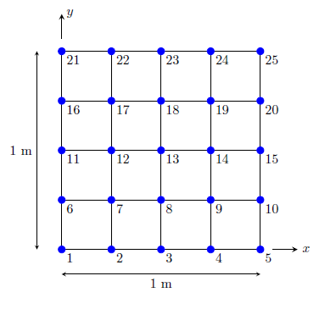
Solve continuity equation to find Wigner flow
Dirichlet B.C.
2D Grid example

Slide 14
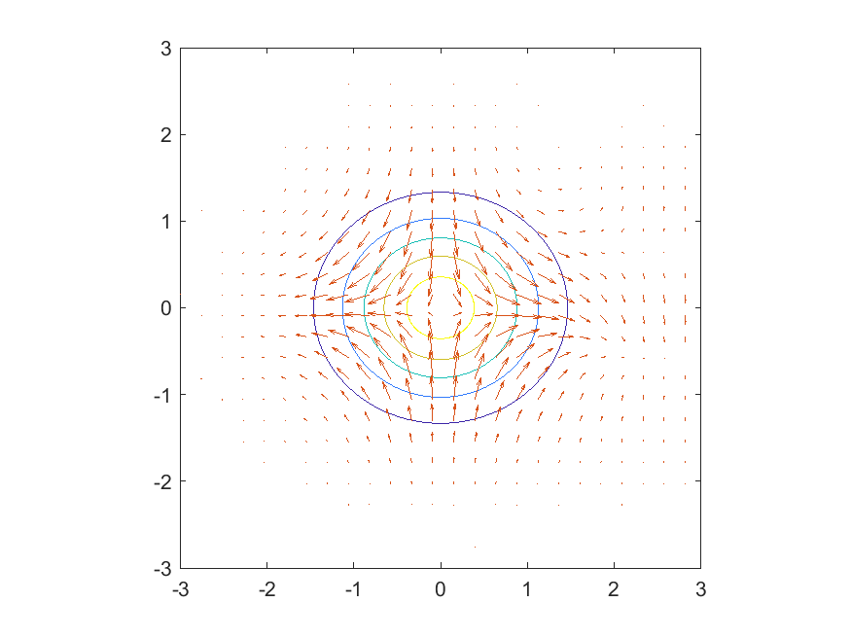
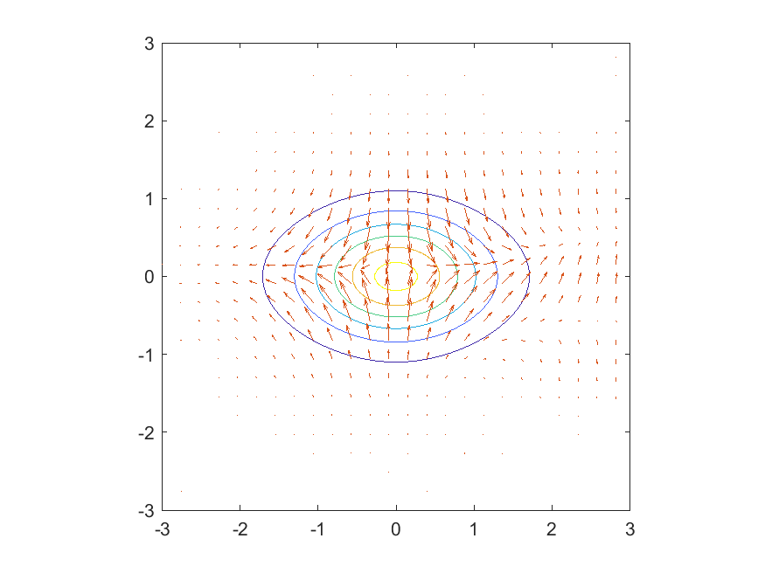
Wigner flow (experimental data)
Pump power

Slide 15
Quantum optics package developed by our lab
Github repository: package1
Github repository: package2
Real time inference system: Demo

Slide 16
Summary
By using machine learning, we can reconstruct density matrix as well as Wigner function/Wigner flow almost real time.
SQ-learner only need to 2048 data points and get high fidelity results.
With density matrix, we can get purity information real time in Lab.
With fast quadrature simulator, we can also train fock state CNN machine and cat CNN machine.

